Slide 1
Extra Activities to have a go at!
This is work to do If you have time to do it.
Look through at the activities and have a go.

Slide 2
Activity 1: Make a Power-point
Think of a famous person who invented something:
Make a power-point on the person using the questions below:
What is their name?
When were they born?
When did they die?
What did they invent?
How did it help?

Slide 3
Activity 2: Create a Fact file
Find an animal that you are interested in and create a fact file about them:
What do they eat?
What do they look like?
Where are they from?
How many are there in the world?
Find three fun facts about them.

Slide 4
Activity 3: Make a Pizza
Use this website to make a pizza base: https://www.bbc.co.uk/food/recipes/pizzadoughbase_70980
Once you have made the base, add the toppings of your choice. (Don’t forget the tomato sauce)
Write a method of how you made the pizza and how you organised your toppings.

Slide 5
Activity 4: Egg Drop Experiment
Find a box of 6 eggs:
Humpty Dumpty sat on the wall and fell off.
- What materials would stop his fall?
- Find 6 materials around your house and test which one is best.
- Record this in a table like this →
Material: | Egg Drop 1 | Egg Drop 2 | Egg Drop 3

Slide 6
Activity 5: Create a treasure hunt
Hide some treasure somewhere in the house or your garden.
Create some clues for your family to find them.
Each clue leads you to another clue until you find the treasure.
Who can find it first?

Slide 7
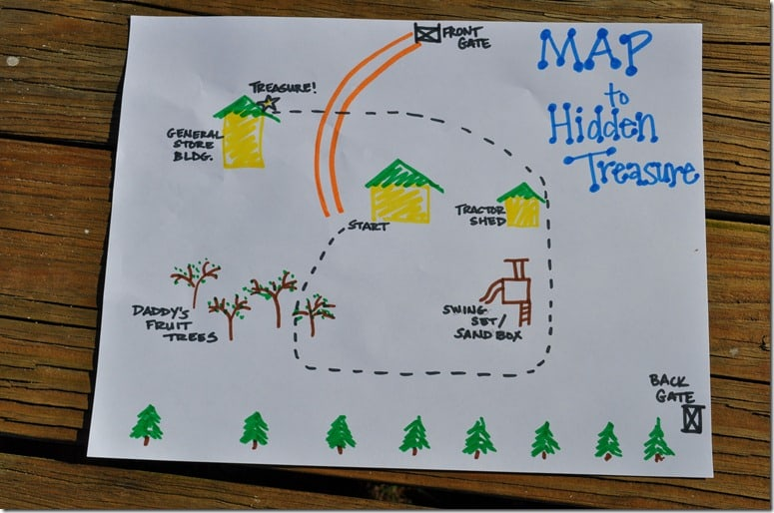
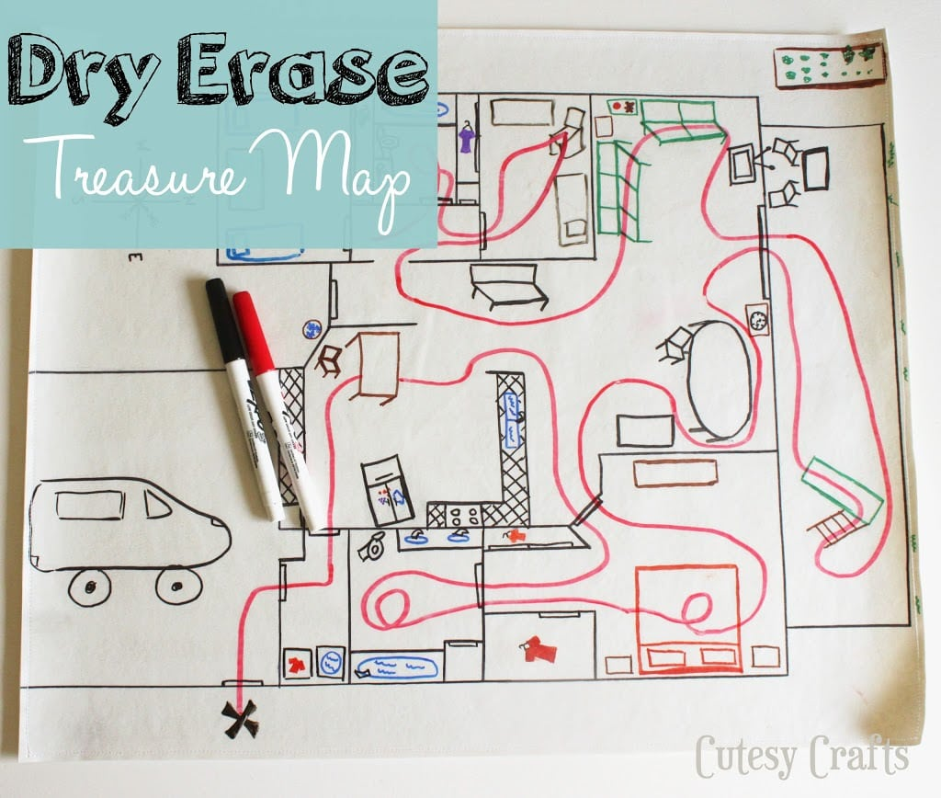
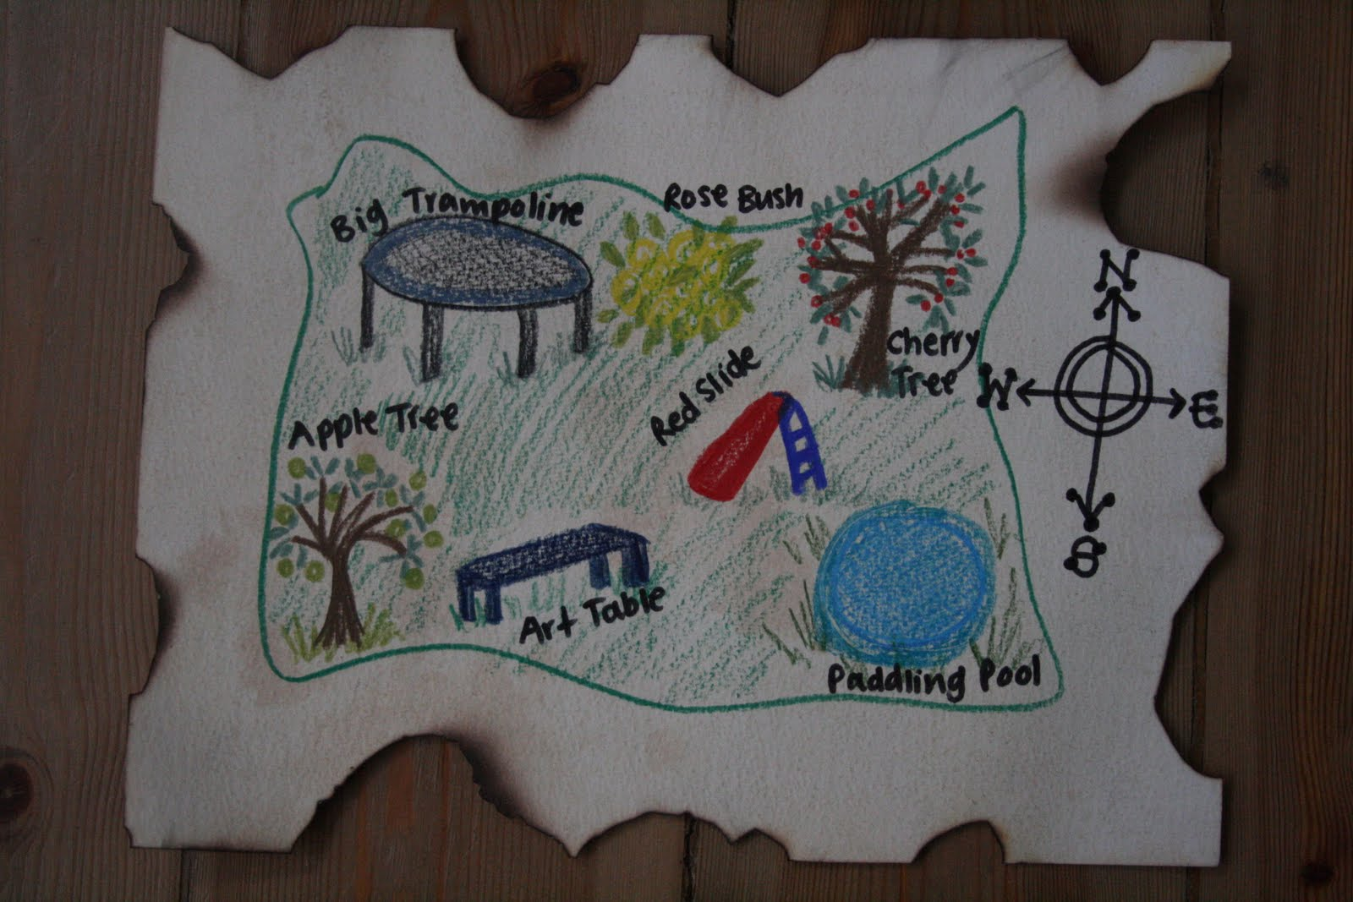
Activity 6: Create a treasure map
Hide some treasure in your house or garden.
Make a map that your family has to follow.
Make sure there is a key and use objects to help them find the treasure.
←Here are some examples:

Slide 8
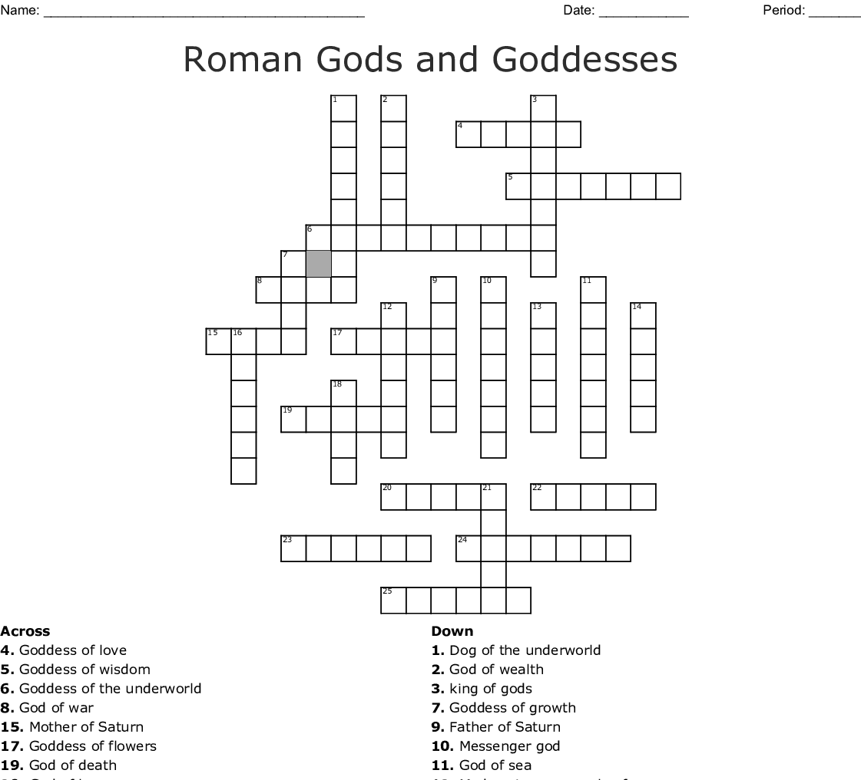
Activity 7: Create a crossword
Where the answer to the meaning goes.
Using the Topic of Romans:
Make a crossword.
Think of some words that we have learnt on the romans and search for their meanings.
Try to create a wordsearch for someone in your family to answer it.
←Here is an example.
Meanings of the words.

Slide 9
Activity 8: Make a Questionnaire
Think of 5 questions that you would like to ask your family.
Give them 4 answers (a, b, c, d) for each question that they need to choose from.
Ask each member of your family the questions.
Record your answers in either:
A tally chart.
A table.
A bar chart.

Slide 10
Activity 9: Make an erupting volcano
Design and create a volcano using some cardboard and other recyclable materials.
Method:
Put some coca cola into a plastic bottle.
Make your volcano around the bottle. (Leave a gap at the top)
Take your creation outside.
Put the mento in the coca cola.
Record your results.

