Slide 2
Aim
I can identify and explain the three main functions of a skeleton.
Success Criteria
I can identify parts of the skeleton that protect the body.
I can identify parts of the skeleton that support the body and help it move.
I can explain how different parts of the skeleton work.

Slide 3
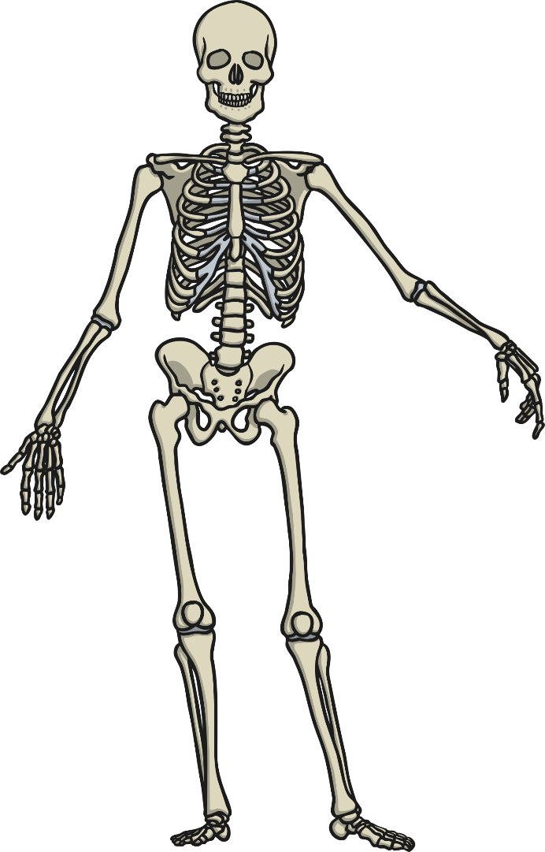
Recap: Purpose of a Skeleton
Discuss the following questions with your adult:
Why do we have skeletons?
What would happen if we did not have a skeleton?
(Draw what we would look like)
1
2

Slide 4
Functions of the Skeleton
There are a few different functions of the skeleton.
Protection
Movement
Support
Joints

Slide 5
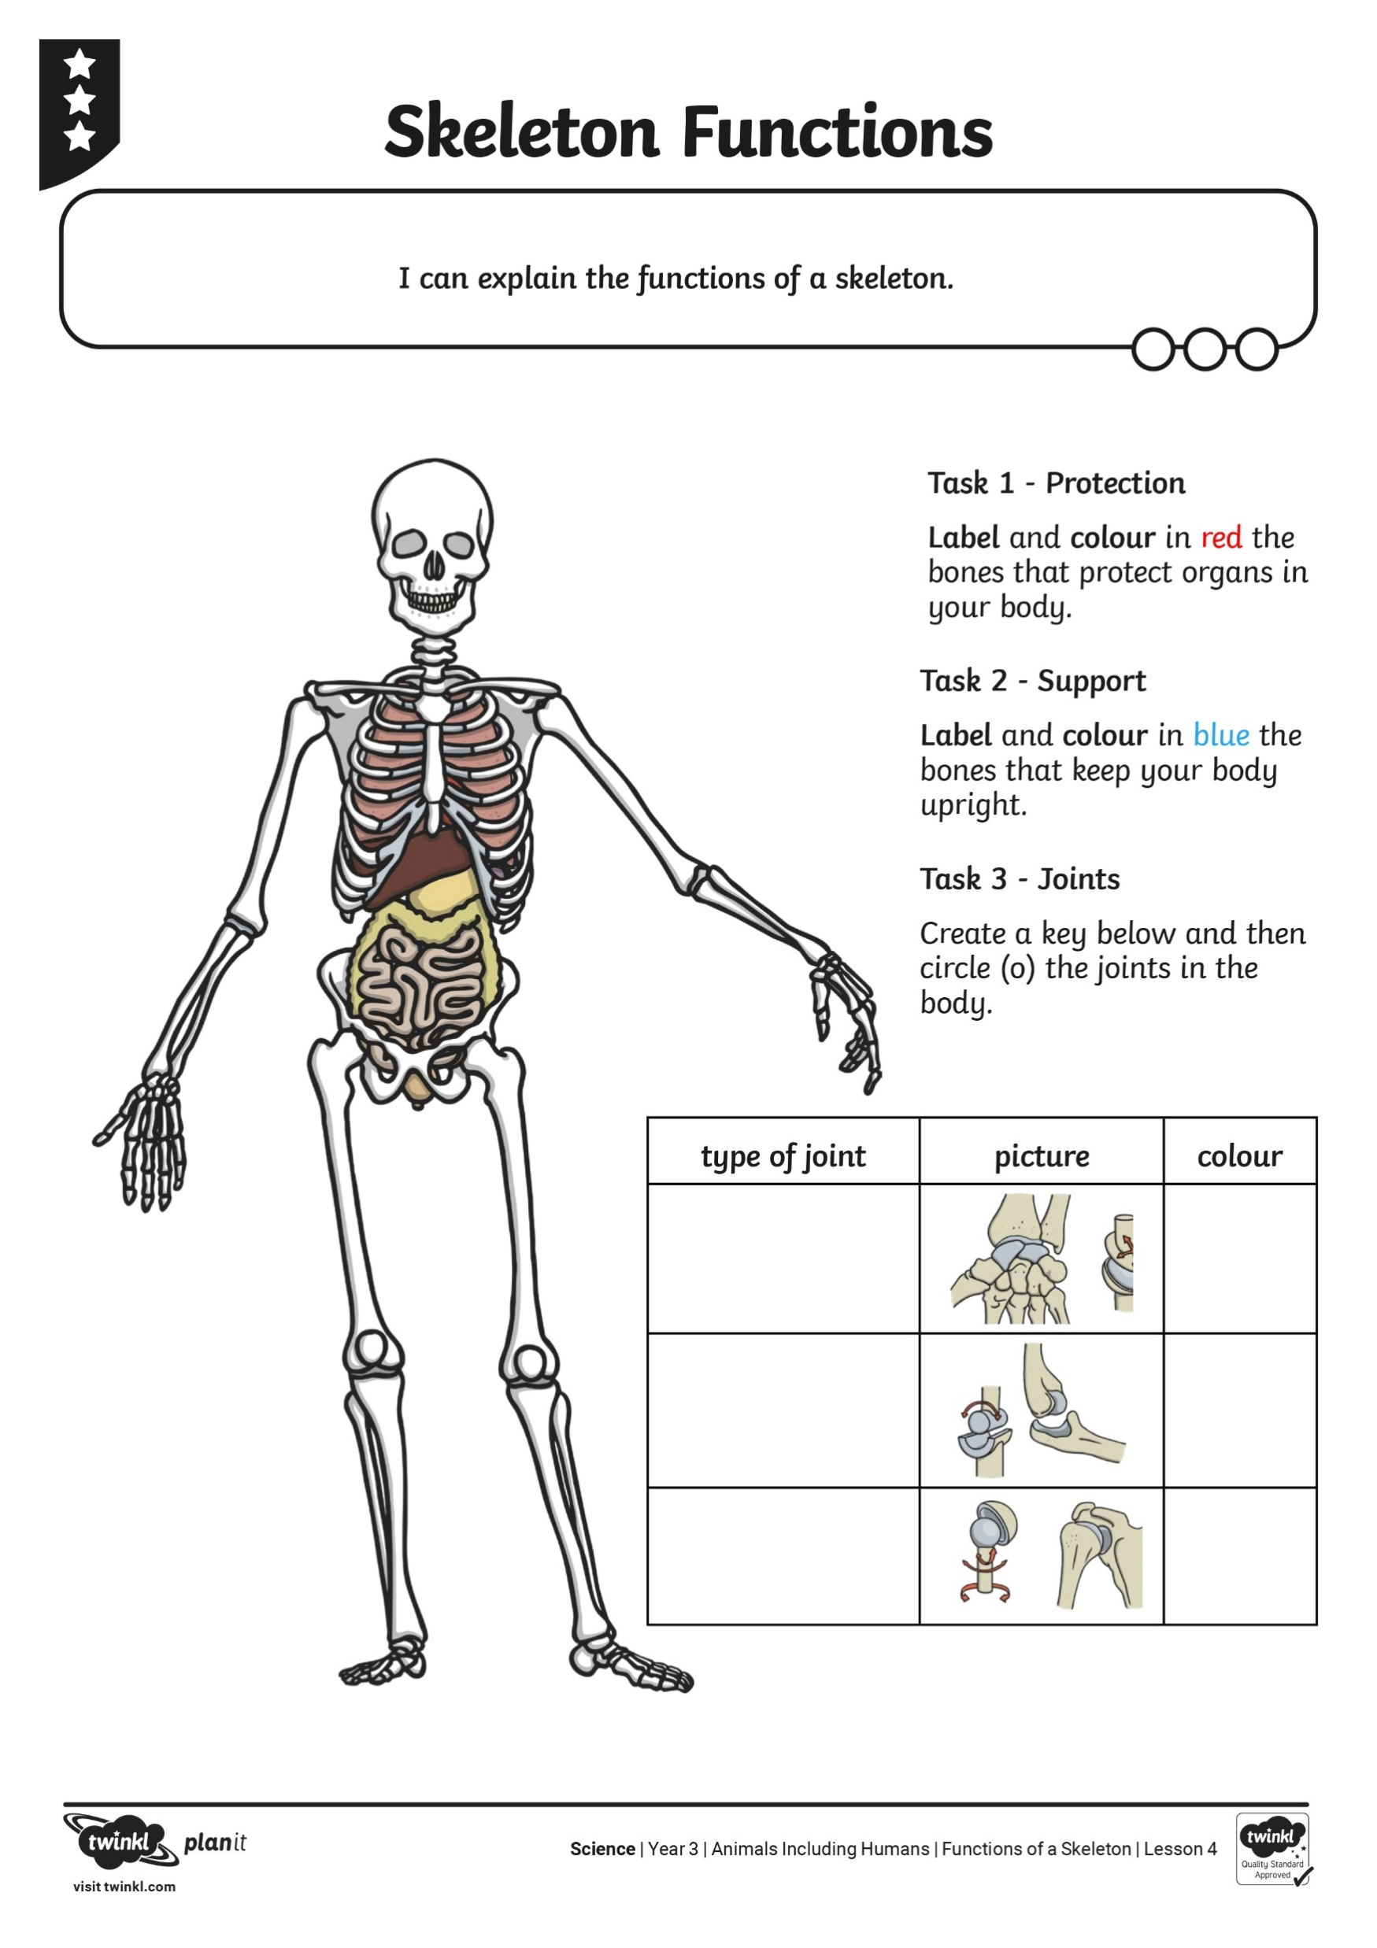
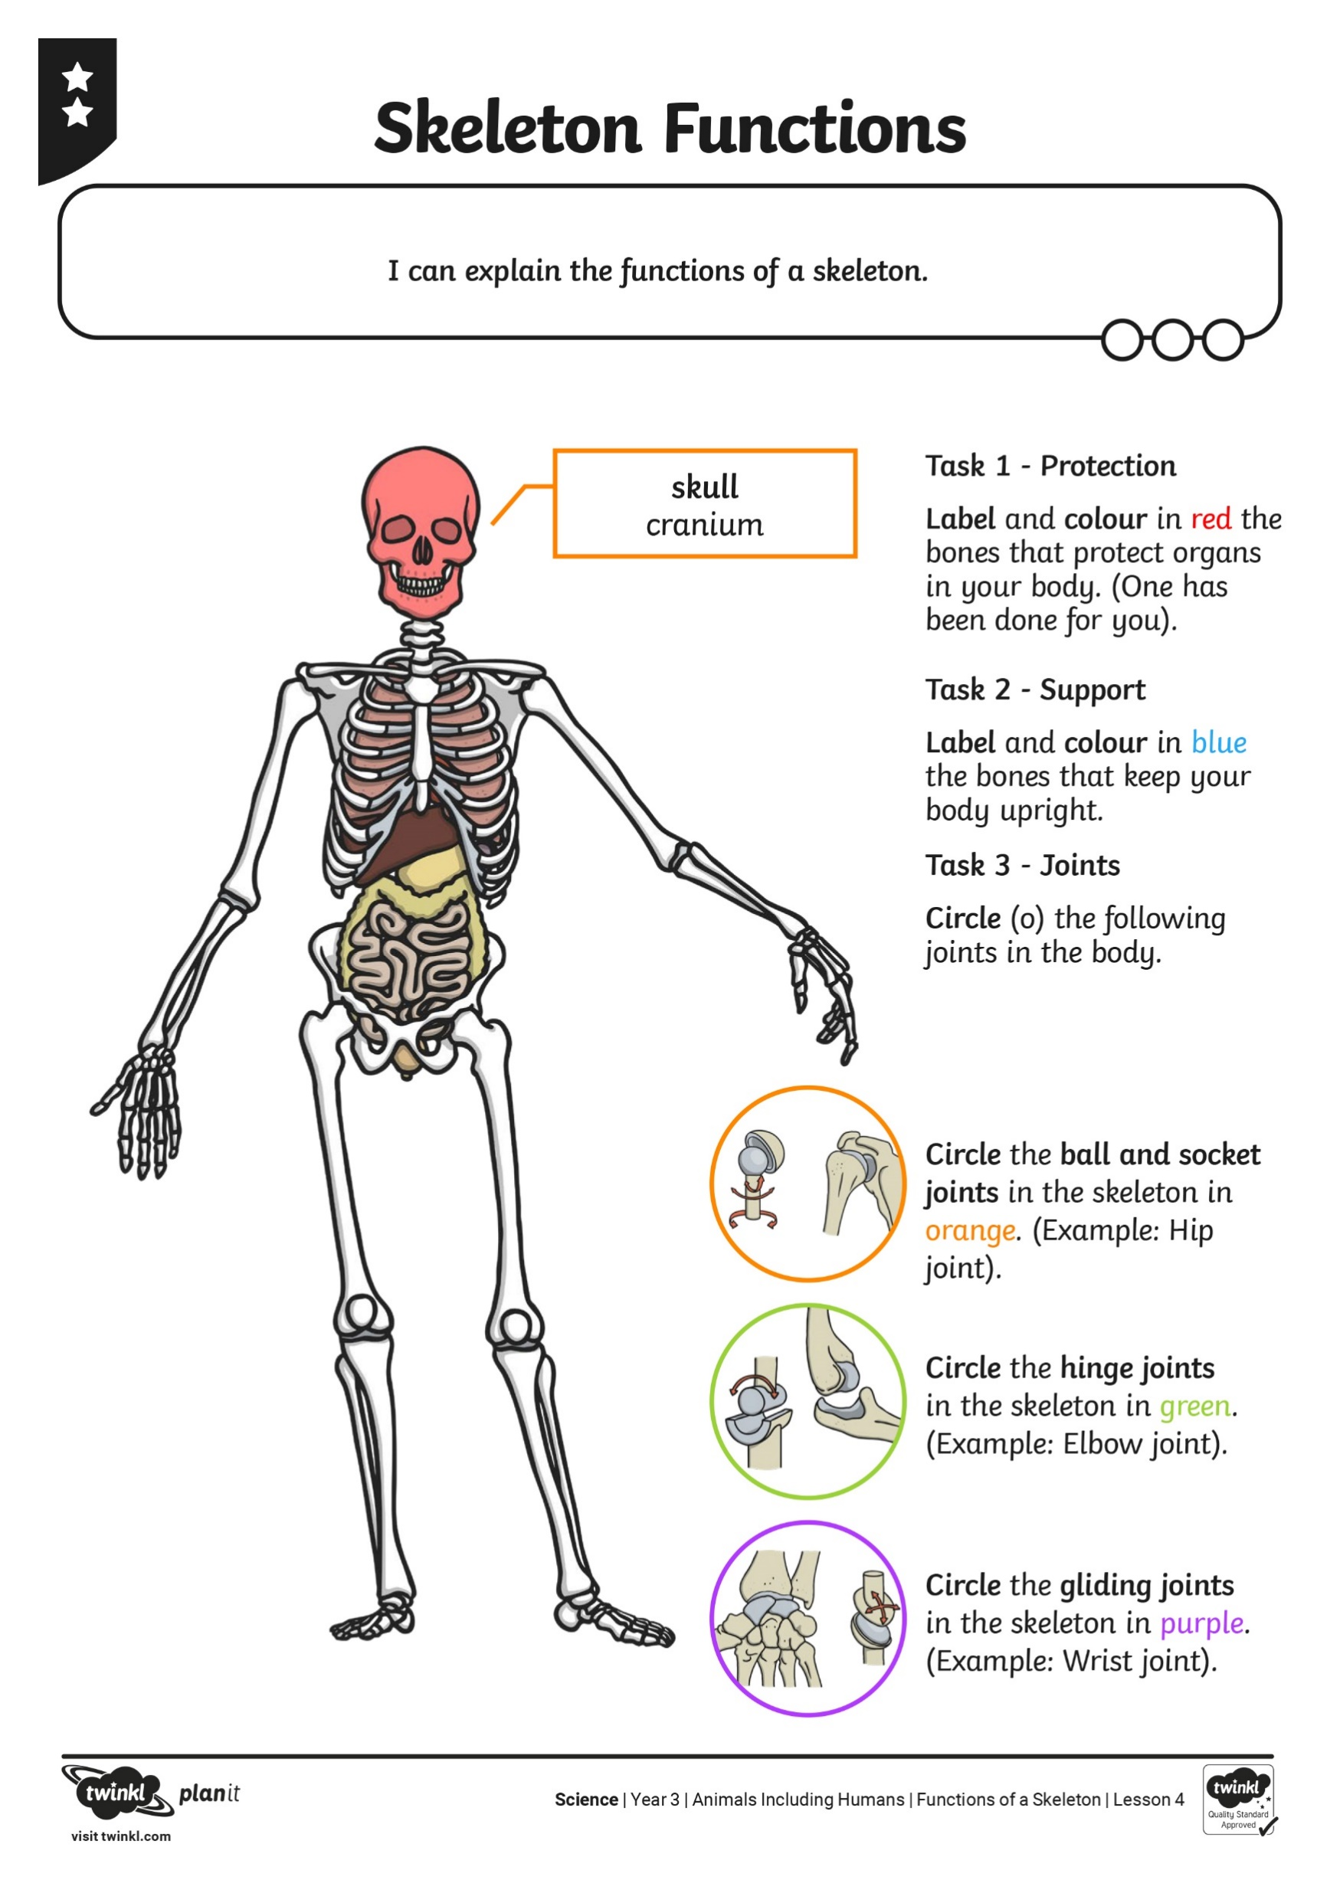
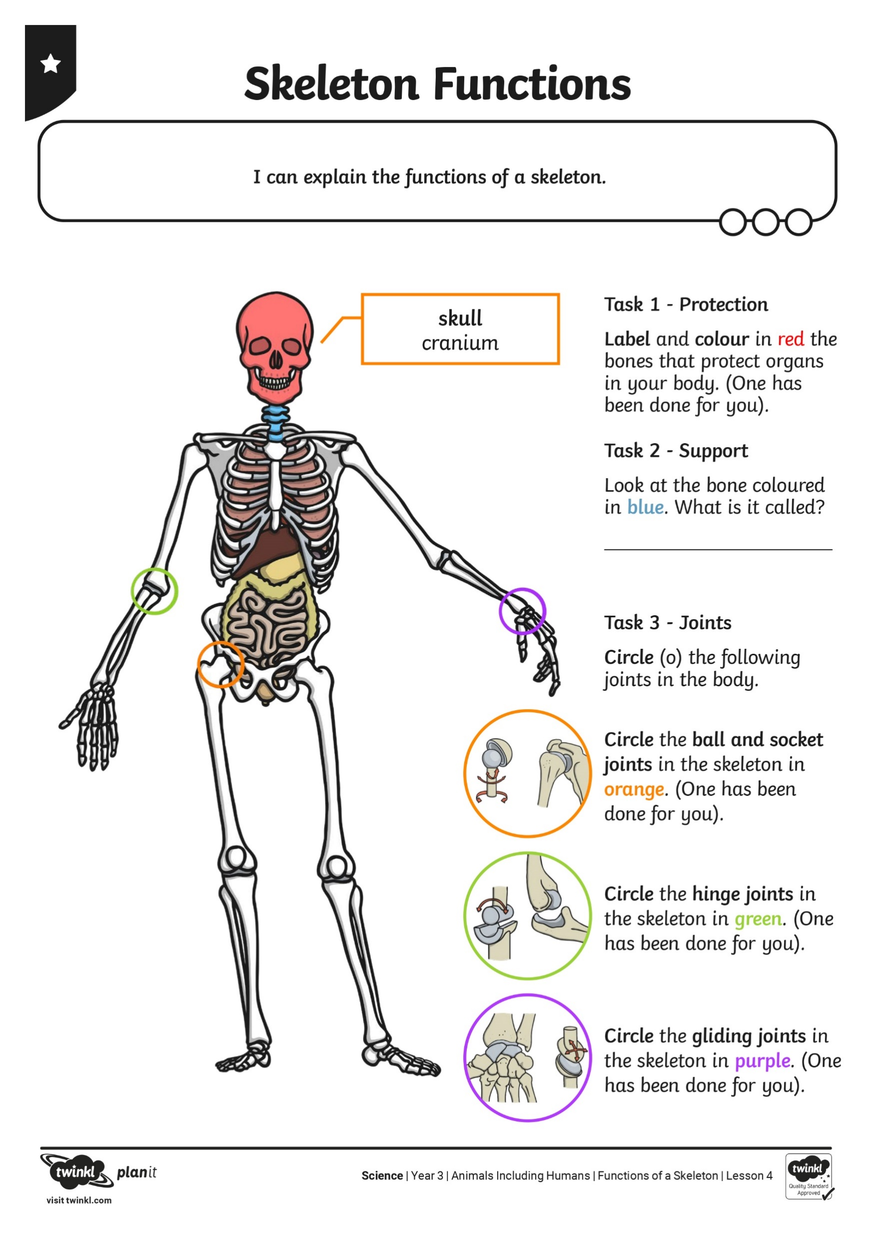
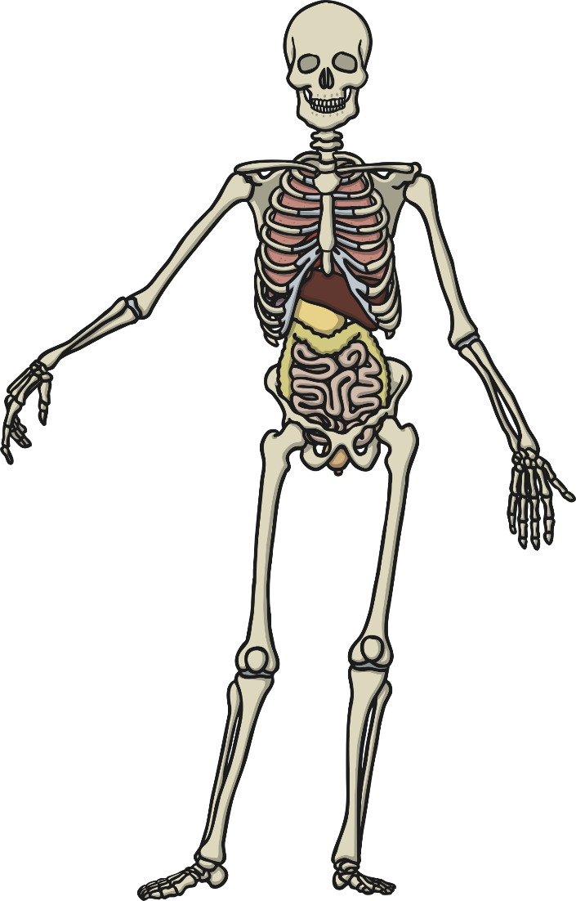
Protection
Parts of the skeleton provide protection to our internal organs. (E.g. the Heart)
Find your sheet on the Science Word Document.
Choose your colour that you would like to work on.
Have a go at answering Task 1.
- Green
- Red
- Blue

Slide 6
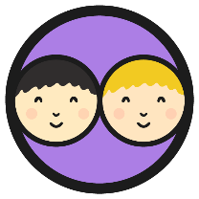
Support
Hint: it is in this area…
One of the functions of a skeleton is to support your body.
What would happen if you had no bones in your body?
Which part of the skeleton keeps your body upright?
On your activity sheet:
Answer Task 2.
Using a different coloured pencil, colour in the main bones that keep your body upright.

Slide 7
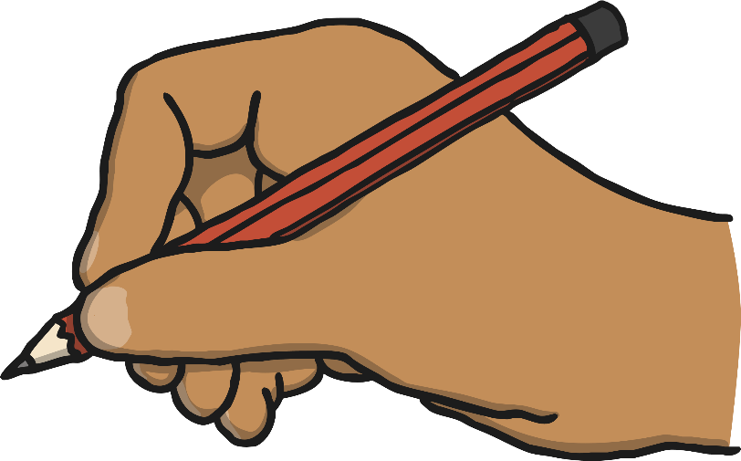
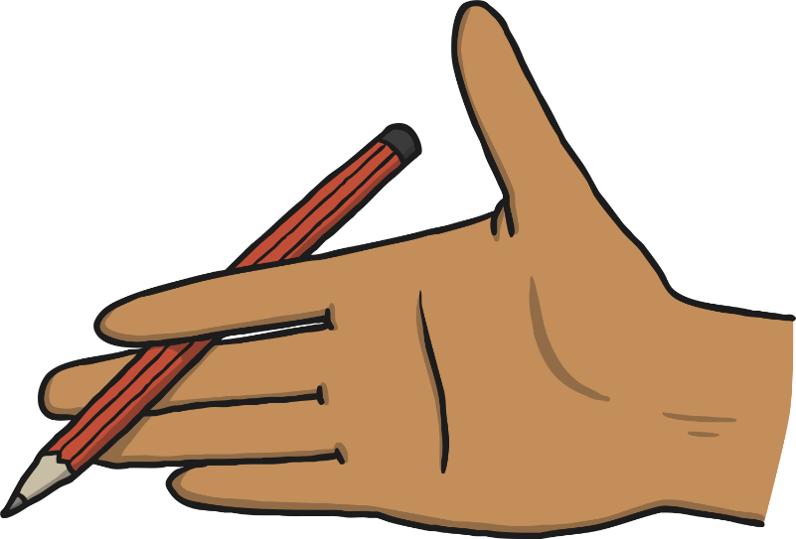
Movement
What happened when I tried to pick up a pencil the first time and the second time?
Write your answer on a piece of paper:
What allows you to hold the pencil?
How do they move to hold the pencil?

Slide 8
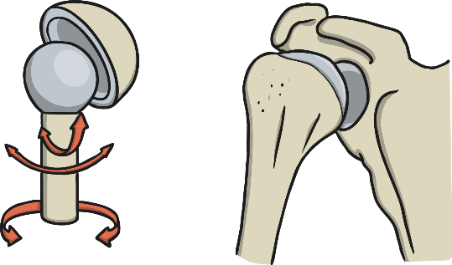
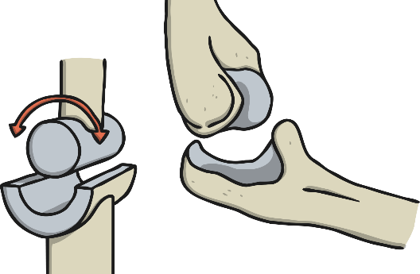
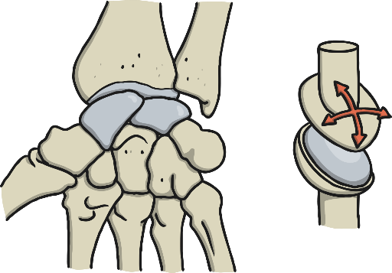
Joints
Without joints connecting our bones we would not be able to move the way we do. We would not be able to bend, jump, skip to name a few movements. There are 3 different types of joints in the body. (Click the pictures to see how they move!)
ball and socket
hinge
gliding
Ball and socket joints allow the most freedom of movement. One example in the human skeleton is the between the pelvis (hip) and femur (upper leg bone).
Hinge joints allow flex and extend movements. One example in the human skeleton is between the humerus (upper arm bone) and radius/ulna (lower arm bones).
Gliding joints are also known as ‘plane’ joints. The bones are shaped to glide over one another and allow for small limited movements in different directions. One example in the human skeleton is the wrist bones.

Slide 9
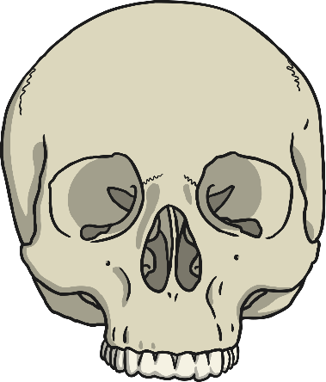
Skeleton Functions
Complete the Skeleton Functions activity sheet

Slide 10
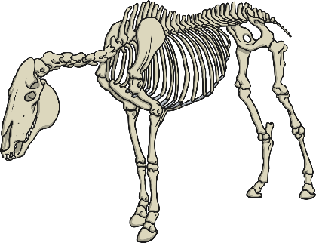
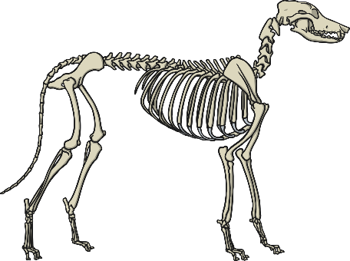
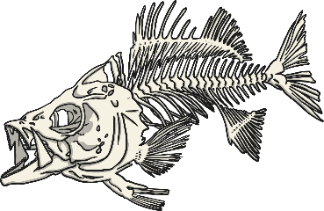
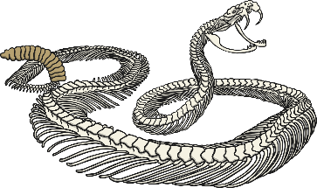
Have a go! - Whose Skeleton?
human
dog
horse
snake
fish

