Slide 1
Make a bravery medal
The people involved in the war were extremely brave, they would receive medals to thank them for bravery and thank them for their service. Click on this link, it will show you how to make your own bravery medal!
https://laughingkidslearn.com/bravery-medal-craft-for kids/?utm_medium=social&utm_source=pinterest&utm_campaign=tailwind_tribes&utm_content=tribes

Slide 2
Cooking DURING WORLD WAR II
World War II saw blackouts, bomb shelters, rationing AND mass evacuation. Surprisingly, it also saw people eating a healthier diet than many eat today. Click on this link to have a go at cooking your own WW II RECIPES! http://cookit.e2bn.org/historycookbook/index-20-world-war-2.html

Slide 3
Make celebratory bunting
Use this template to make bunting to celebrate VE day!
How are you going to decorate it?

Slide 4
SECRET MESSAGES
During the war SECRET MESSAGES WERE VERY IMPORTANT. We would send secret messages to one another to stop the enemy finding out our plans! Can you crack this secret message?

Slide 5
Creating a code
Using the A-Z CODE, WRITE A SECRET MESSAGE USING THE CODE IN THE WHITE BOXES. use A / TO SHOW A SPACE BETWEEN WORDS. pass YOUR MESSAGE ON TO SOMEONE ELSE. Can they decipher it?

Slide 6
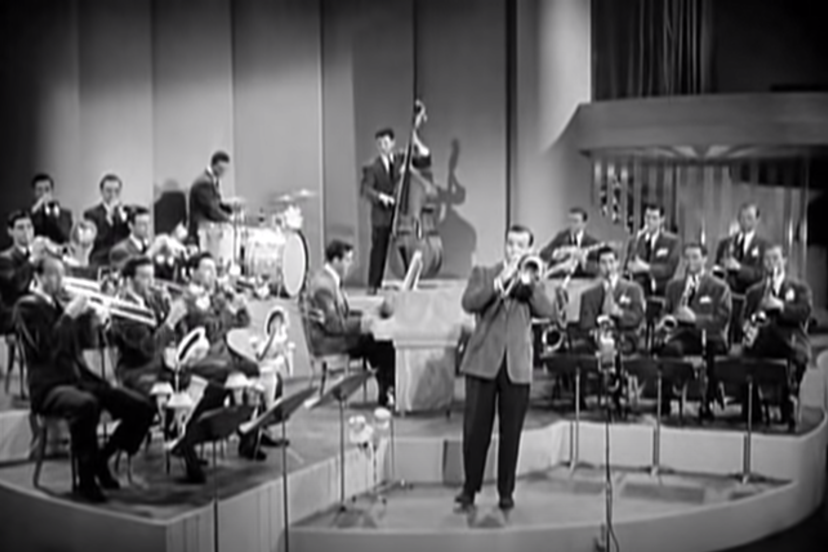
LET’S HAVE SOME MUSIC!
Listen to the sound of the big bands. What different instruments can you hear in the songs? Click on the link to hear one of WW2’s most well-known instrumentals to get budding musicians started https://www.youtube.com/watch?v=6vOUYry_5Nw

Slide 7
Special cups
Go to next slide for activity

Slide 9
Are you ready to dance!
Dancing was one of the most popular pastimes in Britain, with young men and women flocking to local dancehalls, ballrooms and church halls to dance their cares away. In the early 1940s, American troops introduced British dancers to new fast paced dance crazes like the Lindy Hop and Jitterbug. Click on this link below to learn the Jitterbug! https://dance.lovetoknow.com/Jitterbug_Dance_Steps

Slide 10
Having a VE DAY PARTY tomorrow!
Menu options:
Cauliflower cheese with bacon – make the most of the rationed cheese with this British classic
Spam hash – A can of spam can last 5 meals so this party dish will certainly serve everyone
Veggie options
Homity Pie – a rich, wholemeal pie with a potato, onion and cheese filling said to be made by Land Girls during the Second World War
Vegetable turnovers – a bit like the Homity Pie only in pasty form
Desserts
Eggless fruit cake – eggs were rationed but don’t worry, there was still delicious cake to have
Pear crumble
A social media campaign has called for residents across the country to decorate their homes in red, white and blue to mark VE Day with stay at home 'street parties'.
So today prepare for your party! This website has templates for bunting you can print out and stick in your windows or posters to colour in - https://ve-vjday75.gov.uk/toolkit/
Families in the same household are also being called on to have picnics or buffets to mark the occasion.
These can either be held in their garden or indoors.

Slide 11
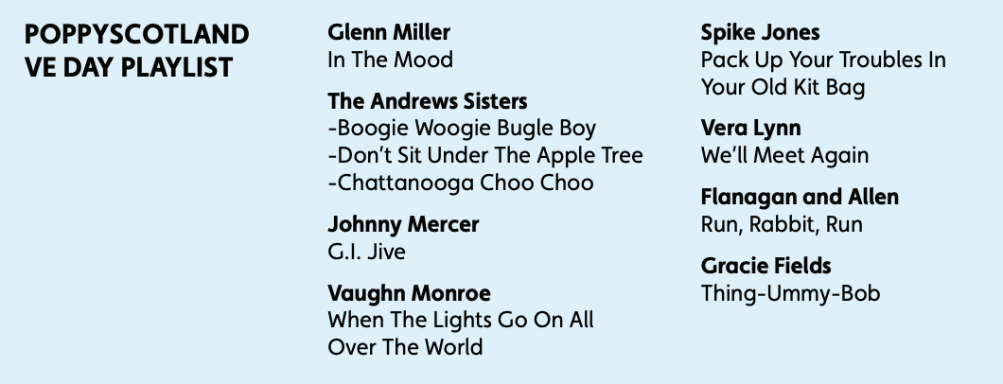
Keep dancing!
Host a dancing competition with family members dancing to the Poppy Scotland VE Day playlist.

Slide 12
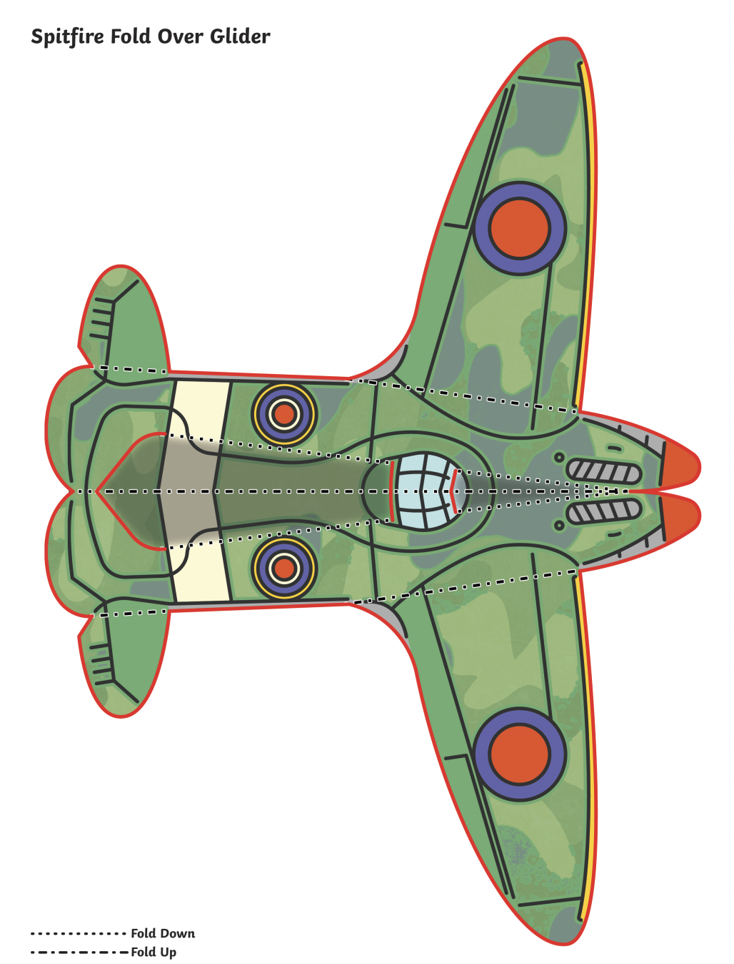
Make a spitfire
Airplanes were very important during the war. This plane is called a spitfire. Have a go at making your own! Print the picture off and fold it to make the spitfire.

Slide 13
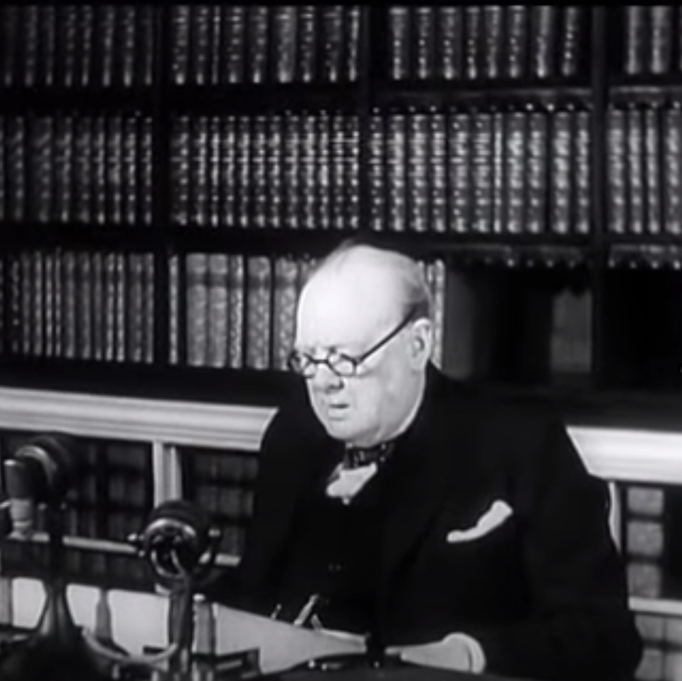
Watch this video
This video shows the celebrations that took place on VE DAY, THE SPEECH WINSTON CHURCHILL GAVE AND MUCH MORE. CLICK ON THIS LINK TO TAKE YOU TO THE VIDEO! https://www.youtube.com/watch?v=NEavcsrMoMw&t=4s

Slide 14
Veterans of WORLD war II

