Slide 1
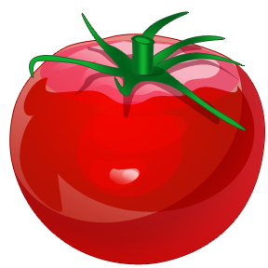

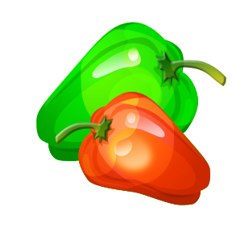
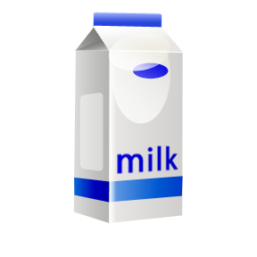
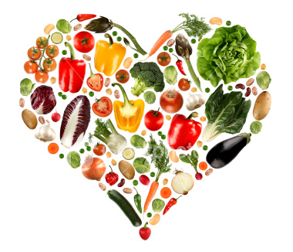
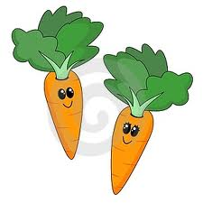

Healthy eating.

Slide 2

WALT:
Understand what a diet is.
Know what the different food groups are.

Slide 3
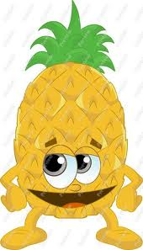
WILF:
a balanced diet plate with different types of food.

Slide 4
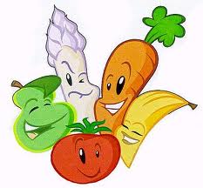
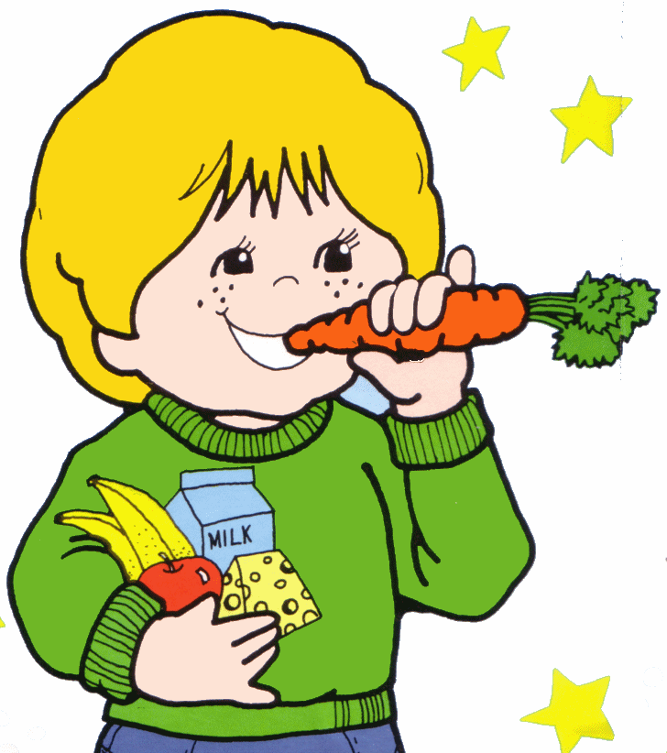

What is a diet?
Your diet is the food and drink that you eat and drink every day.

Slide 5
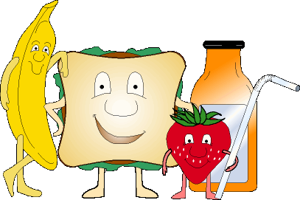
Staying healthy.
You need to eat lots of different foods to stay healthy.
Eating lots of different foods is called having a ‘balanced diet’

Slide 6
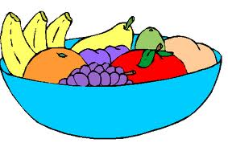
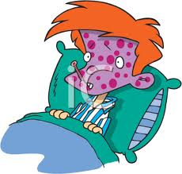
A balanced diet
Give us energy
Help us grow
Normal body functions
Repair our bodies when we are ill

Slide 7
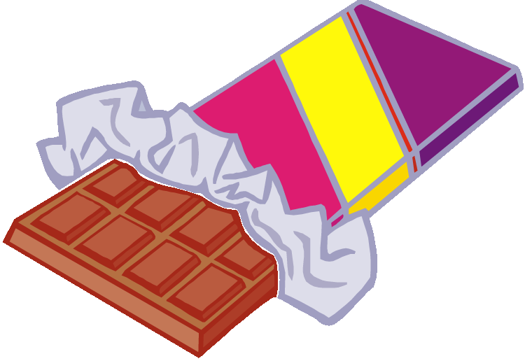

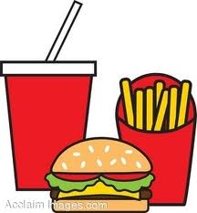
Good and bad foods.

Slide 8
Different foods.
To help your body to grow and work well it is important that you enjoy your food, eat plenty of fruit and vegetables and eat a variety of different food.
It is important to eat different types of foods.

Slide 9
Food types
The different types of food can be put into groups:
Bread and cereals
Meat, fish and eggs
Dairy
Fruit and vegetables.

Slide 10
How does food help us?
Fruit and vegetables contain minerals and vitamins. They stop us becoming poorly.
Milk and dairy foods contain calcium. It helps our bones, teeth and nails to grow.
Meat and fish contain protein. It helps our body to grow and repair itself.
Bread, cereals and potatoes contain fibre and carbohydrates. This helps us to digest our food.
Fatty and sugary foods contain fat. They give us energy, but only in small amounts.

Slide 11
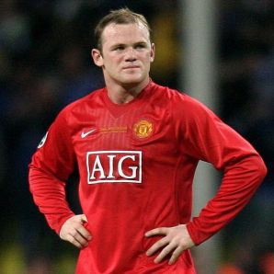
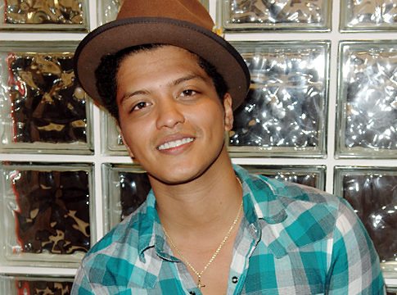
Everybody needs to eat a balanced diet.
Wayne Rooney Bruno Mars

Slide 12



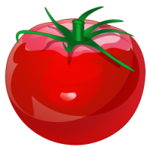
Your job...
You are a chef for either Wayne Rooney or Bruno Mars. It is important that they eat a balanced diet of food as they live busy lifestyles.
Design a plate of food which is healthy and a balanced diet.

Slide 13
Now I can ...
understand that a diet is the food and drink we eat every day
recognise some different food groups
discuss what makes a meal healthy
Design a balanced diet meal.

