Slide 1
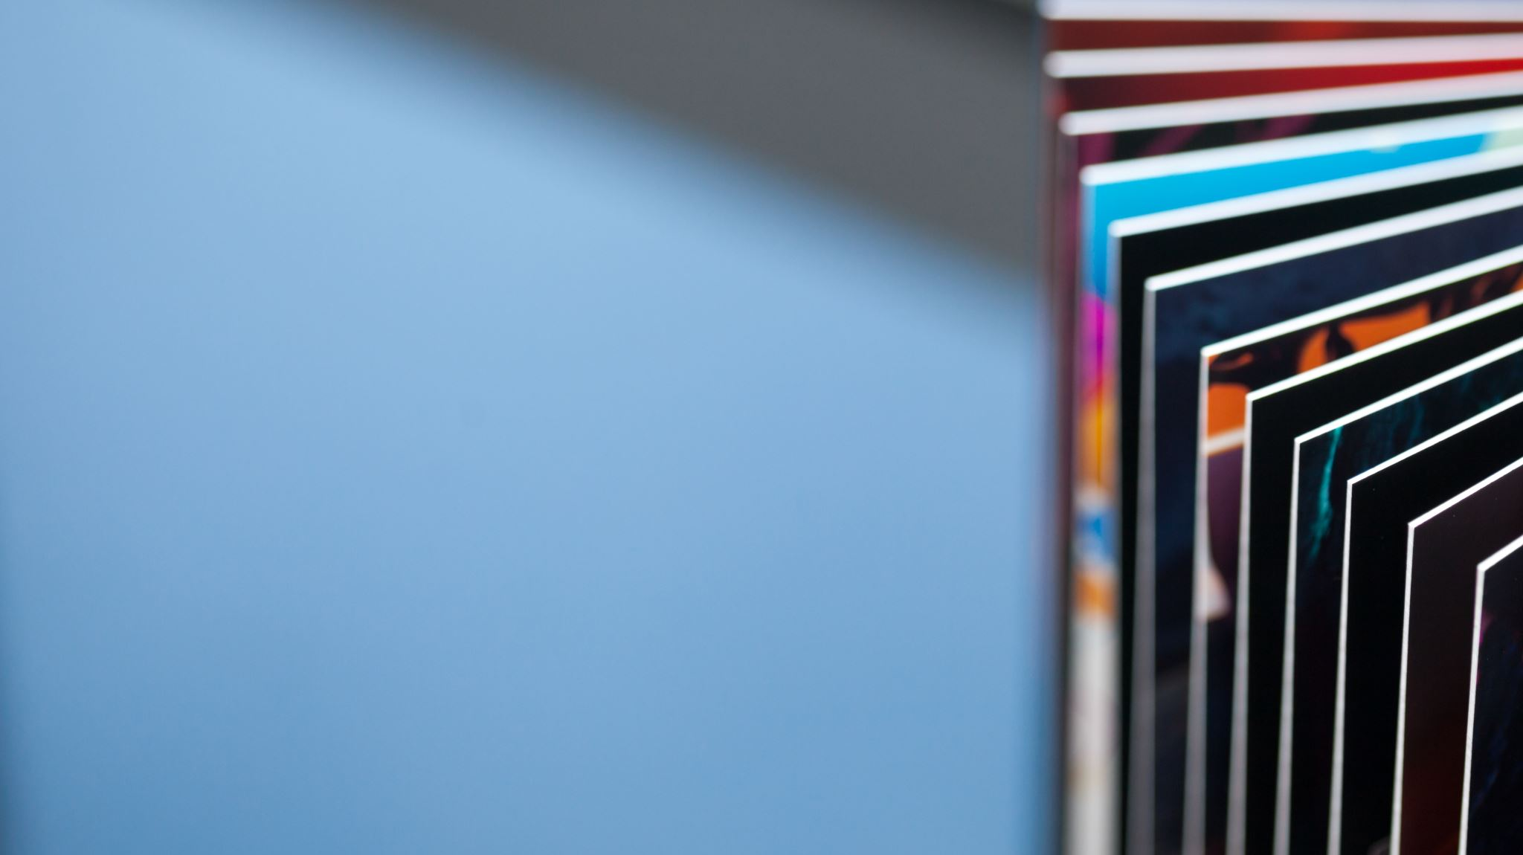
Paper Plate Art

Slide 2
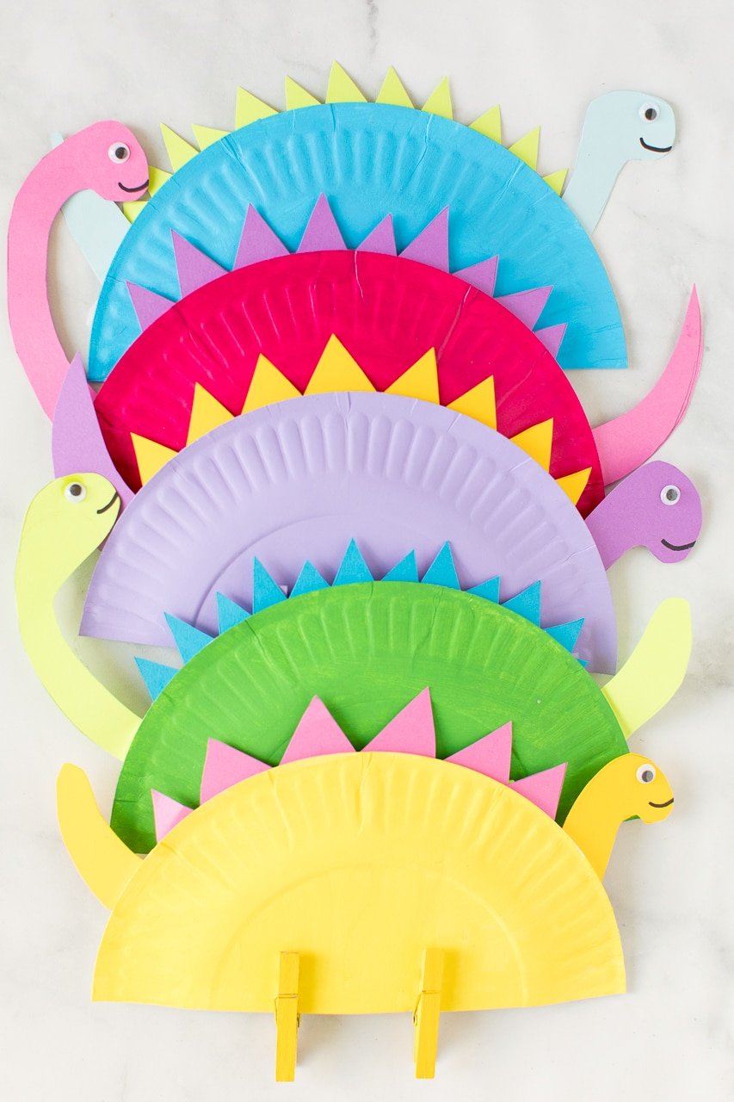
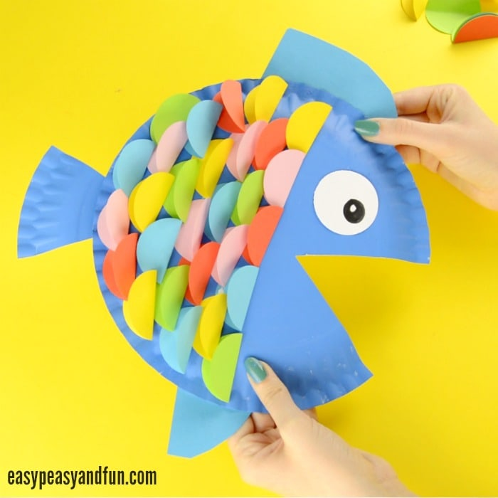
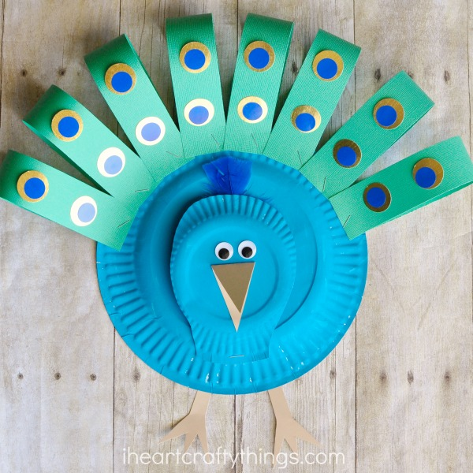
Here are some examples:

Slide 3
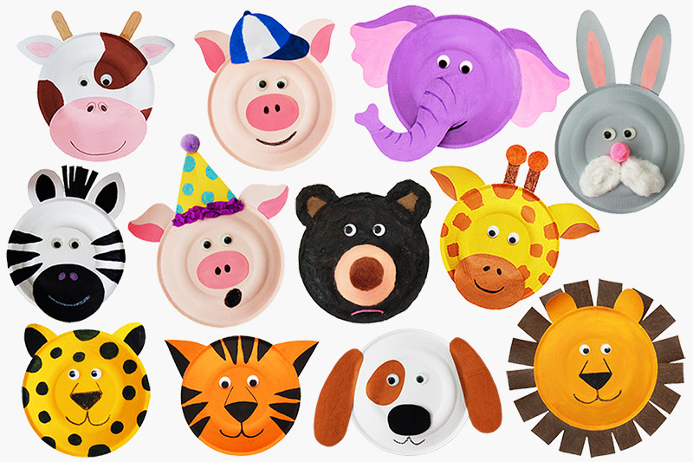
And some more…

Slide 4
What materials do we need to make:
Materials:
Paper Plate
Paint
Coloured Cardboard
Glue

Slide 5
What materials do we need to make:
Materials:
Paper Plate
Paint
Coloured Cardboard
Glue

Slide 6
How would you build it?
Construction:
Cut the shape of the mouth into the fish.
Use the ‘cut out part’ to make the fins.
Use different colours of card/paper to create the scales.

Slide 7
How would you build it?
Construction:
Cut the shape of the mouth into the fish.
Use the ‘cut out part’ to make the fins.
Use different colours of card/paper to create the scales.

Slide 8
Activity:
Use the pictures throughout the PowerPoint to gather ideas on your chosen animal.
If you do not have a paper plate, please use paper that can be cut into a circle.
Have fun with this activity!

