Slide 1
The Tudors
Introducing the Tudors

Slide 2
1st June 2020
The War of the Roses
Success Criteria
To know what the War of the Roses was.
To understand how Henry VII came to power, and held it.
To analyse the reasons for Henry Tudor winning the Battle of Bosworth.

Slide 3

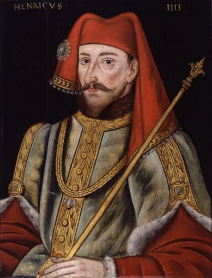
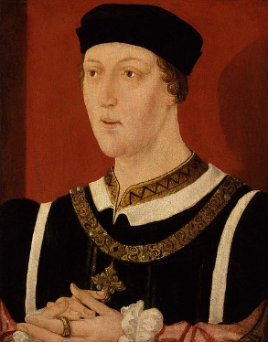
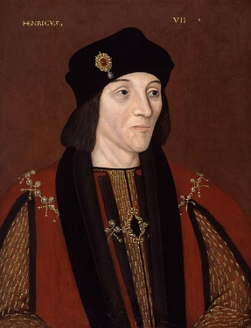
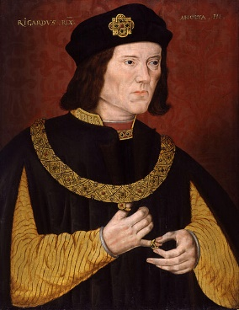
Odd One Out
Examine these four pictures and, with your adult, decide which king is the odd one out.
Record your choice and a reason on scrap paper.
Henry IV
Henry VI
Henry VII
Richard III

Slide 4
Horrible Histories – The War of the Roses
https://www.youtube.com/watch?v=BMZv9ys60nk
Watch this video to give you some insight to the War of the Roses.
Quick Questions:
1. When year are we in?
2. Who was King of England at the time? Why was he unfit to rule?
3. What are the names of the two ‘Houses’ that are against each other?
4. Why were the houses at war?

Slide 5
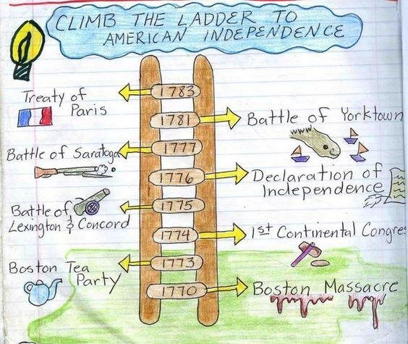
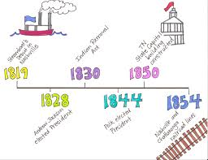
Activity:
Using the information from the video, create a timeline of the different battles that occurred during the time of the ‘Battle of the Roses.’
Include:
What happened (sentence)
Who won each battle.
Below is an example of some timelines to base yours on….

Slide 6


The War of the Roses (in more detail)
At the beginning of the 15th century, England was ruled by the House of Lancaster. Henry IV held the throne of England, but not everybody was happy about this. A grandson of Edward III, Henry IV had rivals for the throne from his own family.
Henry IV’s father was John of Gaunt, Duke of Lancaster, and John’s brother was Edmund, the Duke of York. The two families of Lancaster and York both desired to rule England and this family feud was to lead, later in the century, to the War of the Roses.
The war was given its name due to the symbols of each house; a red rose for Lancaster and a white rose for York.
Lancaster
York

Slide 7
The War of the Roses
From 1455, the two houses were at open war with each other. A series of important battles led to the crown changing hands between Lancaster and York several times.
The fighting seems to have been started when Henry VI (grandson of Henry IV and great-grandson of Edward III) suffered a bout of depression - or madness as it was seen at the time - and could not rule England. Richard, Duke of York, was given the role of ‘protector’ and ruled for Henry VI during this time. When Henry VI became healthy enough to rule again, Richard didn’t want to relinquish power and fought a battle with Henry.
Richard won this battle, but Henry VI’s wife, Margaret, built an army and defeated and killed Richard, thus restoring power to Henry.
Richard’s son Edward was so angry that he entered into a series of battles to take the throne from the Lancasters, which saw the crown change hands between himself and Henry VI several times. This was before Henry VI was imprisoned in the Tower of London and murdered, making Edward IV King of England.

Slide 8


The War of the Roses
When Edward IV died of natural causes in 1483, the crown went to his brother who became Richard III.
Richard III would only hold the crown for the House of York for two years before it was taken from him by another Henry, Henry VII of Lancaster, who would end the War of the Roses once and for all.
This story can seem quite confusing; the sheer amount of people called Henry and Richard makes things difficult to follow! Create a timeline of the kings of England during this period by using your activity sheet. Indicate whether each king was Lancastrian or Yorkist by shading the Lancastrians red and leaving the Yorkists white.

Slide 9
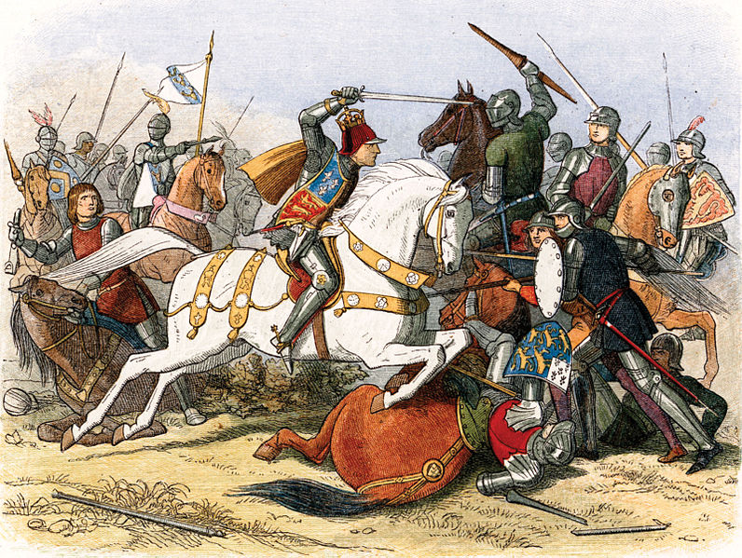
The Battle of Bosworth
The final battle of the War of the Roses was at Bosworth in Leicestershire. This battle saw Richard III unhorsed and killed by Henry VII, thus passing the crown from York to Lancaster.
This was a battle that was hard-fought on both sides, but Richard outnumbered Henry by roughly 2-1, so how did Henry win?
With a partner, read through the Battle of Bosworth Cards and decide which of these cards show things Richard did wrong, and which show what Henry did right.
When you have discussed the cards together, explain how Henry Tudor won the Battle of Bosworth on your activity sheet.

Slide 10
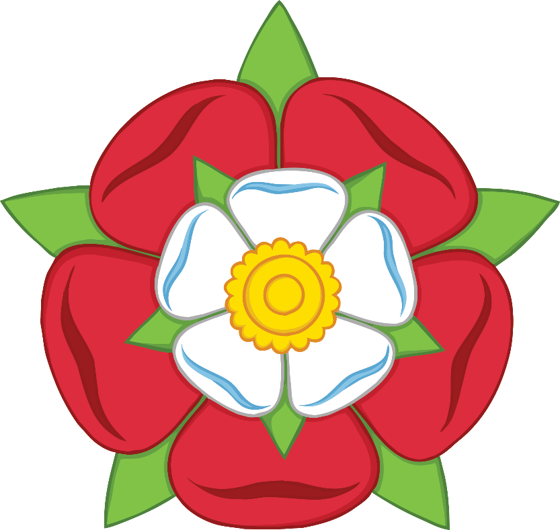
The Tudor Rose
With the battle won and Richard III slain, Henry Tudor became Henry VII of England. He decided that he would end the war between Lancaster and York with a shrewd political move; he married Edward IV’s daughter, Elizabeth.
Now Lancaster and York were one family and the squabble could end. To mark the significance of this event, Henry created a new symbol for his house which shows a red and white rose joined together. This became known as the Tudor Rose.
It is important to note, though, that the larger rose is red and the smaller white - Henry was a Lancaster after all!

Slide 11
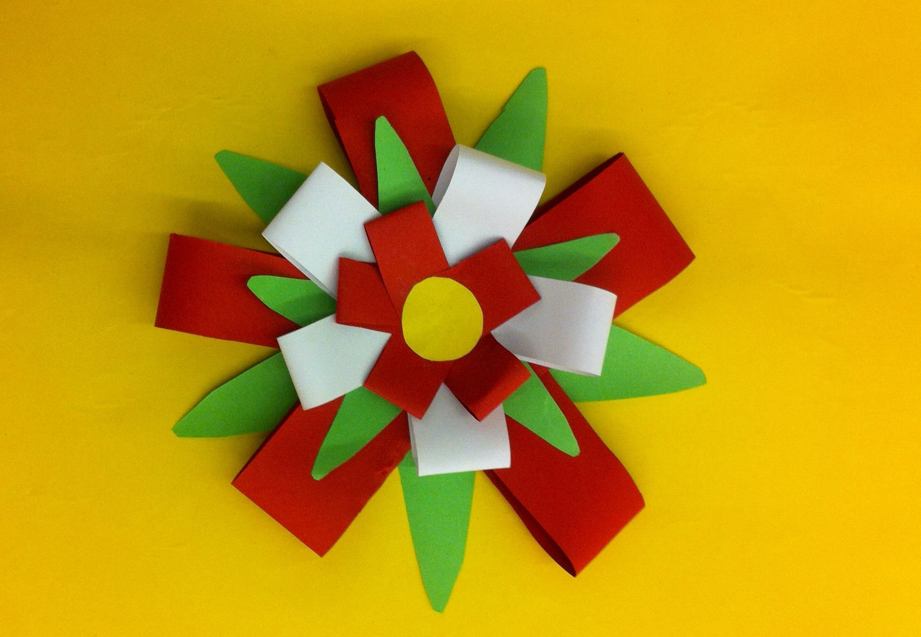
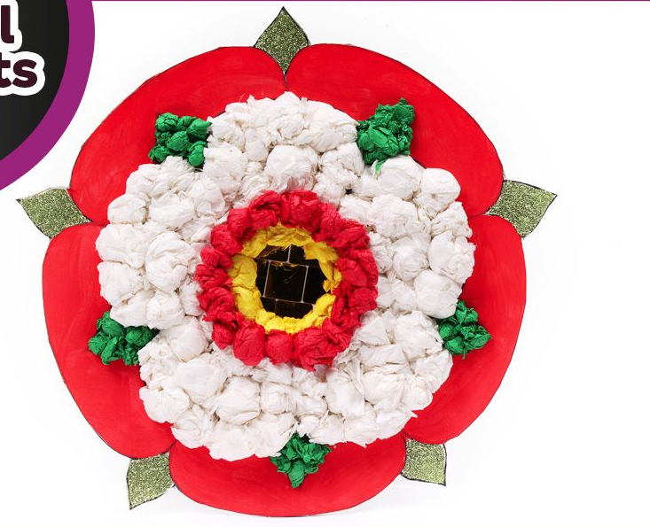
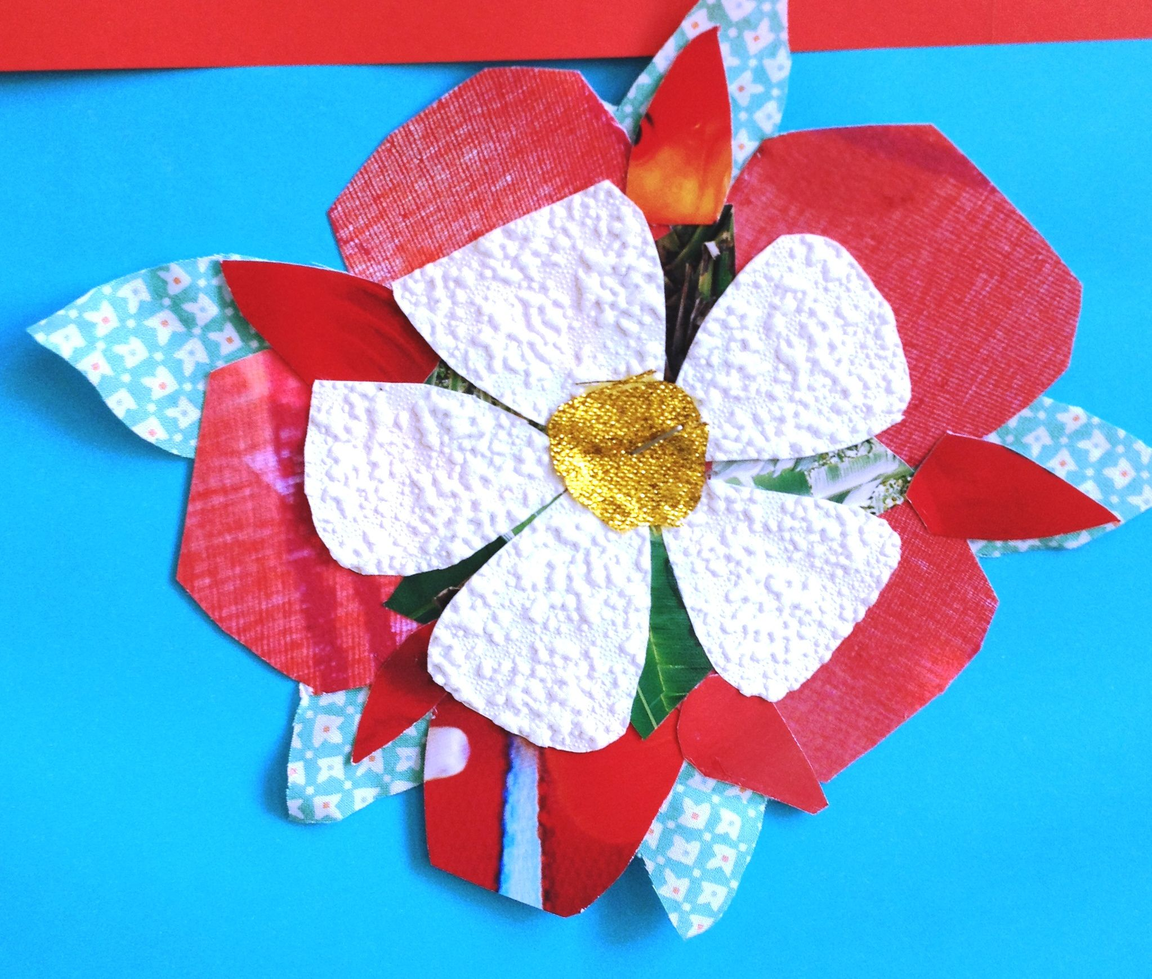
Activity:
Using the Tudor Rose above, create your own Tudor Rose in any way you would like.
Here are some examples…

Slide 12
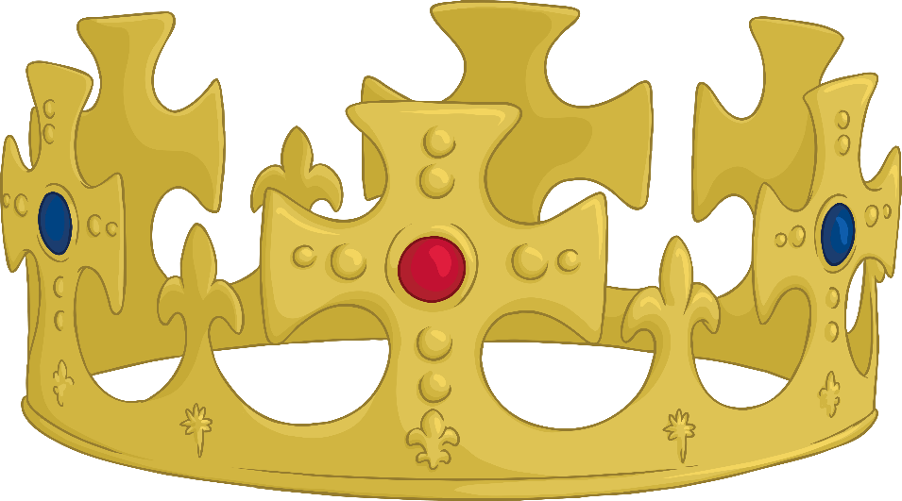
Keeping the Crown
Henry VII made some shrewd moves to ensure his power as king would not be challenged, and that the history of families feuding for the throne would be avoided.
Read through the Keeping the Crown Sheet to find out some of the things Henry did to secure his power.
When you have completed this reading, explain how Henry kept control of England on your activity sheet.

Slide 13
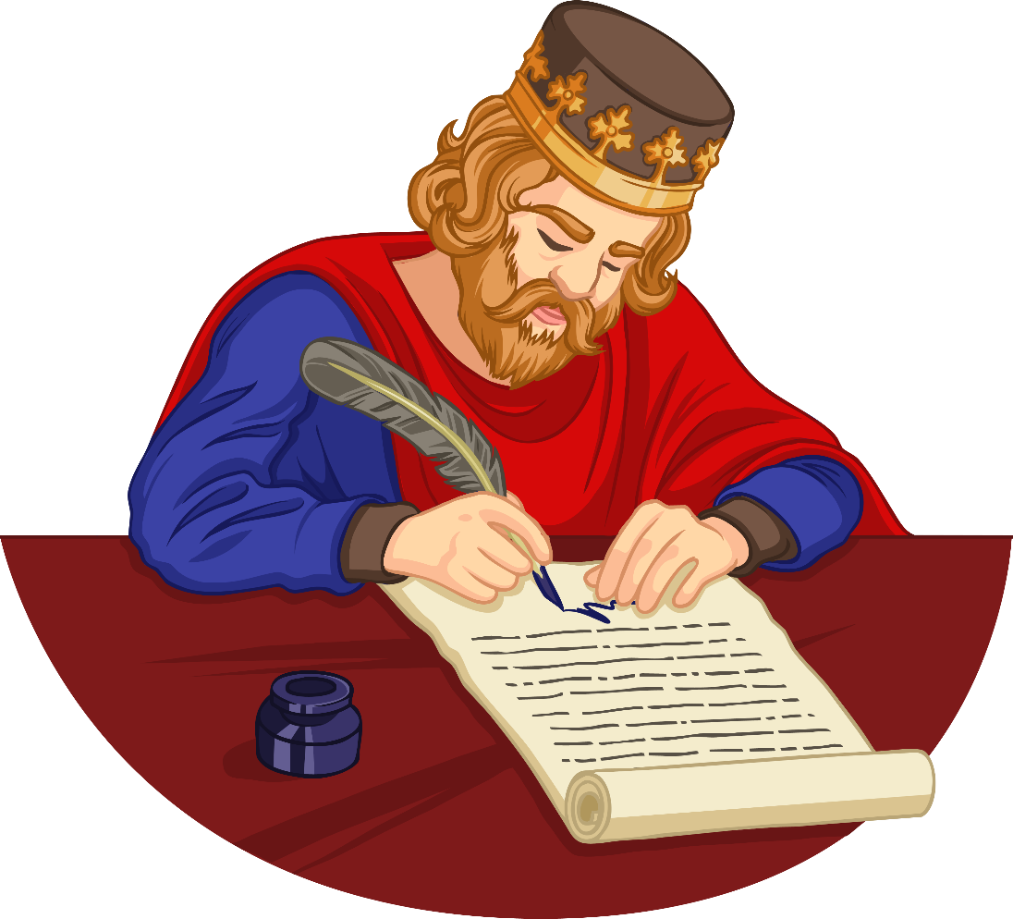
Summary in a Sentence
To finish today, write a short sentence to sum up the way the Tudors came to control England. You must use a maximum of ten words. What will your sentence be?

