Slide 1
One Point Perspective

Slide 2
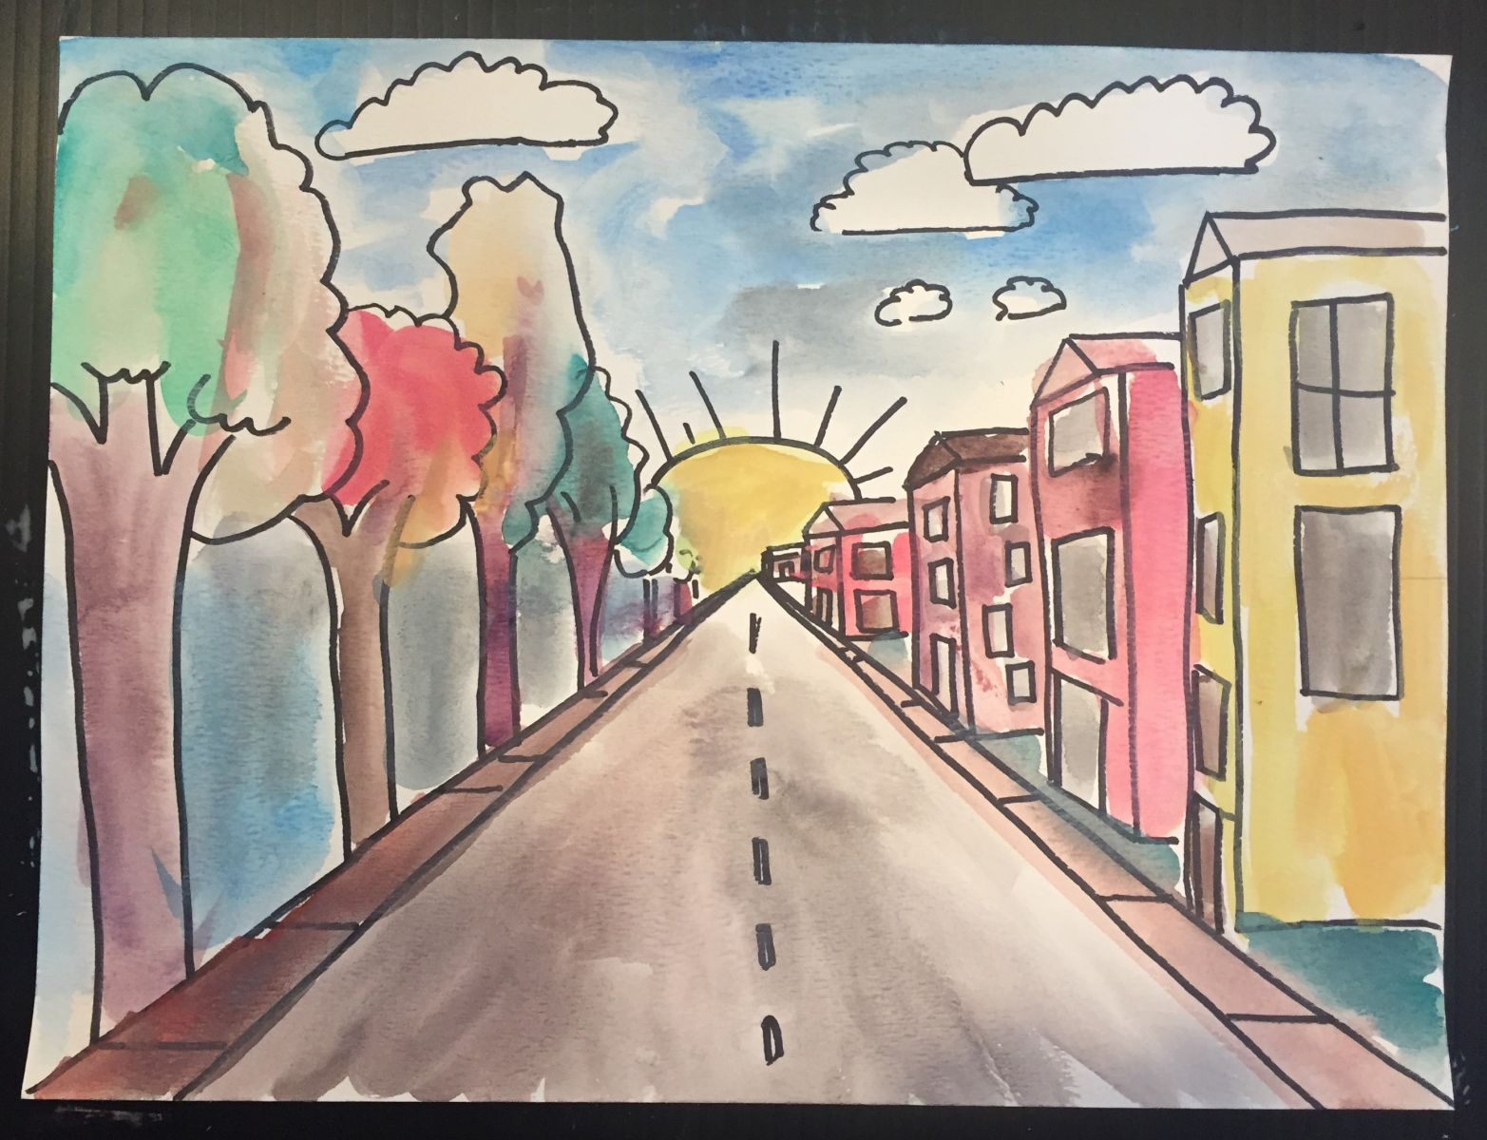
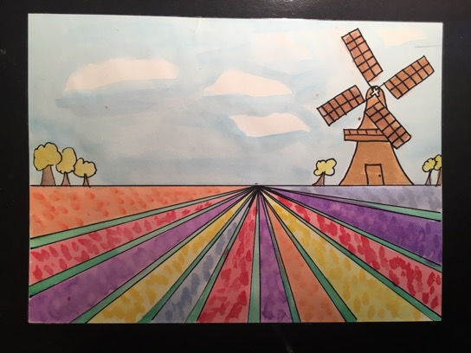
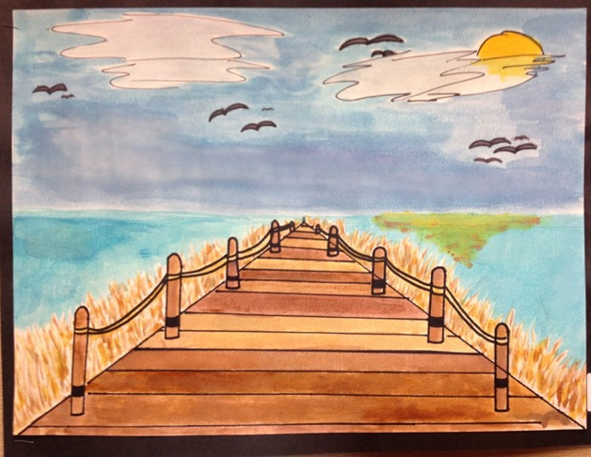
Art
Today you are going to have a go at ‘One Point Perspective.’
- This means that there is a straight on view has one single vanishing spot.
A Vanishing Point is the point at which all the parallel lines meet in the distance.
Here are some examples: Can you see the vanishing point they have chosen on these pictures?

Slide 3
Now it is your turn to have a go:
Follow the steps:
Lightly with pencil, draw an “x” from corner to corner of the paper.
Draw a dot in the middle of the “x” (the vanishing point).
Draw a horizontal line through the middle of the paper, passing through the dot.

Slide 4
Next:
4. Split the bottom half of your page into 6 parts as shown.
5. Make sure each line meets back in the middle of your page.
Middle Point
1.
6.
5.
2.
3.
4.

Slide 5
Then,
7. In section 1 and 6, begin to draw trees.
8. Make sure the trees closest to the centre are small.
9. Gradually make the trees bigger as you come away from the middle point.
1.
6.

Slide 6
After that:
10. In the top half of your picture, draw a semi-circle in the centre, just on top of the middle point.
11. Finally, rub out lines 7 and 8 up until the middle point.

Slide 7
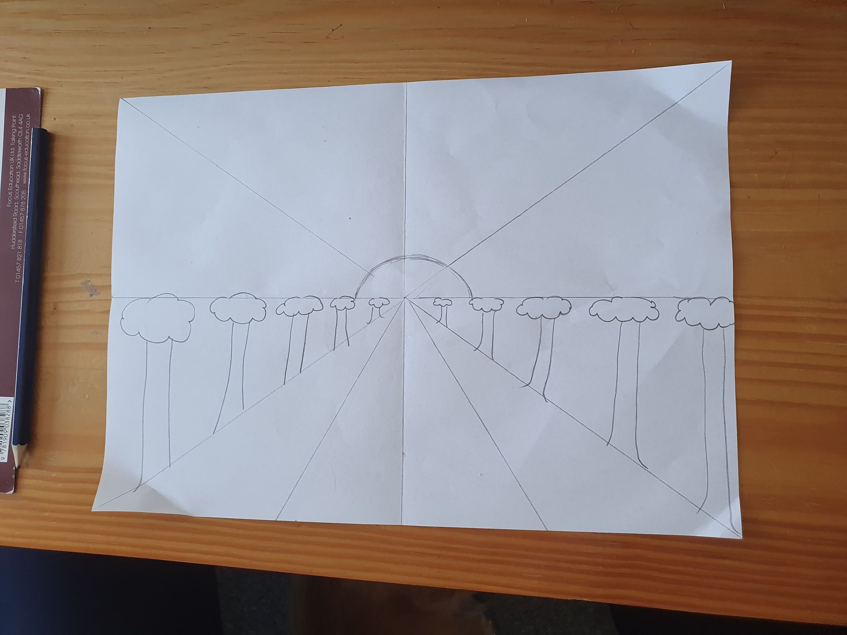
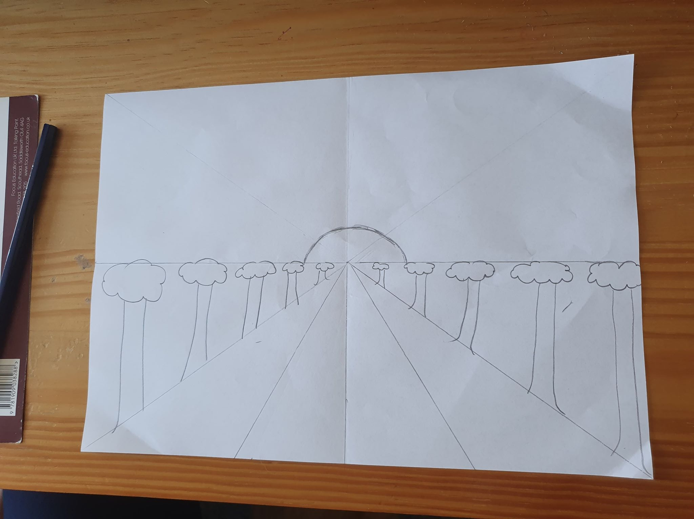
Finally:
7.
8.
11. Finally, rub out lines 7 and 8 up until the middle point.
12. You should have something that looks like this

Slide 8
To finish off:
This is an example of a similar painting.
Can you see what is different?
Activity:
Using either, colouring pencils or paint, add some colour to your pictures to create something similar to this

