Slide 1
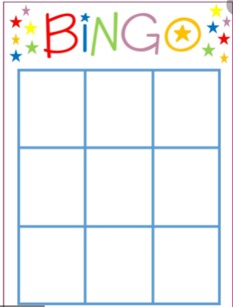
BINGO

Slide 2
AREA OF PARALLELOGRAMS

Slide 3
Tuesday 26th January 2021
LO: Can I calculate the area of a parallelogram?
Success Criteria
I know the formula for calculating the area of triangles and parallelograms.
I can understand why these formulas give the area of triangles and parallelograms.
I can use the formulae to calculate the area of triangles and parallelograms.

Slide 4
The Area of a Parallelogram
The area of a parallelogram is based upon the area of a rectangle that can be made by cutting off one end
and moving it to make the parallelogram.

Slide 5
Calculate the Area of a Parallelogram
Area of a parallelogram = the area of the rectangle
= base x height
height
base

Slide 6
Calculate
Calculate the area of this parallelogram.
10cm
12cm
Area = 12cm × 10cm =
120cm²

Slide 7
Calculate
Calculate the area of this parallelogram.
7cm
14cm
Area = 14cm × 7cm =
98cm²

Slide 8
Calculate
Calculate the base of this parallelogram.
6cm
Area = 42cm²
Base = =
42
7cm
6

Slide 9
Calculate
Calculate the height of this parallelogram.
Area = 300cm²
20cm
Height = =
300
15cm
20

