Slide 1
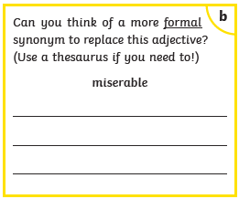

Slide 2
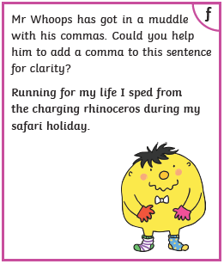

Slide 3
Monday 1st February 2021
LO: Can I consider the character of Mina and her fascination with William Blake?
Success Criteria
To learn about William Blake.
To read and understand a William Blake poem.
To consider how and why Mina is influenced by William Blake.

Slide 4
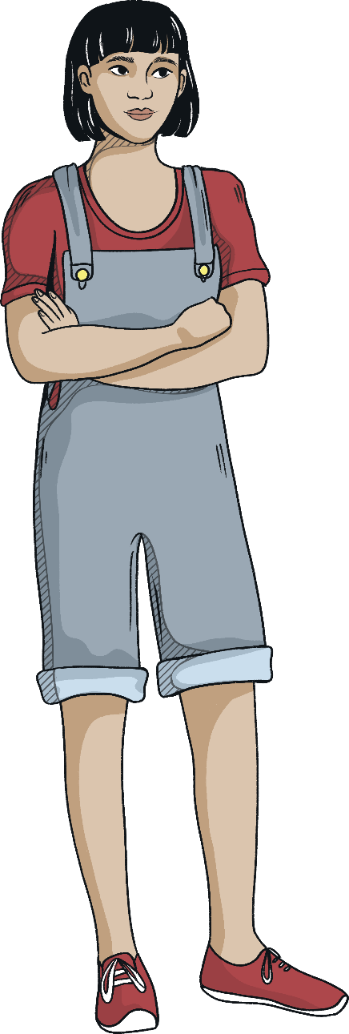
Mina
What do we know about Mina so far? Write two lists:
Words to describe Mina
Bossy Well-read Eloquent Curious
Intelligent Unusual Direct Kind
Quirky Thoughtful Talented Brave
Facts about Mina
Michael’s neighbour
Black hair
Eyes that see right through you
Likes nature
Likes drawing
Interested in birds
Home-educated
Walks in her sleep

Slide 5
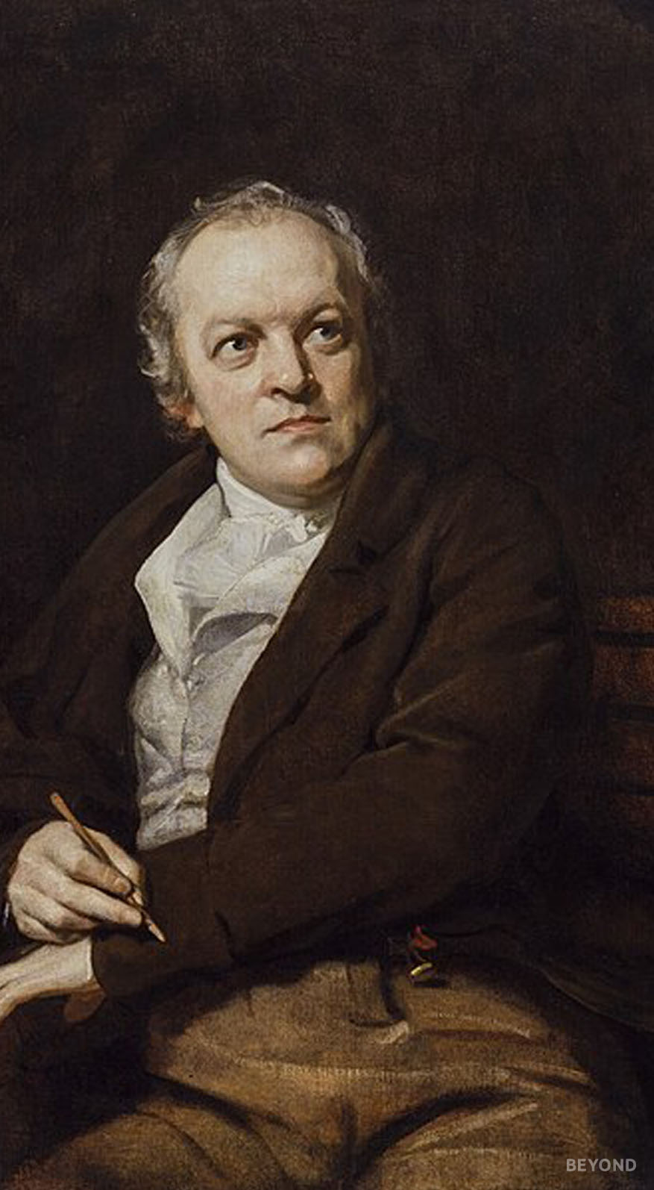
William Blake
Mina likes to quote William Blake. Have you heard of him before? What do you know about him?
William Blake was born in London in 1757. He was a poet and painter, and is considered to be a major contributor to the Romantic movement.
Romantics were interested in the power of nature, humanity and emotion; they were opposed to the industrialisation and scientific progress which was sweeping through Europe at the time. They were also concerned about the rights of the poor, feeling that they were often exploited by the Establishment.
4&5. https://upload.wikimedia.org/wikipedia/commons/d/d3/Reddragon.jpg

Slide 6
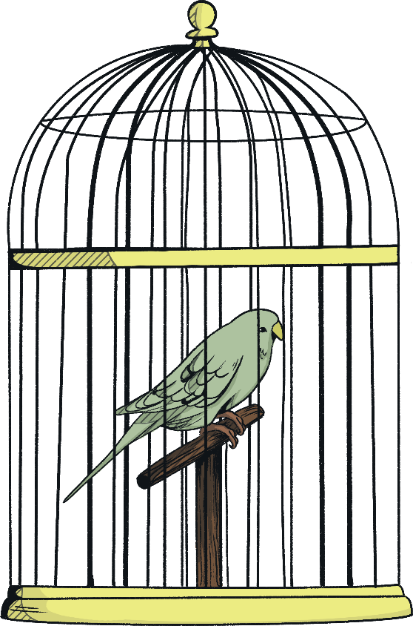
The Schoolboy
From Songs of Experience by William Blake.
How can the bird that is born for joy
Sit in a cage and sing?
How can a child, when fears annoy,
But droop his tender wing,
And forget his youthful spring!
O father and mother if buds are nipped,
And blossoms blown away;
And if the tender plants are stripped
Of their joy in the springing day,
By sorrow and care's dismay, -
How shall the summer arise in joy,
Or the summer fruits appear?
Or how shall we gather what griefs destroy,
Or bless the mellowing year,
When the blasts of winter appear?
I love to rise in a summer morn,
When the birds sing on every tree;
The distant huntsman winds his horn,
And the skylark sings with me:
O what sweet company!
But to go to school in a summer morn, -
O it drives all joy away!
Under a cruel eye outworn,
The little ones spend the day
In sighing and dismay.
Ah then at times I drooping sit,
And spend many an anxious hour;
Nor in my book can I take delight,
Nor sit in learning's bower,
Worn through with the dreary shower.

Slide 7
What is William Blake’s message in this poem?
What imagery does he use to make his point?
Do you agree with him?
How does this poem connect Mina and Michael?
Activity 1
Now answer these questions in your own words. Try and answer in much detail as possible. Aim to write at least 3/4 lines for each answer and express your views using evidence from the poem.

Slide 8
Activity 2
Now write a short review of the poem The Schoolboy.
Here are some prompts to help you write your review:
What is the poem about?
Does the poem rhyme?
What is your favourite word or phrase in the poem? Explain why you like it.
What is your least favourite word or phrase in the poem? Explain why you don’t like it.
Are there any similes or metaphors in the poem? If so, find and copy one.
How does the poem make you feel? Explain your answer.

