Slide 1
Click me

Slide 2
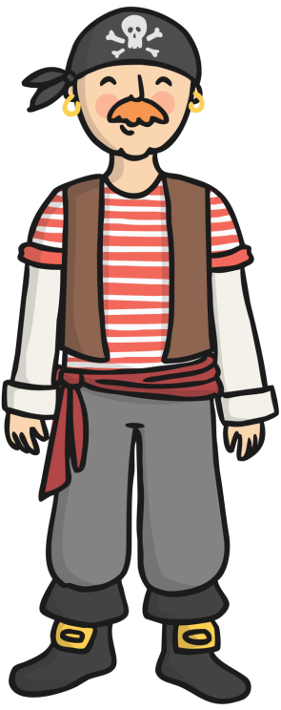
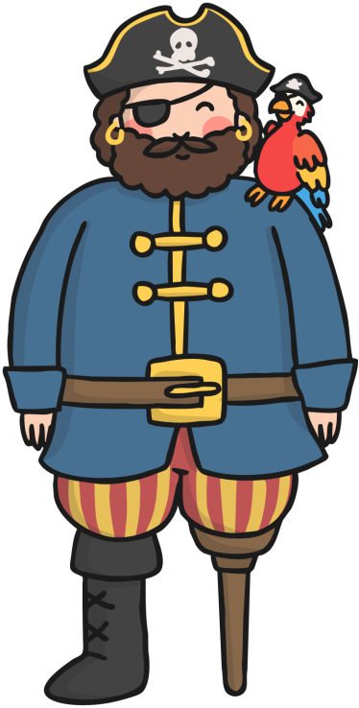
Click on a picture to learn more about the pirate.
William Kidd
Anne Bonney
Blackbeard
Black Bart
Click me
Click on this button to come back to this page.

Slide 3
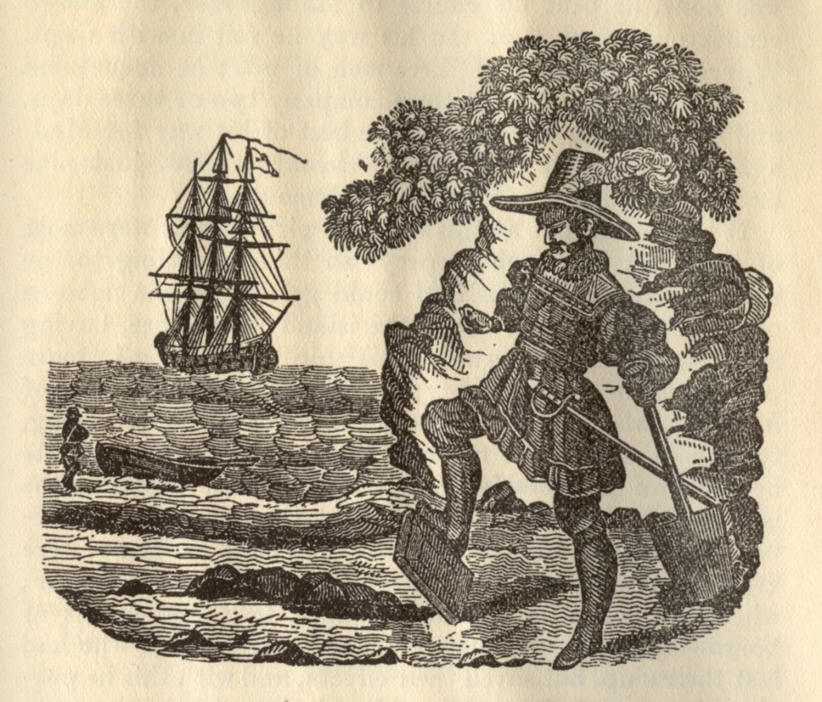
Captain William Kidd
Born:
1645, Dundee, Scotland
Died:
23rd May 1701
Click me

Slide 4
Interesting Facts
Before William Kidd became a Pirate, he was actually a ‘Privateer.’ This means he protected the British and American trade routes from French warships.
Kidd was very unlucky as he was forced into piracy by his unruly ship crew whilst on duty.
Click me
Kidd was the only pirate known to have ever buried any treasure on Long Island, New York.

Slide 5
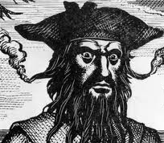
Captain Blackbeard
Born: 1680
Died: 22nd November 1718.
Click me

Slide 6
Interesting Facts
His real name was Edward Teach.
Blackbeard was a pirate for only 2 years before he was caught.
Click me

Slide 7
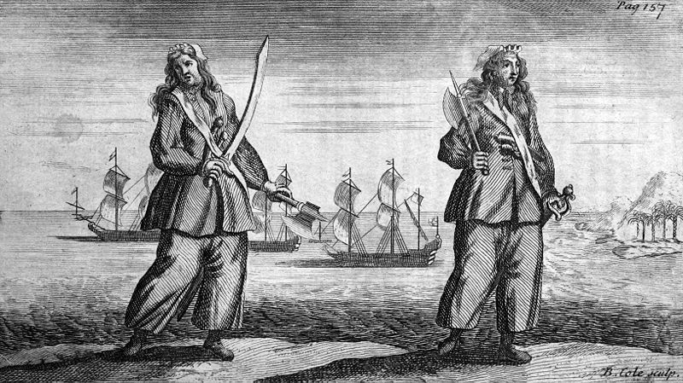
Anne Bonny
Click me
Born:
8th March 1698
Died:
22nd April 1782

Slide 8
Interesting Facts
Anne was the girlfriend of another pirate called Calico Jack.
Anne acted and dressed just like a male pirate and was excellent at fighting.
Click me

Slide 9
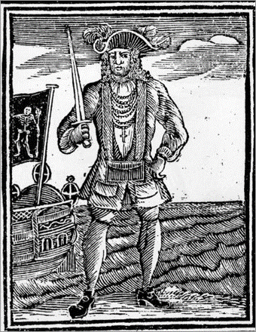
Black Bart
Born:
17th May 1682
Died:
10th February 1722
Click me

Slide 10
Interesting Facts
He was born in South Wales as John Roberts and later adopted the name 'Bartholomew', or Black Bart, when he became a pirate.
He was known to love expensive clothes and jewellery and was always well-dressed, even in battles!
He was eventually caught by the British Government, and his crew were put on trial in the biggest pirate trial in history!
Click me

Slide 11
It’s Quiz Time
What did William Kidd do before he became a pirate?
A Butcher
Privateer
Sailor
Click me

Slide 12
It’s Quiz Tme
2. What was Blackbeard’s real name?
Edward Leach
Edward Teach
John Teach
Click me

Slide 13
It’s Quiz Time
2. What did Black Bart like?
Hint: There are 2 answers.
Treasure
Nice Clothes
Jewellery
Click me

