Slide 1
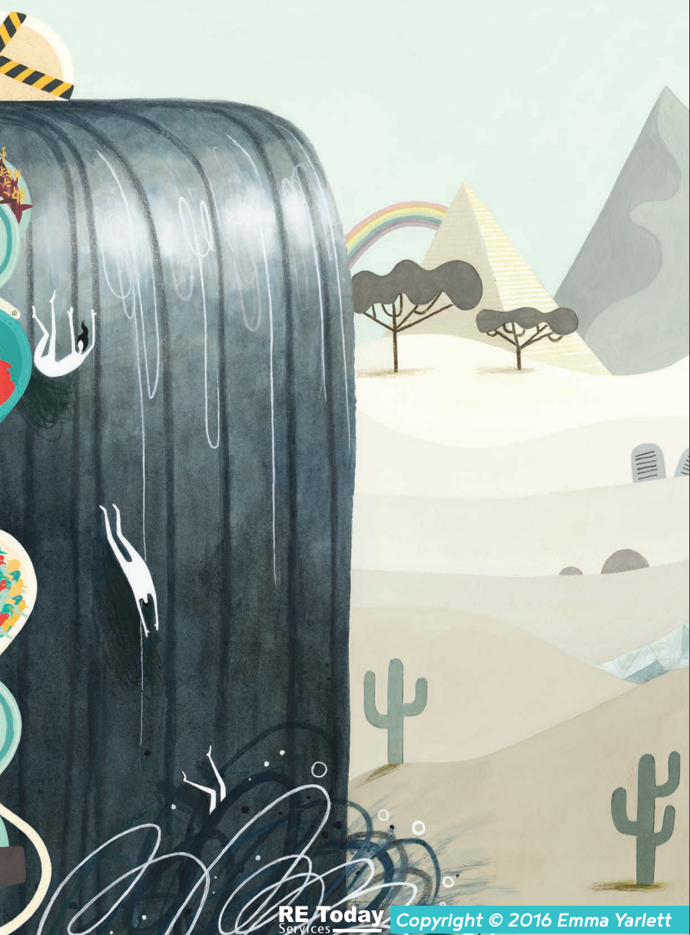
What can you see in this picture?
Where is it set?
What does this picture represent?
What makes you think this?
Once you’ve heard the story of Moses, can you draw an appropriate image to represent his story on the big frieze?

