Slide 1
Starter Improve the sentence
And they lived happily ever after.
Indisputably, the young couple lived happily ever after in their old, ancient dwelling in the middle of tall, oak, indestructible trees.

Slide 2
Monday 11th January 2021 LO: Can I make inferences and predictions based on the text?
I can participate in a discussion
I can make inferences
I can ask relevant questions
I can write a suitable prediction

Slide 3
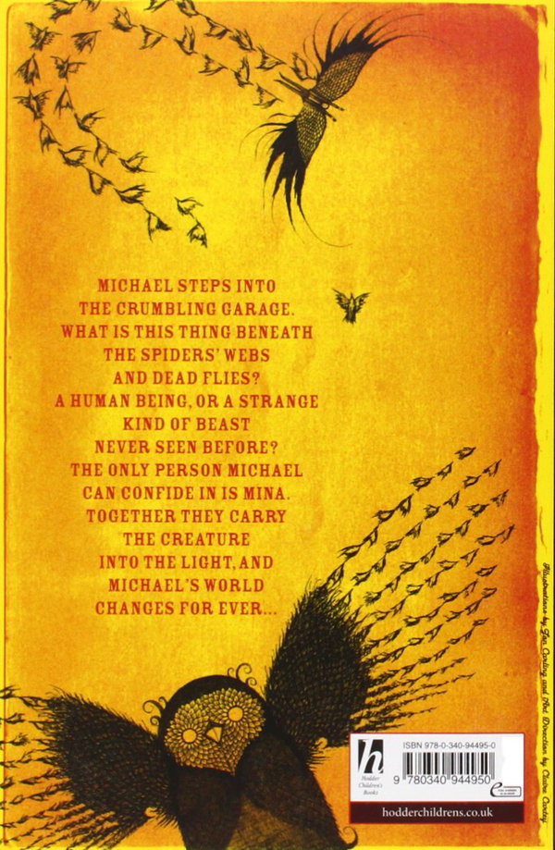
What are our first impressions?
Who/what is this?
Does this remind you of anything you've read before?
What do you think about the title?
characters, story, genre, what happens?
Judging a book by its cover?

Slide 4
Working Wall
Feature | Prediction | Justification
characters | I predict that the characters of the novel will be... | ...because in the _____ it says/shows _____.
setting
plot
genre

Slide 5
Five Words
Write down five words to describe what you think Skellig will be like.
1)
2)
3)
4)
5)

Slide 6
Now write your prediction using suitable language. You should aim to write at least one long paragraph or two quoting reasons. Prediction
I predict this book is about an angel who guards the main characters.

Slide 7
Preparation for tomorrow’s lesson
Read chapter 1 – 3
If you don’t have a copy of the book, go to the word document titled ‘Skellig ch 1-6’ on the website or on teams where you can read the book.
DO NOT read on unless you are asked to do so

