Slide 1
Starter

Slide 2
Don’t ‘Shun’ These Words!
Day
4
Spelling Focus – S47: Endings that sound like /shuhn/, spelt –tion, –sion, –ssion, –cian
Can you think of (and spell) the ‘tion’/’sion’/’ssion’ or ’cian’ letter string words that are missing from these sentences?
We always make a before we start any science experiments.
If you’ve completed your work, please complete the activity.
Do you have to be out of the classroom?
After watching the , I had a go at doing some of the card tricks on my friends!
Can you think of two more words with each of the letter strings above?

Slide 3
Don’t ‘Shun’ These Words! Answers
Day
4
Spelling Focus – S47: Endings that sound like /shuhn/, spelt –tion, –sion, –ssion, –cian
Can you think of (and spell) the ‘tion’/’sion’/’ssion’ or ’cian’ letter string words that are missing from these sentences?
We always make a before we start any science experiments.
We always make a prediction before we start any science experiments.
If you’ve completed your work, please complete the activity.
If you’ve completed your work, please complete the extension activity.
Do you have to be out of the classroom?
Do you have permission to be out of the classroom?
After watching the , I had a go at doing some of the card tricks on my friends!
After watching the magician, I had a go at doing some of the card tricks on my friends!

Slide 4
Don’t ‘Shun’ These Words! Answers
Day
4
Spelling Focus – S47: Endings that sound like /shuhn/, spelt –tion, –sion, –ssion, –cian
Can you think of two more words with each of the letter strings above?
Possible answers include:
tion
nation
imagination
pollution
sion
division
confusion
collision
ssion
impression
expression
possession
cian
musician
politician
electrician

Slide 5
Tuesday 19th January 2021
LO: Can I write from the viewpoint of a character?
Success Criteria
I can recap on the events in the novel so far.
I can think like the main character.
I can use my knowledge of subtext to create a convincing diary entry

Slide 6
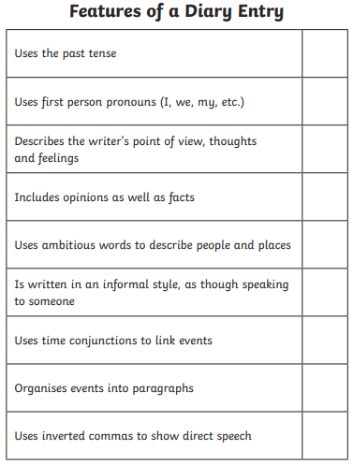

Slide 7
What do we know about Michael’s life so far?
List main events chronologically?
What emotions is he going through?

Slide 9
Plan 1) Michael moves to a new house. Falconer Road, Spring. He is disappointed the house needs lots of work. wants to move back home. 2) Mr Stone the estate agent is annoying. Michael is frustrated 'see it with your minds eye'. Use it as a hide away for your friends...yeah right! 3) Ernie Myers. Michael is annoyed- why did he have to die in the kitchen. who knows how long he was lying there 4) Baby came too early. jealous. 5) Getting lots of buses to school.

Slide 10
Dear diary, Ever since we moved to this dump, and that exasperating estate agent persuaded mum and dad to buy this rotten place, nothing has been the same! Sitting here I feel utterly overwhelmed. I know mum and dad said it would be a new beginning but the baby has bought so much chaos into my life...OUR lives! Oh why did we have to move here! To make matters worse, that estate agent (Mr Stone) kept annoyingly pointing out "See it with your minds eye!". Yeah right, all I can see is an old wreck, that has no working facilities, just a dead man's toilet and a dilapidated garage with crumbling walls!! Mum and dad are so preoccupied with the baby, that nobody has even noticed I have to catch 3 buses, just to get to school! AAAArgh!!!!! I'm…

Slide 11
Activity
Now write your own diary entry as the main character (Michael). Use the features checklist, the plan and the model diary entry if you are stuck.

