Slide 1
Starter

Slide 2
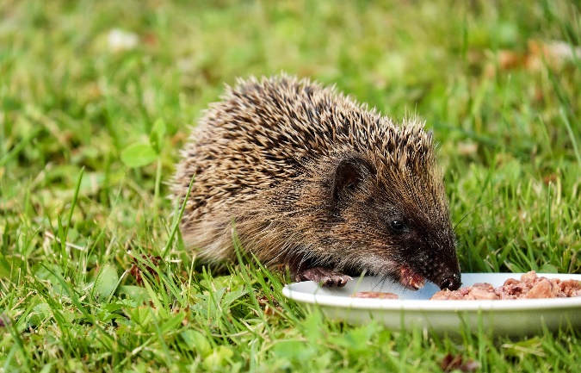
Punctuation, Grammar and Vocabulary Focus – Mixed Skills
Think and Write
Click to view image full screen
Use this photograph as your inspiration to think and write using the following pattern of sentences:
Sentence 1
Must contain a preposition indicating location.
Sentence 2
Needs to include a subordinate clause.
Sentence 3
Must be a passive sentence.
Sentence 4
Must contain an apostrophe for contraction.
Read through your passage carefully – does it include everything we are looking for?

Slide 3
Think and Write Example Answer
Punctuation, Grammar and Vocabulary Focus – Mixed Skills
Here’s an example of what you could have thought and written…
We found a young hedgehog behind the compost bin.
location preposition
As he was so small, we knew that he needed to eat.
subordinate clause
The cat food was gobbled up very quickly by the hungry hedgehog.
passive sentence
We thought that he’d need somewhere warm to sleep.
apostrophe for contraction

Slide 4
Monday 25th January 2021
LO: Can I summarise the opening story so far using varied sentence openers?
Success Criteria
I can write in the 3st person and in the correct tense
I can use rhetorical questions to draw the reader in
I can use varied sentence openers.
I will be able to refrain from giving personal opinion

Slide 5
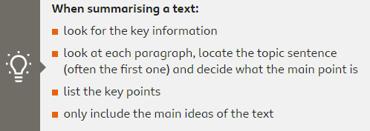
How to summarise a text?

Slide 6
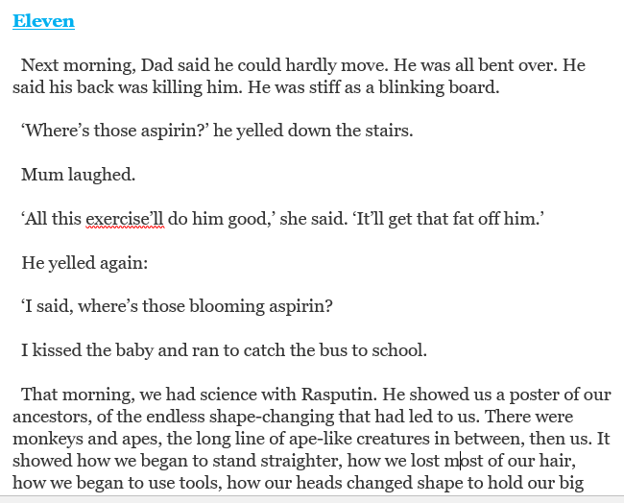
Summarising Ch 11 and 12
Topic sentence?

Slide 7
Summarising Ch 11 – KEY NOTES
Michael’s dad couldn’t move, trouble with back
Michael has science lessons same day – based on evolution
How humans evolved and got straighter
Disagreement over the theory, people offering their opinions
Shoulders blades became a discussion point and resulted in strange behavior
Michael’s baby sister is a continued worry

Slide 8
Summary
Home renovation activities were seeming to take a toll on Michael’s dad who woke up with excruciating back pain one day. Aspirin was his chosen medicine and his desperation to have one, probably meant it worked on him miraculously.
During his science lesson the same day, Michael’s teacher ‘Rasputin’ delved deeper into the theory of Evolution, something not everyone can readily agree with. Did humans really evolve from the Apes? This was something the class was busy disputing.

Slide 9
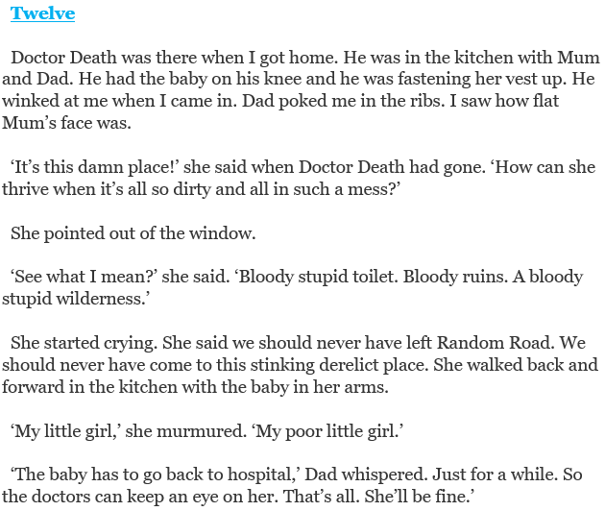
Topic sentence?

Slide 10
Summarising Ch 12 – KEY NOTES

Slide 11
ACTIVITY Make key notes on chapter 11 and 12 Using these summarise each chapter in at least two paragraphs (or more if you need). You should at least write 4 paragraphs altogether. Remember to use varied sentence openers, rhetorical questions and write in 3rd person.

