Slide 1
Starter

Slide 2
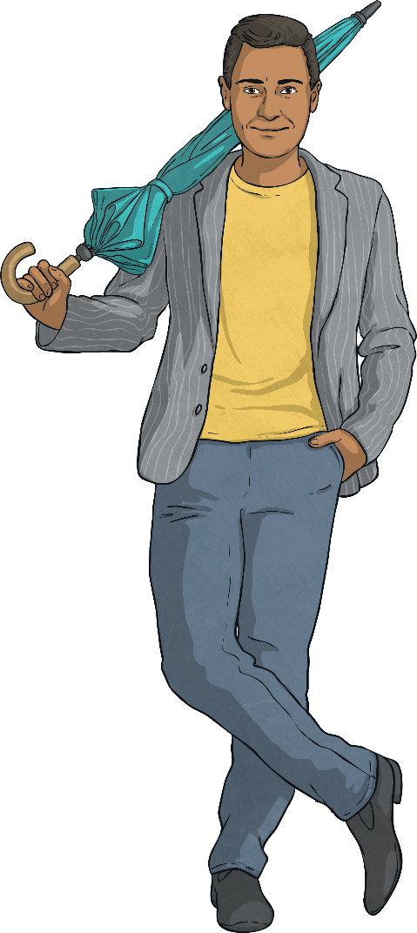
Commas to the Rescue!
Grammar focus - G.5.5: Commas to separate items in a list.
G.5.9: Punctuation for parenthesis.
G5.6b: Commas after fronted adverbials
Can you save the readers from these difficult sentences with the addition of commas?
Despite the rain he didn’t have his umbrella up.
My neighbour who is called Mr Brown owns a bear called Paddington.
Although it wasn’t dark the candle was burning brightly.
My favourite things to eat are chocolate bread apples and cheese and onion crisps.
Because my dad loves London we often go for day trips.
Dramatically the song finished with a bang.
The house which had been up for sale for several months was terribly dirty inside.
Can you classify the sentences according to why commas have been used?

Slide 3
Commas to the Rescue! Answers
Day
5
Grammar focus - G.5.5: Commas to separate items in a list.
G.5.9: Punctuation for parenthesis.
G5.6b: Commas after fronted adverbials
Despite the rain, he didn’t have his umbrella up.
My neighbour, who is called Mr Brown, owns a bear called Paddington.
Although it wasn’t dark, the candle was burning brightly.
My favourite things to eat are chocolate, bread, apples and cheese and onion crisps.
Because my dad loves London, we often go for day trips.
Dramatically, the song finished with a bang.
The house, which had been up for sale for several months, was terribly dirty inside.

Slide 4
Commas to the Rescue! Answers
Day
5
Grammar focus - G.5.5: Commas to separate items in a list.
G.5.9: Punctuation for parenthesis.
G5.6b: Commas after fronted adverbials
Can you classify the sentences according to why commas have been used?
To separate items in a list
My favourite things to eat are chocolate, bread, apples and cheese and onion crisps.
To punctuate parenthesis or relative clauses.
My neighbour, who is called Mr Brown, owns a bear called Paddington.
The house, which had been up for sale for several months, was terribly dirty inside.
After fronted adverbials
Because my dad loves London, we often go for day trips.
Dramatically, the song finished with a bang.
Despite the rain, he didn’t have his umbrella up.
Although it wasn’t dark, the candle was burning brightly.

Slide 5
Tuesday 26th January 2021
LO: Can I write a sophisticated poem using adjectives?
Success Criteria
I can write in verses
I can get my feelings across
I can use descriptive and sophisticated language.

Slide 6
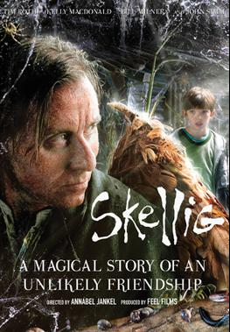
Poetry
What words describe his appearance, character, mood, needs?
Unshaven
Rugged
Puckered, sunken, stained face
Derelict and grubby
Skeletal/slender
Rude/abrupt/insulting towards Michael
Puny (undernourished/weak)
Antisocial
Feeble bones – arthritis
Bewildering/unreal
Cross between man and owl
Indisposed
No fighting spirit
Grumpy towards support
Loner
Mystical/magical – seems immortal
Question mark – puzzling
Solitary, negative

Slide 7
Skellig
Wings of an owl, a raven’s mind
Trapped in his nest, what has he left behind?
A boy enters the garage, Skellig’s humble abode
Oblivious, unsuspecting, wondering who else knows
What can fill his void?
Derelict and grubby he sits in a corner
Waiting to die, where is the mourner?
He cannot behold what maybe inside
He sits pondering if he’ll ever get fed
Mystical or magical, it can never be said.

Slide 8
ACTIVITY Record all the words that describe Skellig 2) Write 3 verses 3) Your poem does not have to rhyme

