Slide 1
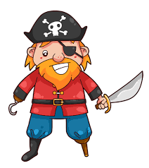
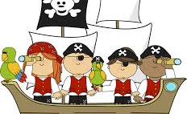
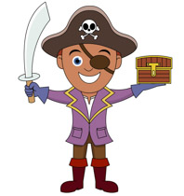
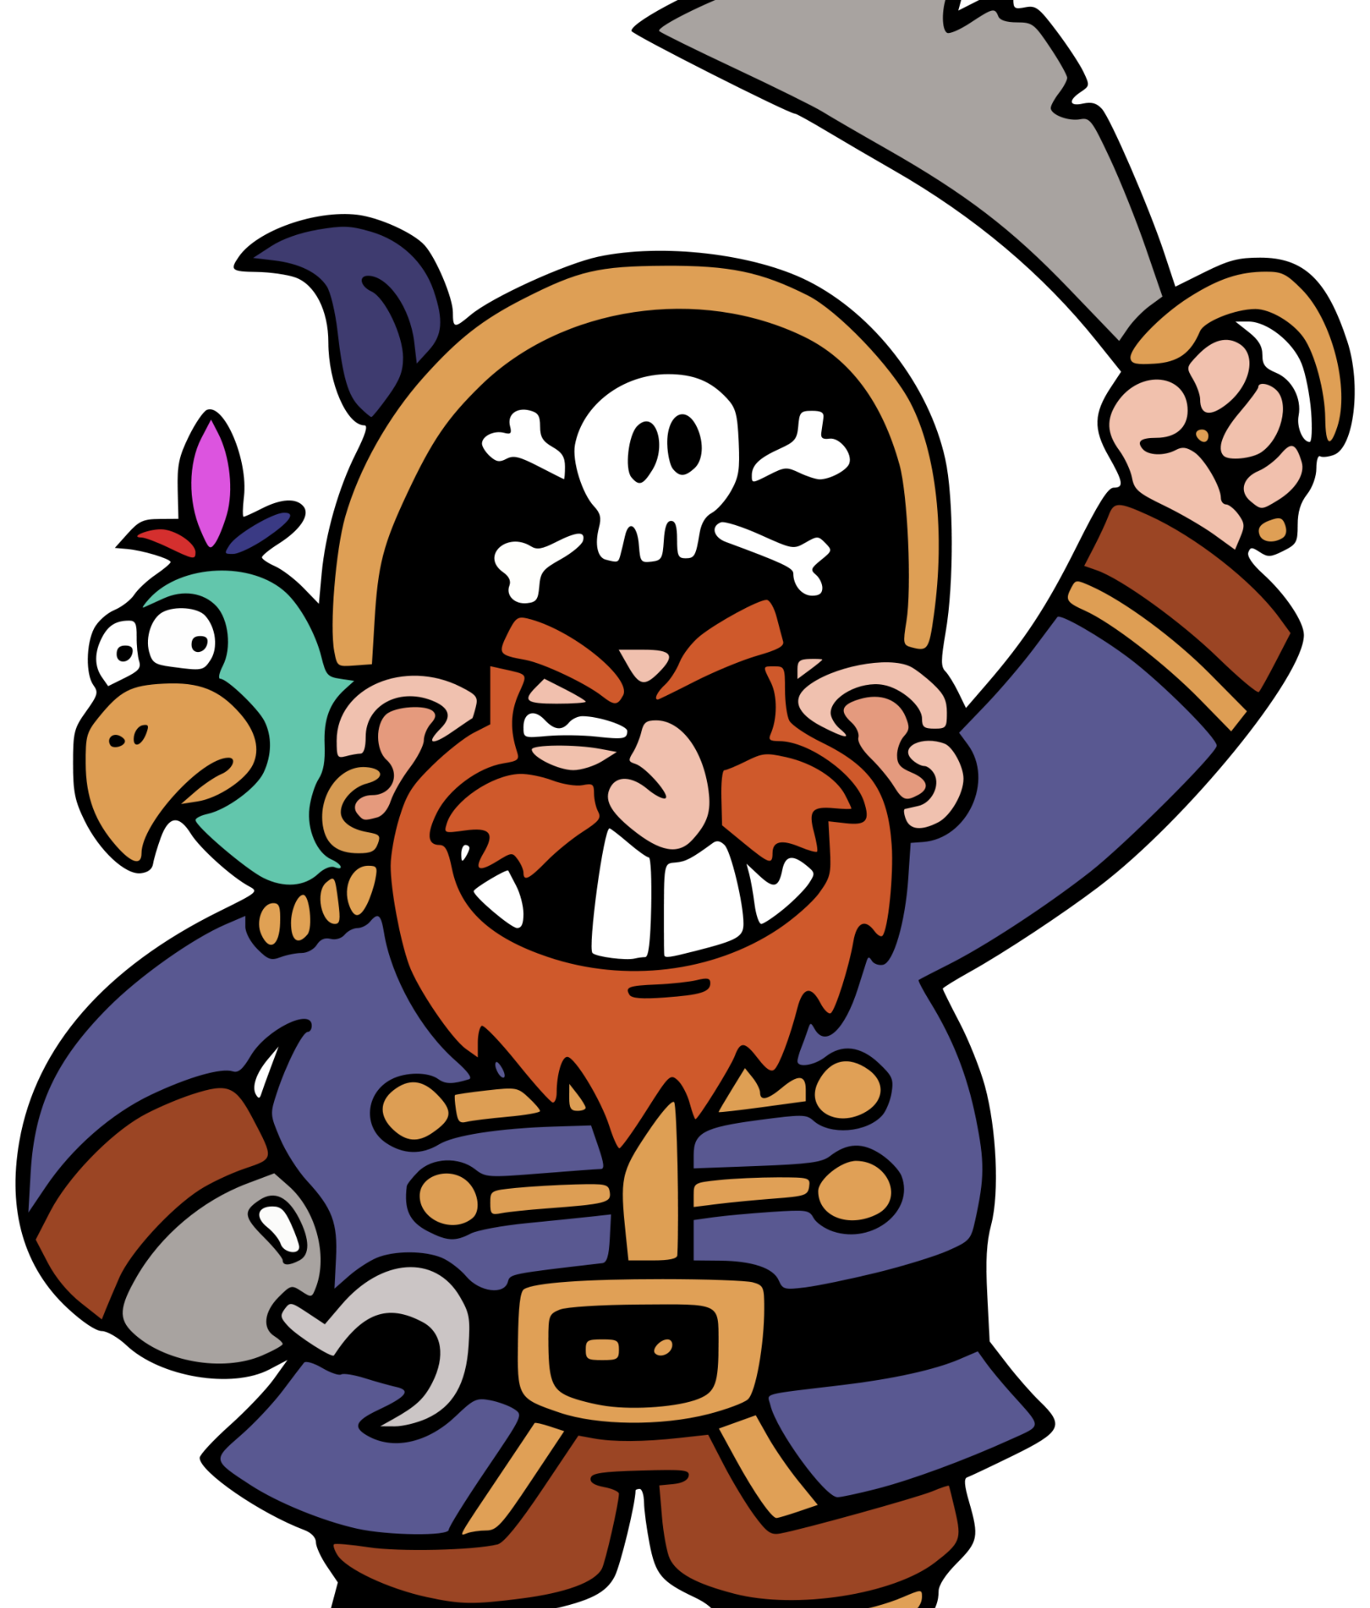
Pirates
Monday 18th January 2021

Slide 2
Pirates:
Hello Squirrels,
As you know, our topic this term is ‘Pirates.’ So far in this topic, we have learnt about some famous pirates from the United Kingdom.
On the next slides, there are 3 activities for you to complete.

Slide 3
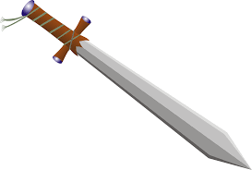
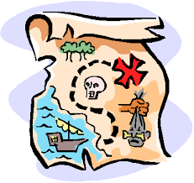
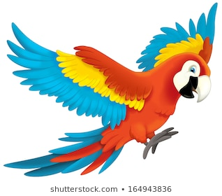
Activity 1: What do we know?
Let’s start by thinking about what we already know about pirates.
Write a list about what you know about pirates. Use the questions below to help you:
Do you know any famous pirates?
Do you know what pirates do?
What do they use to fight?

Slide 4
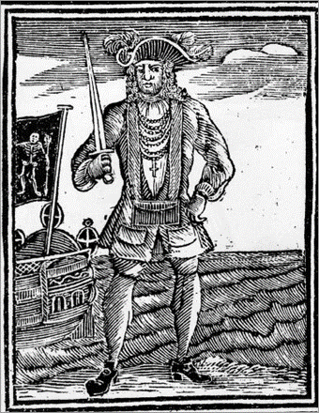
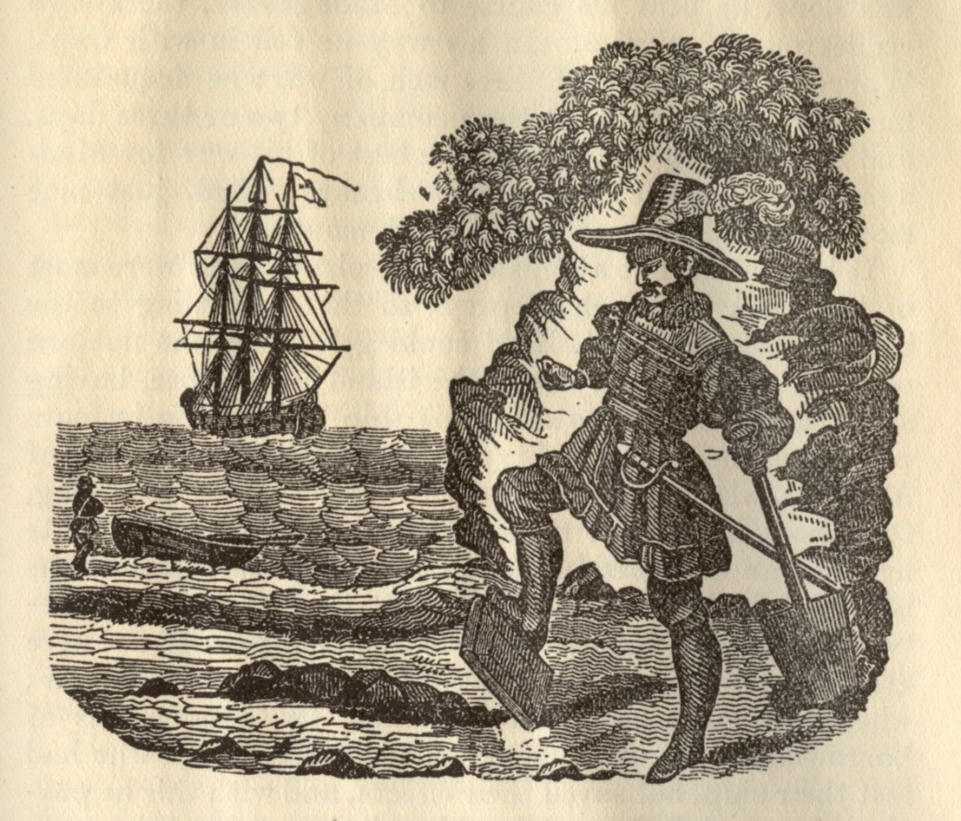
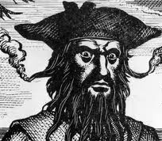
Activity 2: Ordering Dates
Look at the pirates below – Do you remember their names?
We are going to learn how to order these dates.
Born:
1645
Born:
1680
Born:
1698
Born:
1682

Slide 5
Let’s take a closer look:
All the dates have 16 at the beginning of them (highlighted in red)
We now know that they were all born in the same ‘Century.’
Now we focus on the other numbers (highlighted in green)
Born:
1645
Born:
1680
Born:
1698
Born:
1682

Slide 6
1. Find the smallest number (highlighted in green)
This means that they were born first – They are the oldest.
2. Now find the biggest number (highlighted in green)
- This means they were born later on in the century – They are the youngest pirate.
Born:
1645
Born:
1680
Born:
1698
Born:
1682

Slide 7
Let’s Order:
Can you order the dates from oldest to youngest? (drag the pictures and dates into the spaces on the timeline.)
Born:
1645
Born:
1682
Born:
1698
Born:
1680
Oldest
Youngest

Slide 8
Activity 3: True or False
Below there are some facts about pirates. Some are true and some are false. Can you work out which ones are true and which are false?
Pirates made their prisoners ‘walk the plank.’
Pirates ships all flew the ‘Jolly Roger.’
Pirates all carried treasure maps.
Pirates wore hoop earrings.
Pirates buried their treasure.
Hooks, eyepatches and peg legs were common amongst pirates.
Pirates carried parrots on their shoulders.
Pirates used to say ‘Arrr.’

Slide 9
Answers
Pirates buried their treasure.
Pirates made their prisoners ‘walk the plank.’
Pirates all carried treasure maps.
Pirates ships all flew the ‘Jolly Roger.’
Pirates wore hoop earrings.
Hooks, eyepatches and peg legs were common amongst pirates.
Pirates carried parrots on their shoulders.
Pirates used to say ‘Arrr.’

Slide 10
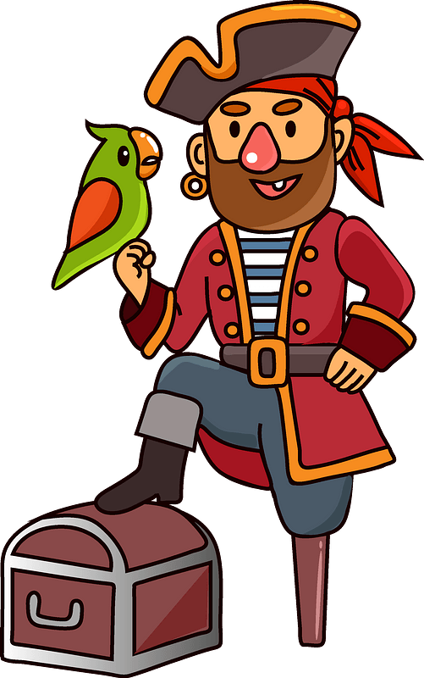
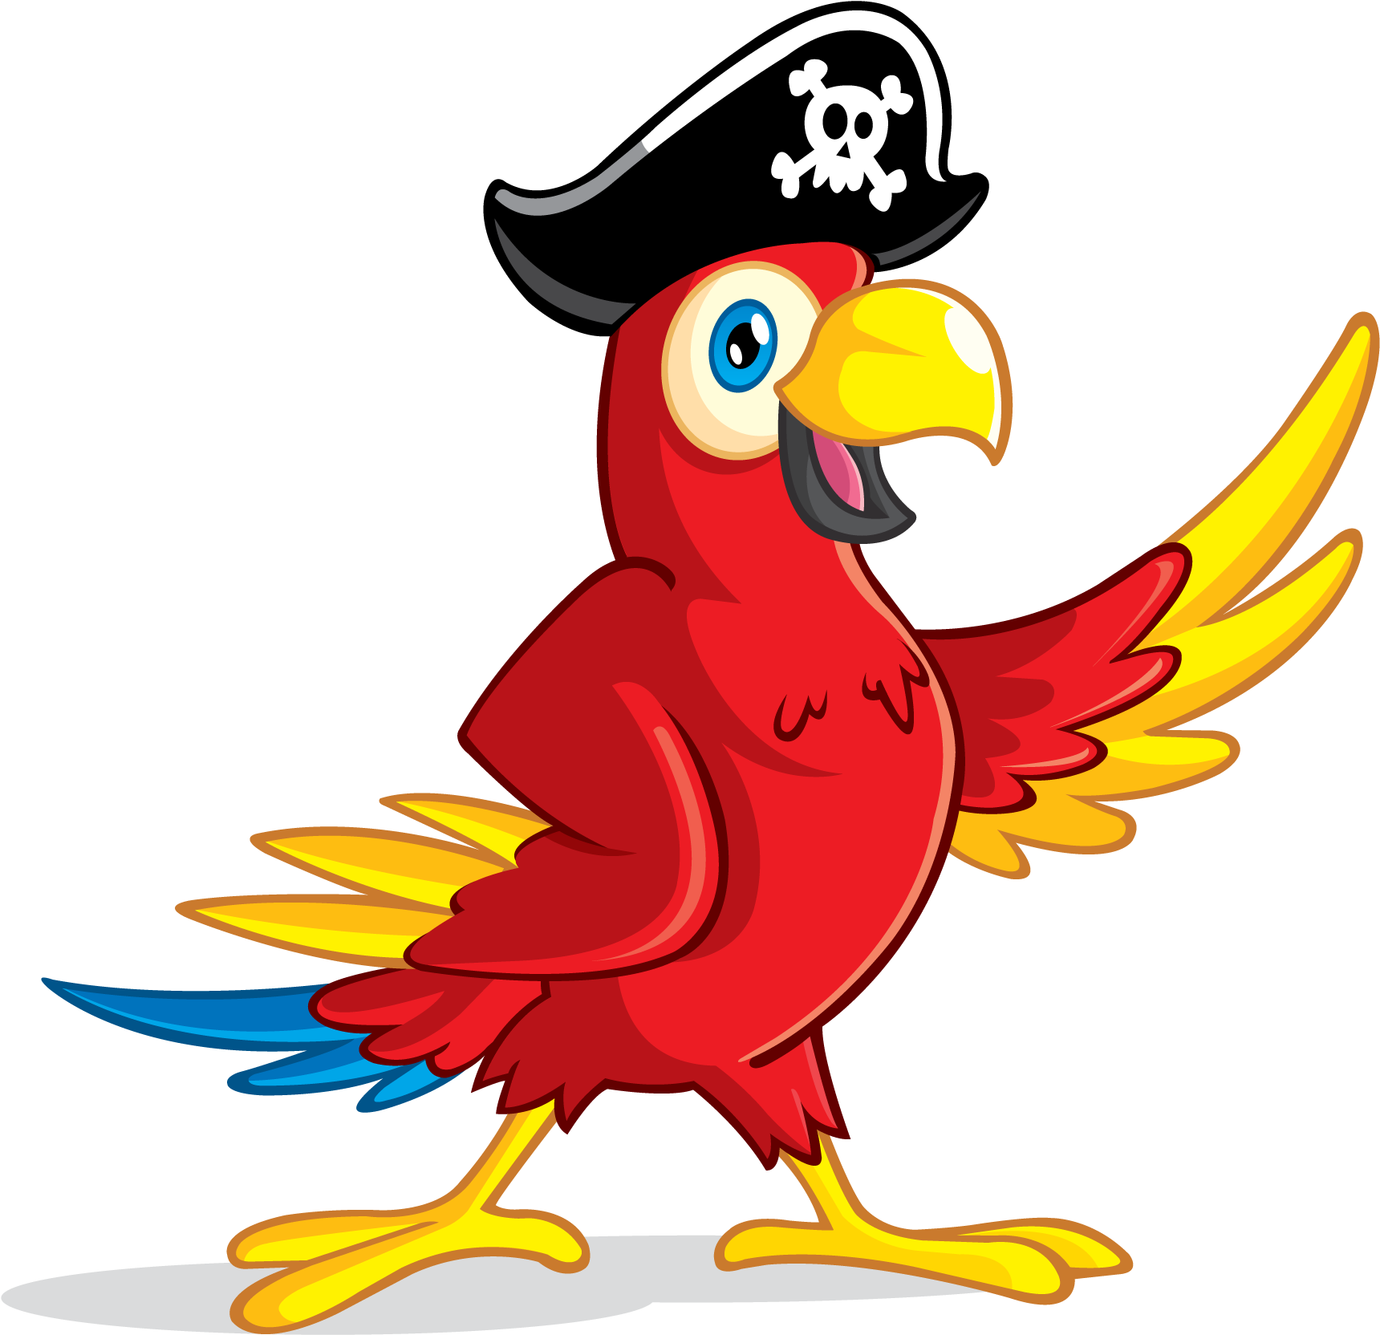
Activity 4:
Pirates ships all flew the ‘Jolly Roger.’
Let’s focus on this fact:
Using the information below, write a sentence explaining why this fact is true and draw a picture of the ‘Jolly Roger Flag.’
You could start like this:
‘Pirate ships all flew the ‘Jolly Roger’ because….
It was used to scared people.
The ‘Jolly Roger’ was a skull and cross bones.
Some flags were red and some were black.

