Slide 1
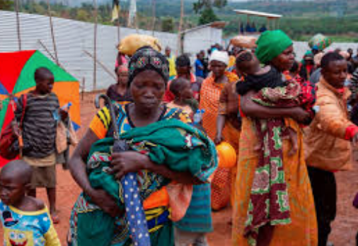
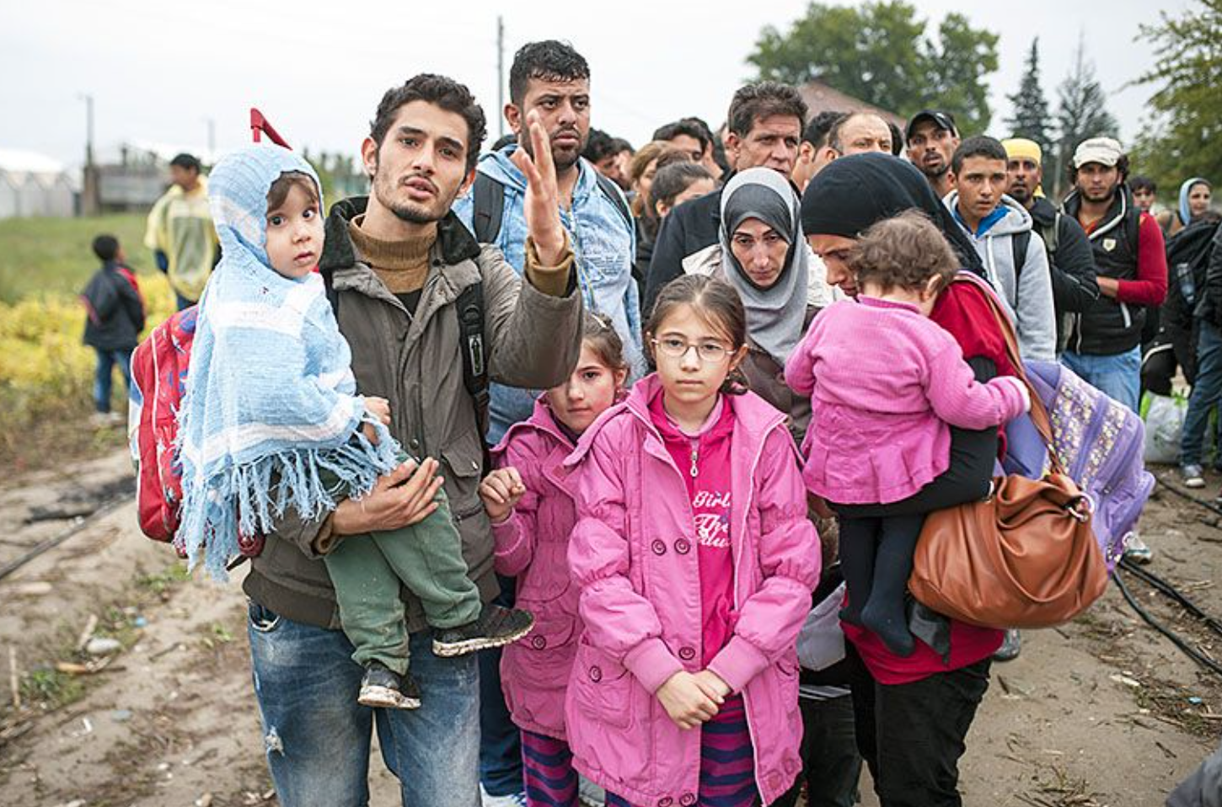
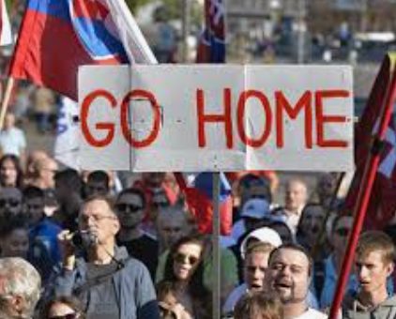
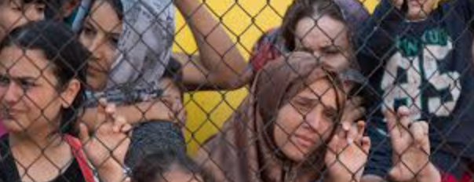
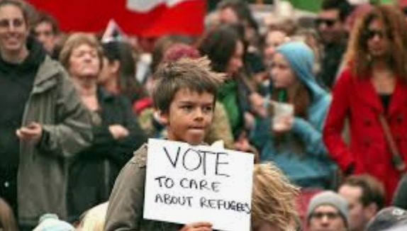
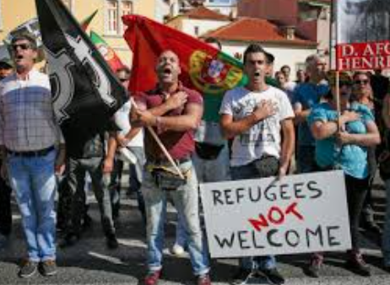
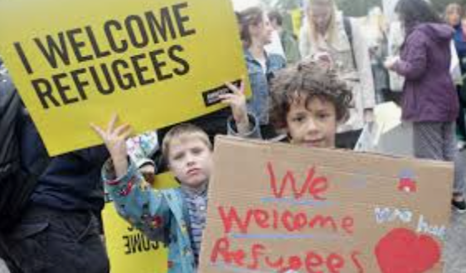
Refugees

Slide 2
Asylum Seeker | Someone who leaves their homeland to go to another country because they don’t feel safe in their own country. They stay in the new country while the government decide if they have a genuine claim.
Refugee | Someone who has proven to the government of their new country that they cannot return home so they are allowed to stay forever.
Migrant | Someone how has left their home to go to new places to find a better or safer life.
Persecution | Mistreating a person because of who they are and/or what they believe. This could be their race, religion, political belief.

Slide 3
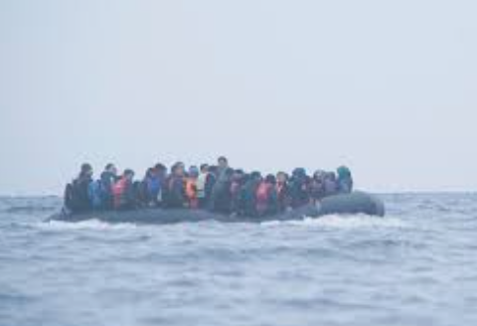
Why do people become refugees?
Push Factors
Pull Factors
Poverty
War
Famine
Drought
Persecution
Lack of education
No jobs
Corrupt leaders
Lack of freedom
Stable and safe home
Freedom
Fair leaders
Education
Medical care
Family
Better jobs

Slide 4
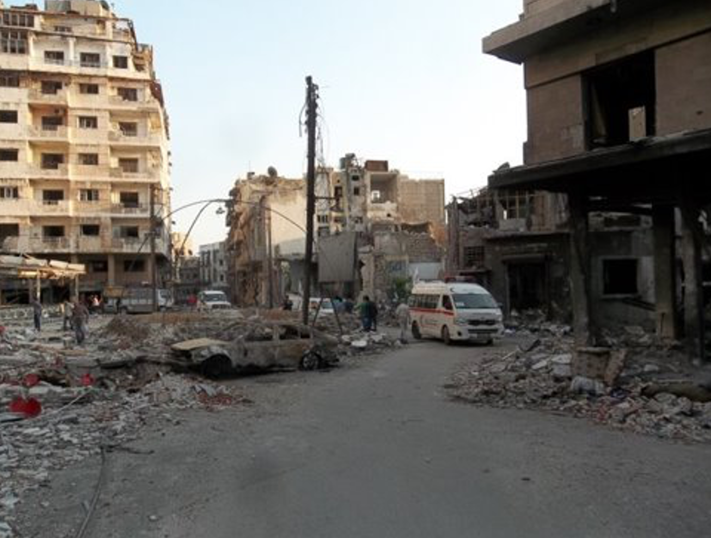
Should I stay or should I go?
There is fighting in your country.
Every night you can hear bombs and fighting.
Lots of people have already left.
Young people are being taken to become soldiers.

Slide 5
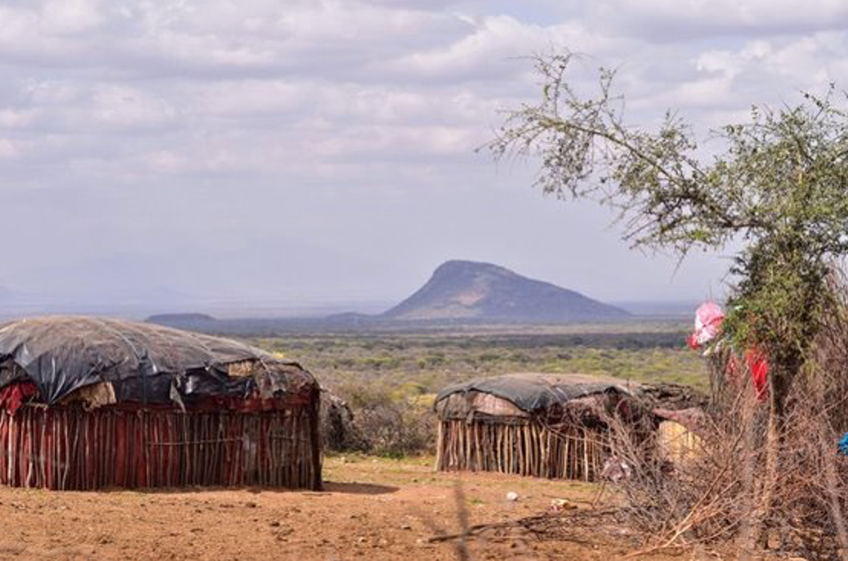
Should I stay or should I go?
There has been no rain for years.
You cannot grow food or crops to sell.
Lots of people are hungry.
Fresh water is a long walk away.
School is too expensive.

Slide 6
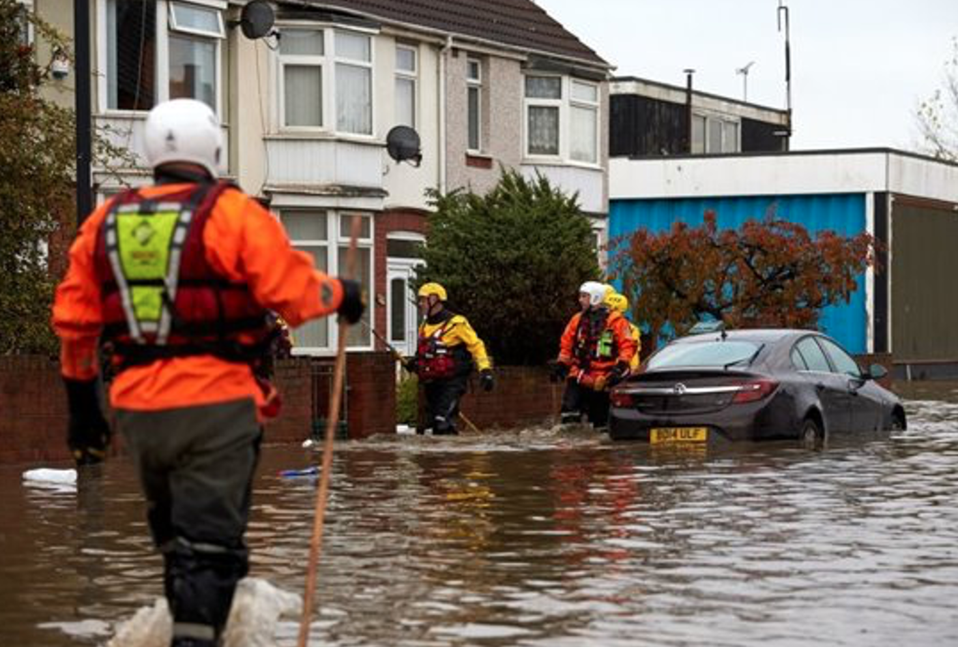
Should I stay or should I go?
The next village is flooded, water will come in to your house soon.
This happens every year when it rains heavily.
You have had to move our of your own house so you are now sharing with family. The house is very cramped.

Slide 7
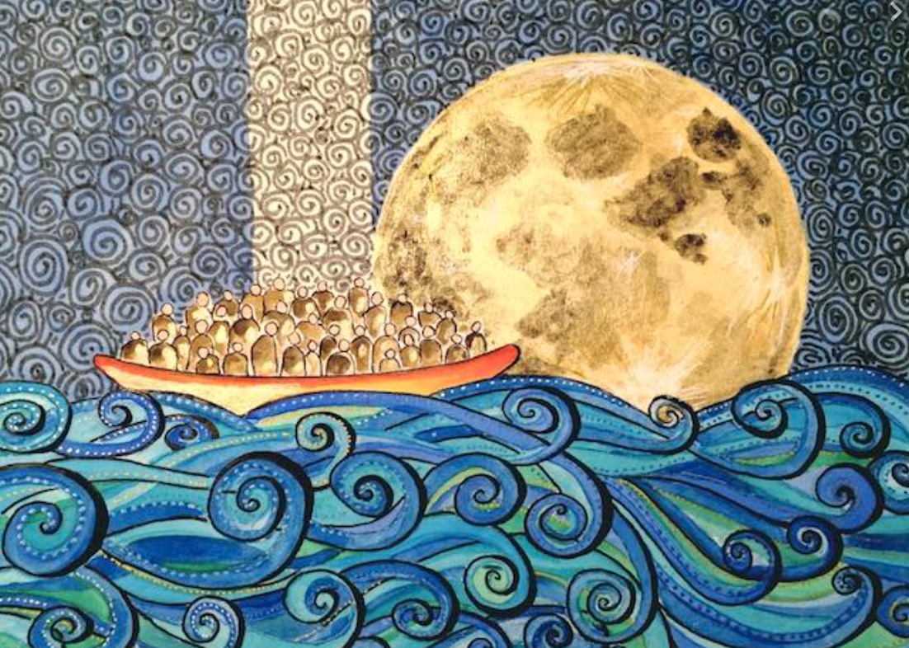
Can you answer the following questions?
What is a refugee?
Why might they seek a new home?
How would you feel if you had to leave your home? Give at least three emotions and reasons why you’d feel that way.
Should safer countries welcome refugees?

