Slide 1
Menu
Week 1 Day 1
Fluency
Complete these questions.
Problem Solving
Write the three missing digits to make this addition correct.
1. 847 - 100 =
2. = 375 + 789
3. 85 ÷ 5 =
4. 37 × 6 =
5. 383.49 – 74.84 =
6. 0.8 ÷ 10 =
747
Reveal answer
3
8
 | 1
4 |  | 4
7 | 9 | 2
1164
Reveal answer
+
7
Reveal answer
17
Reveal answer
222
Reveal answer
Reasoning
308.65
15 × 6.1 = 91.5
Prove it!
Reveal answer
0.08
Reveal answer

Slide 2
Monday 1st February 2021 LO: Can I calculate Volume of shapes?
I understand volume
I know the formula
I can apply it to find the answer

Slide 3
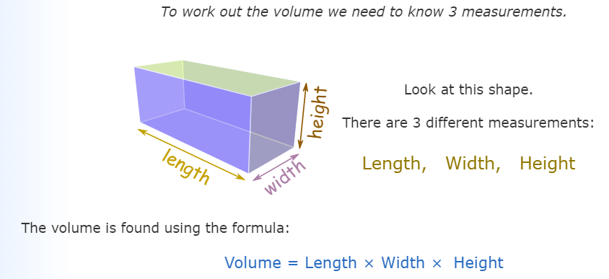
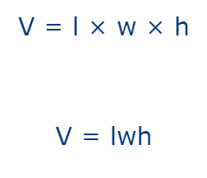

Slide 4
Why this formula works?

Slide 5
Which volume is the correct measurement?
2x2x4
20 cubic units
Incorrect! Try again.
16 cubic units
Correct! Well done.
15 cubic units
Incorrect! Try again.
Next question

Slide 6
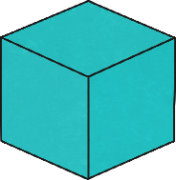
Which volume is the correct measurement?
4x4x4
12 cubic units
Incorrect! Try again.
16 cubic units
Incorrect! Try again.
64 cubic units
Correct! Well done.
Next question

Slide 7
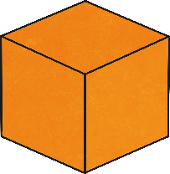
Which volume is the correct measurement?
2x6x3
12 cubic units
Incorrect! Try again.
36 cubic units
Correct! Well done.
18 cubic units
Incorrect! Try again.
Next question

Slide 8
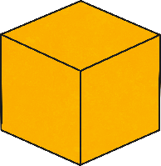
Which volume is the correct measurement?
3x4x4
12 cubic units
Incorrect! Try again.
48 cubic units
Correct! Well done.
50 cubic units
Incorrect! Try again.
Next question

Slide 9
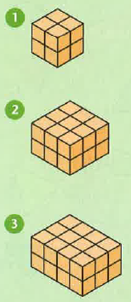
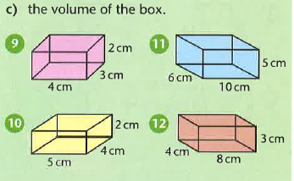
Questions

Slide 10
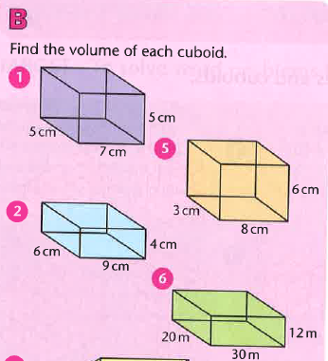
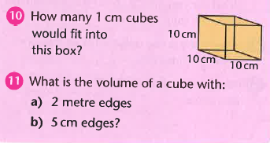
Questions

Slide 11
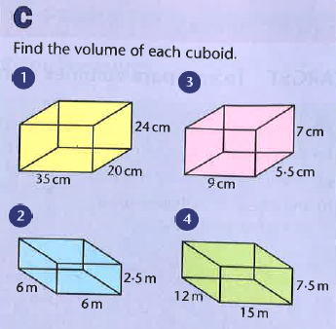
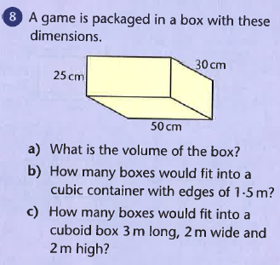
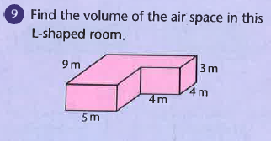
Questions
Challenges

Slide 12
Answers
A | B | C
1. 8 cubic cm 2. 18 cu cm 3. 24 cu cm 9. 24 cu cm 10. 40 cu cm 11. 300 cu cm 12. 96 cu cm | 1. 175 cu cm 2. 216 cu cm 5. 144 cu cm 6. 7200 cu cm 10. 1000 11. a) 8 cu cm b) 125 cu cm | 1. 16800 cu cm 2. 90 cu m 3. 346.5 cu cm 4. 1350 cu m 8 a) 37500 cu cm b) 90 c) 320 9. 183 cu m

