Slide 1
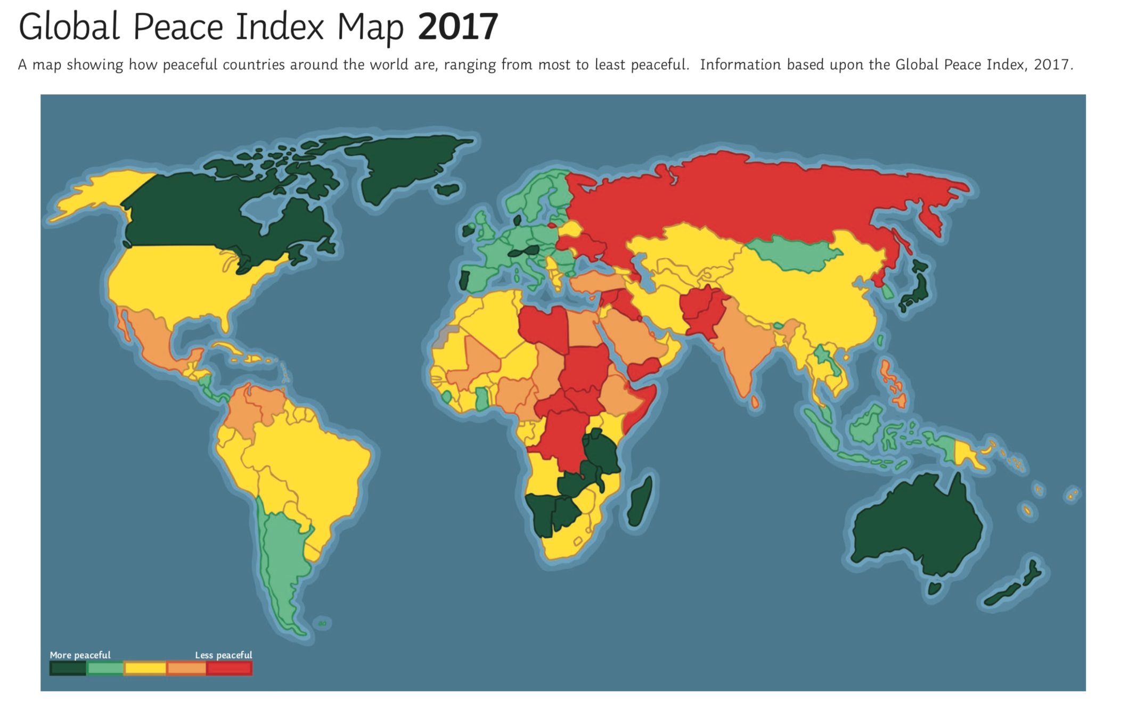
Where is the UK?
Look at the key. Can you find the colour that represents the most peaceful countries? Can you recognise any of them?
Can you identify any of the least peaceful countries?

Slide 2
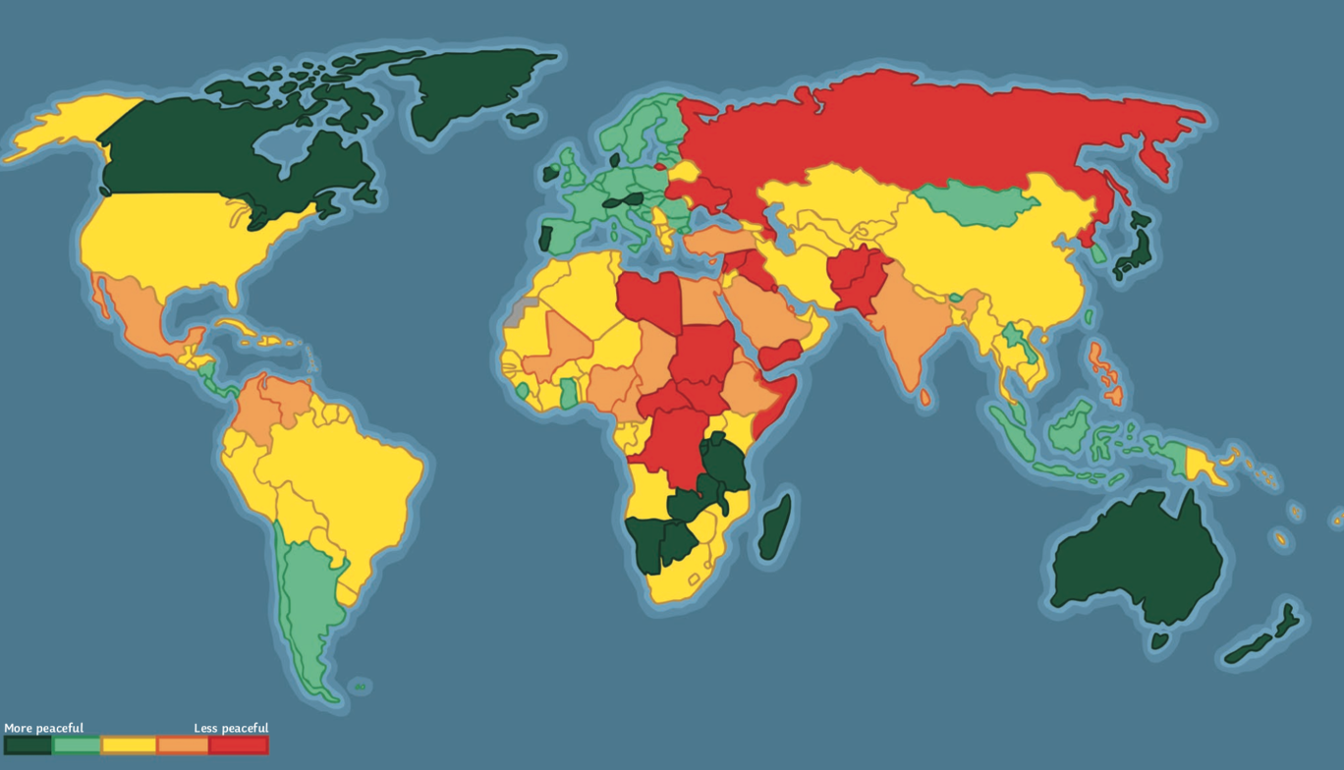
Afghanistan
Syria
Pakistan
Russia
Sudan
Libya
Iraq
Canada
Japan
Democratic Republic of the Congo
China
Zambia
Australia
Botswana
Namibia
New Zealand
Tanzania
Yemen
Central African Republic
South Sudan
Somalia
Madagascar

Slide 3
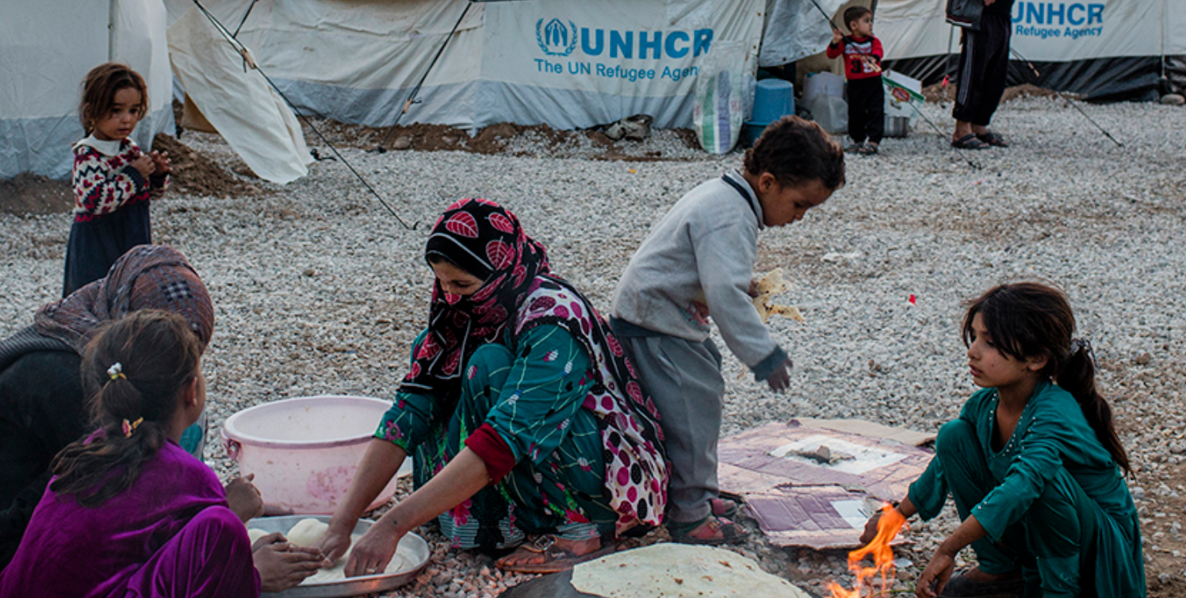
Why don’t some people or countries want refugees?
Some people believe they will fill jobs that means it is hard for people born in that country to find employment.
Some feel that adding people from different cultures could disrupt the peace in their country.
Some countries believe only refugees that share their religion should be welcome.
Why are refugees kept in detention centres?
Sometimes people are kept in immigration detention centres while the government of the country they have arrived in can carry out health, identity and security checks.
These are different to the Refugee Camps. These are temporary facilities built to provide an immediate safe place for refugees forced to leave their homes because of conflict or persecution. Here people can find food, shelter and medical assistance.

Slide 4
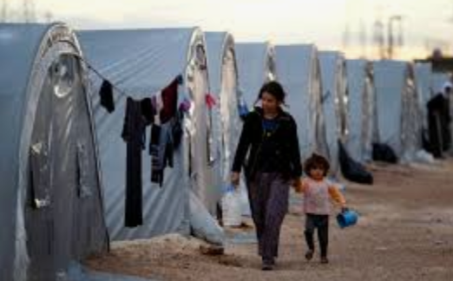
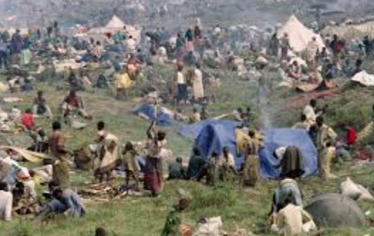
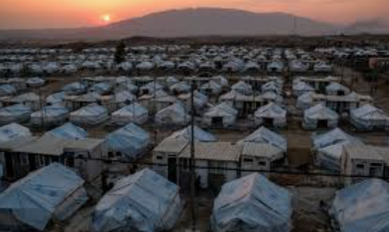
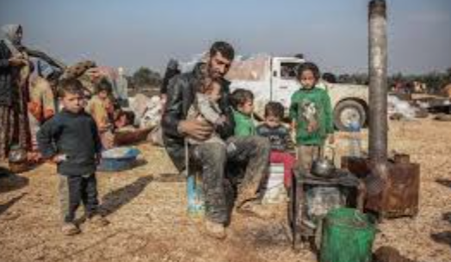
26th January 2021.
Topic Task
Imagine you wake up tomorrow morning and 500 refugees have arrived on the street where you live.
You are the first person to wake up, so you have to take control and start to organise the refugees.
The refugees have nothing other than the clothes they are wearing; some don’t even have shoes. They are tired and hungry.
Write a list of things the refugees need?
Begin with the most important. What do people need right now and what can wait until tomorrow, what is just a nice to have item?

