Slide 1
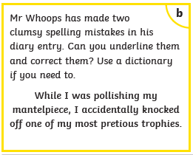
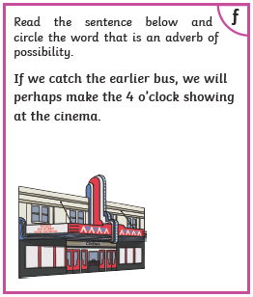
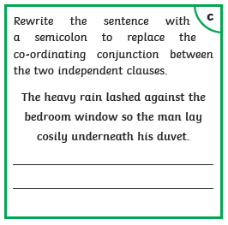
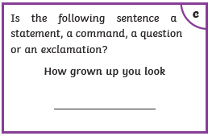

Slide 2
Tuesday 2nd February 2021
LO: Can I analyse character dynamics in Skellig?
Success Criteria
To recap knowledge of Leakey and Coot.
To roleplay in the characters of Leakey, Coot, Mina and Michael.
To write a creative piece in the characters of Leakey, Coot or Mina.

Slide 3
Falling Out
Part of being human is finding out we have different opinions and can disagree. Sometimes, these disagreements can turn into arguments. Discuss the following with your partner.
Who do you fall out with most often?
Do your agreements tend to happen in person, or are they often on social media or via text?
What subjects most often cause disagreements?
Do you tend to argue more with people you are close to?
Have you discovered ways to control conflict or avoid it getting out of hand?
How do you feel when you argue with someone?

Slide 4
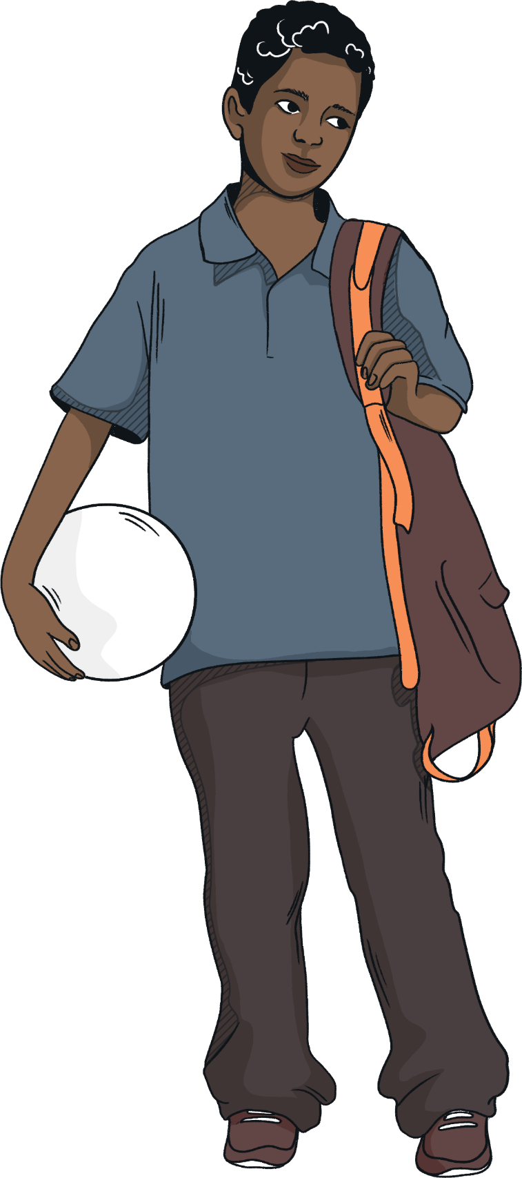
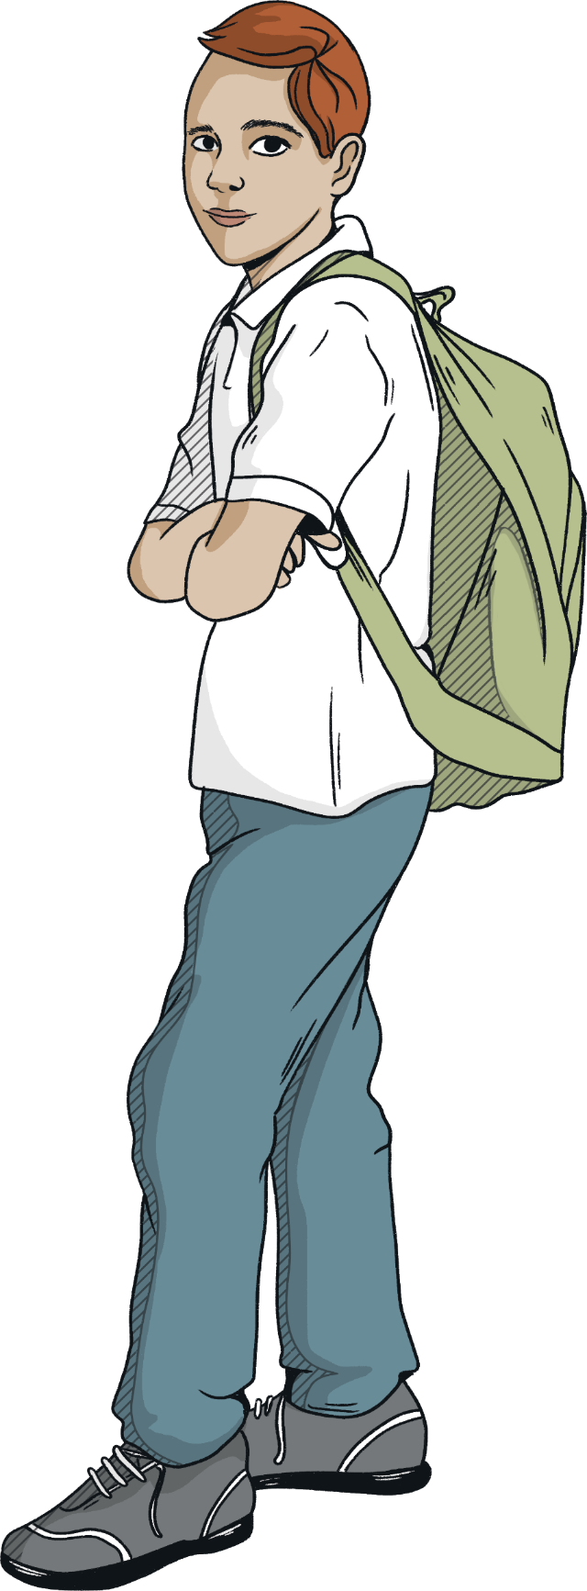
Leakey and Coot
Who are Leakey and Coot? What do we know about them so far?
They like football
They like to tease Michael
Unintentional teasing
Same school
Around Michael quite a lot
Strong opinions
They are quite close

Slide 5
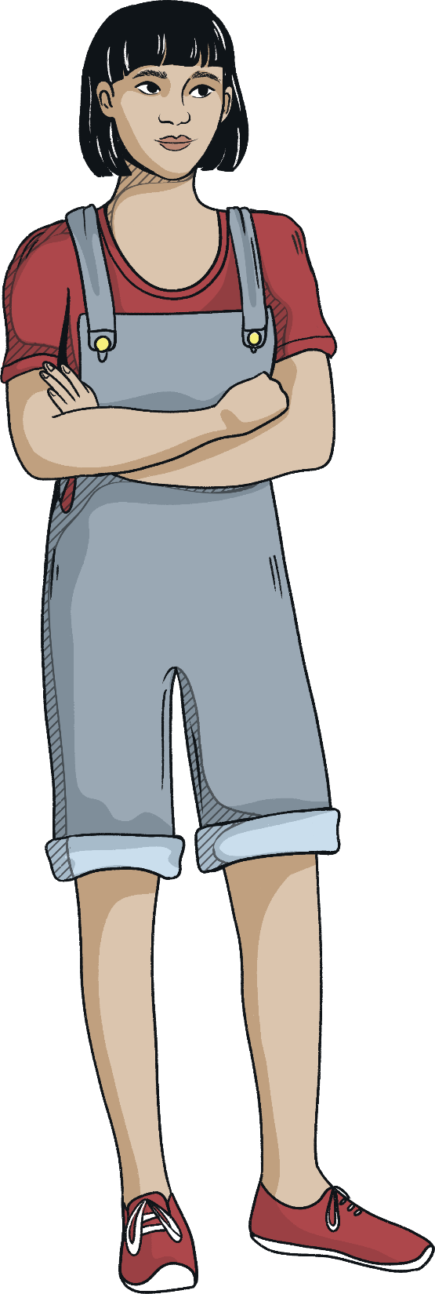
Conflict
Michael is torn between two worlds. On one side, he has Leakey and Coot, his friends from school, who think he is behaving strangely and don’t understand why. On the other side, he has Mina who understands what is troubling him, but doesn’t understand his relationship with Leakey and Coot, or school.
What advice would each of these people give to Michael about his current situation?
You should…
You ought to…
Why don’t you…
You should…
You ought to…
Why don’t you…

Slide 6
Chapter HIGHLIGHTS
Chapter 27
M terrible at football
Leakey/Coot tease him over Mina + football
They call her a monkey/crow
Chapter 28
Garage boarded up/ trembled due to age and condition
Leakey+Coot recommend knocking the structure- Grandad a builder
Michael informs both – Mina is home schooled
M desperate to reveal about Skellig
Chapter 29
M + Mina argue over best type of educational setting?
Michael absent from school
M breaks down over the argument with Mina
Mina feels disliked – L + C

Slide 7
Chapter HIGHLIGHTS

Slide 8
Dear Diary…
ACTIVITY
You’re now going to try writing a diary entry covering events in Chapters 27, 28 and 29. You can choose to be Leakey, Coot or Mina.
In your diary entry you should:
explain what has happened;
explain what your point of view is;
explain how you feel about Michael;
come up with an idea to resolve the conflict.
Remember to write in the first person.
Word Bank
Angry
frustrated
Confused
sporty
Arrogant
boring
Cruel
complicated
Unkind
thoughtful

