Slide 1
Aim
I can use ‘an’ or ‘a’ correctly.
Success Criteria
I can tell you what a vowel or consonant is.
I can identify words beginning with a vowel or consonant.
I can explain the rule for using ‘an’.
I can write independently using ‘an’ or ‘a’ correctly.

Slide 2
Using ‘An’ or ‘A’
Can you write 6 consonants on down in 10 seconds?
How do
you know that they are consonants?
Consonants are letters (or sounds) that are not vowels (a, e, i, o, u). For example j, d and z are all consonants.

Slide 3
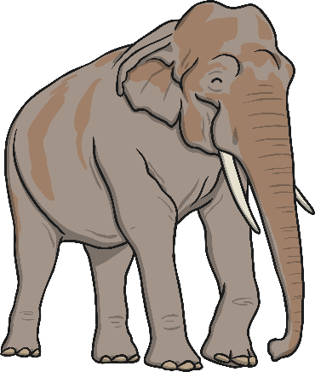
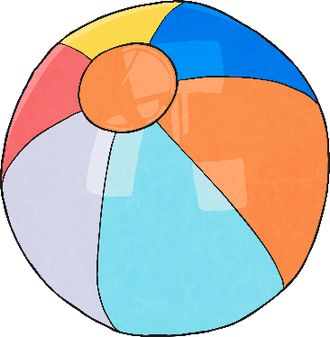
Using ‘An’ or ‘A’
Play the odd one out activity.
Use ‘an’ or ‘a’ to find the odd one out.
elephant
ball
hat

Slide 4
Using ‘An’ or ‘A’
The odd one out was…
an elephant
a ball
a hat

Slide 5
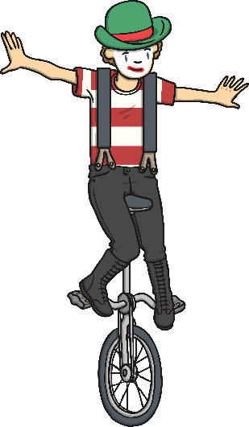
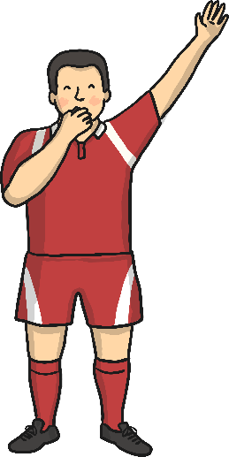
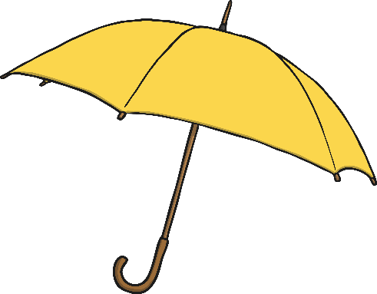
Using ‘An’ or ‘A’
Play the odd one out activity.
Use ‘an’ or ‘a’ to find the odd one out.
umbrella
unicycle
umpire

Slide 6
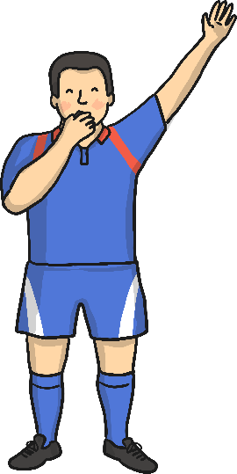
Using ‘An’ or ‘A’
The odd one out was…
A unicycle is difficult to ride.
Although unicycle begins with a vowel, the sound is not a vowel sound. The ‘u’ makes a ‘y’ sound.
an umbrella
a unicycle
an umpire
Can you write a rule about using ‘an’ or ‘a’ on a whiteboard?

Slide 7
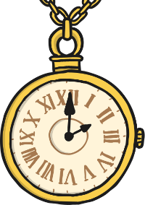
Using ‘An’ or ‘A’
Your rule about using ‘an’ or ‘a’ should sound like this:
Use ‘an’ before a word that starts with a vowel sound.
For example:
an elephant
an umbrella
an hour – ‘hour’ does not start with a vowel (a, e, i, o or u) but it does start with a vowel sound.
an hour because the ‘h’ is silent. Tricky!

Slide 8
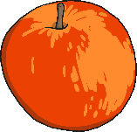
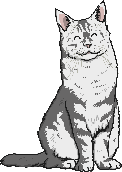
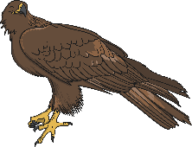
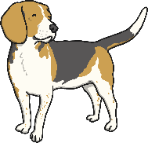
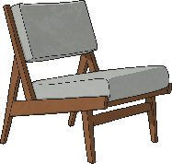
Using ‘An’ or ‘A’
Look at these words below and decide whether ‘an’ or ‘a’ should be used beforehand.
an
apple
hand
cat
hour
eagle
umbrella
a
dog
chair
UFO

Slide 9
Using ‘An’ or ‘A’
The answers are shown below:
an
umbrella
apple
hour
eagle
a
chair
hand
dog
cat
UFO

