Slide 2
Palm Sunday
Holy Week begins on Palm Sunday. On this day, Jesus sent two of his disciples to find a young donkey and bring it to him so that he could ride into Jerusalem.

Slide 3
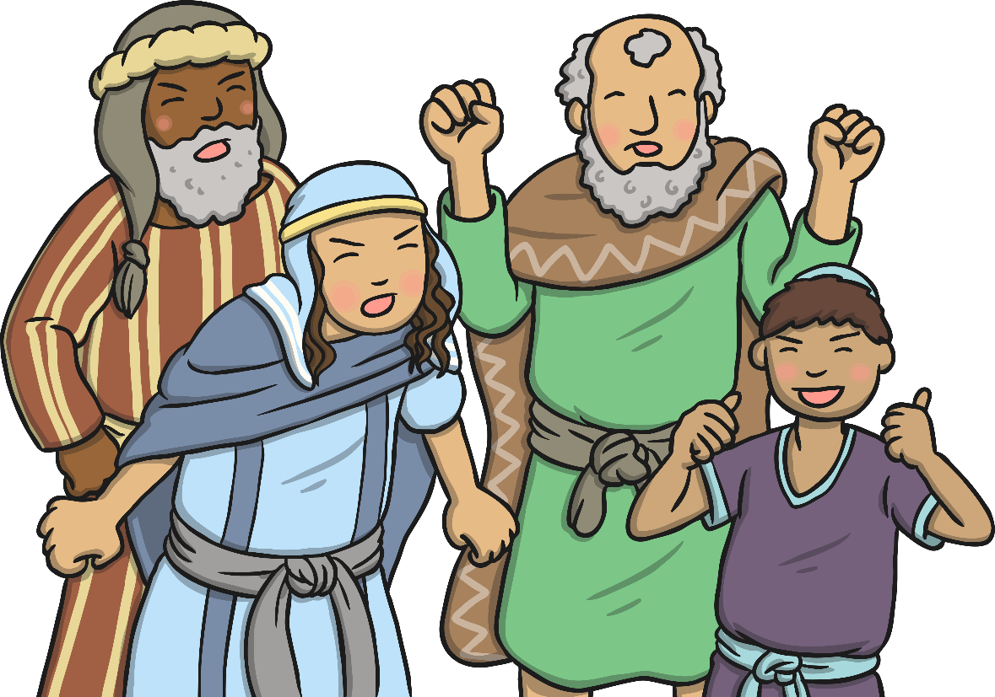
Palm Sunday
The disciples brought the donkey to Jesus and spread their cloaks over its back for him to sit on. As Jesus approached Jerusalem, crowds gathered, waving palm branches and shouting “Hosanna!”
The people were very pleased to see him.

Slide 4
Jesus at the Temple
Jesus entered the Temple. He was horrified to see that people had set up market stalls and were buying and selling things.
Jesus shouted, “My house shall be a house of prayer, but you have turned it into a den of robbers!”
He was very upset that people were not treating the Temple with the respect that they should.

Slide 5
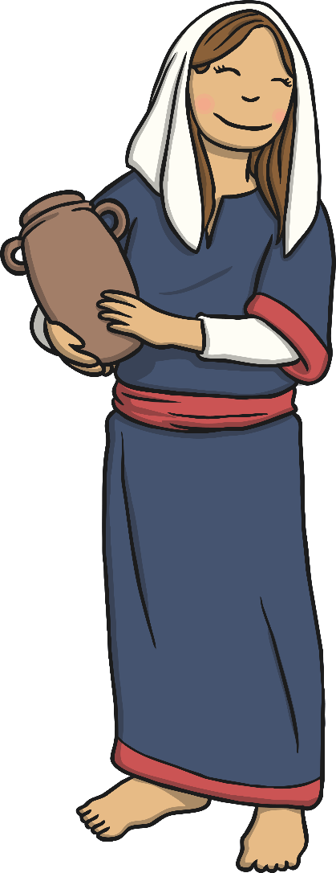
A Woman Washes Jesus’ Feet
While Jesus was at Bethany, a woman arrived carrying an alabaster jar full of expensive perfume.
The woman poured the perfume on Jesus’ head. The disciples were cross, saying that the perfume was expensive and it was now wasted when it could have been sold and the money given to the poor.
Jesus explained that the woman had done what she had to show kindness and respect towards him.

Slide 6
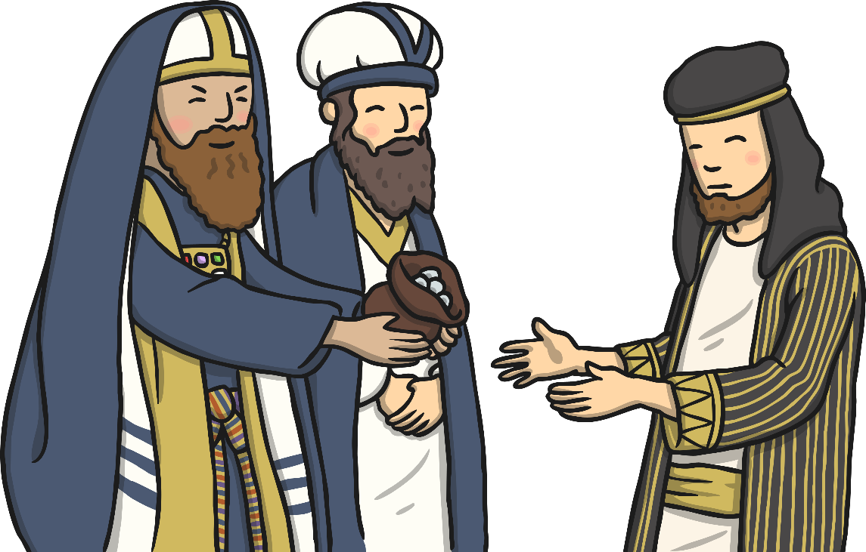
Wednesday
Later that day, Judas Isacariot, one of Jesus’ disciples, planned to betray Jesus to the chief priests and teachers of the law.
He went to them and said “What are you willing to give me if I take you to Jesus?”
They were delighted, and agreed to give him 30 silver coins.

Slide 7
Thursday
The Jewish people were soon to be celebrating Passover. Jesus was going to celebrate it with his twelve disciples. He asked them to take him to an upstairs room and there prepare the meal. This was to be The Last Supper.

Slide 8
Thursday
Then Jesus and the twelve disciples went to the Mount of Olives.
It was here that Jesus spoke to Peter. He said, “Before the cock crows three times today, you will say that you don’t know me, three times.”
Peter was very upset, and said, “I would never do that Lord. Even if all the others fall away from you, I never will.”

Slide 9
The Garden of Gethsemane
Jesus went to pray on the Mount of Olives. He asked the disciples to keep watch for him, but they fell asleep.

Slide 10
Early Friday Morning
A crowd of people arrived. Some were soldiers, others were chief priests and teachers of the law.
Suddenly Judas Isacriot stepped forward.
He walked towards Jesus, said “Rabbi!” which means ‘teacher’, and kissed him on the cheek. This was the sign he had agreed with the chief priests, so that they knew exactly who Jesus was.

Slide 11
Jesus is Arrested!
Soldiers stepped forward and grabbed Jesus. One of his friends brandished their sword to protect him, and cut one of the servant’s ears off. Jesus cried, “No more of this!” He healed the man’s ear.
As Jesus was led away, his disciples ran into the darkness. They were afraid they might get arrested too!

Slide 12
Good Friday
Jesus was taken to the Roman Governor Pontius Pilate. Pilate wanted nothing to do with this decision as he knew Jesus had not done anything wrong.
He got a bowl of water and washed his hands in front of everyone.
“This is nothing to do with me. I wash my hands of all responsibility!”

Slide 13
Good Friday
Jesus was taken away, where the soldiers laughed at him, beat him, stripped him of his clothes and instead, put a scarlet cloak around him. They put a crown of thorns on his head and laughed saying, “Look at the King of the Jews! Ha! Ha!”

Slide 14
Good Friday
As Jesus was being led away to be crucified, the soldiers saw a man called Simon walking along the path. They made Simon carry the huge wooden cross for Jesus.
After a long walk in the hot sun, they reached Golgotha, which is where Jesus was to be crucified.
Jesus was crucified on the hill between two other prisoners.

Slide 15
A Sad Day
The chief priests laughed and jeered at Jesus, saying “Come down from the cross then, if you’re the King of the Jews! Prove to us you can save yourself!”
Later that day, the sky turned black and Jesus cried out to God. Someone nearby soaked a sponge in wine, and held it up to Jesus to drink from it.
Soon after, Jesus died.

Slide 16
Jesus’ Tomb
Jesus’ body was placed in a tomb and a large stone was rolled across the entrance.
Jesus’ friends and disciples were very sad.

Slide 17
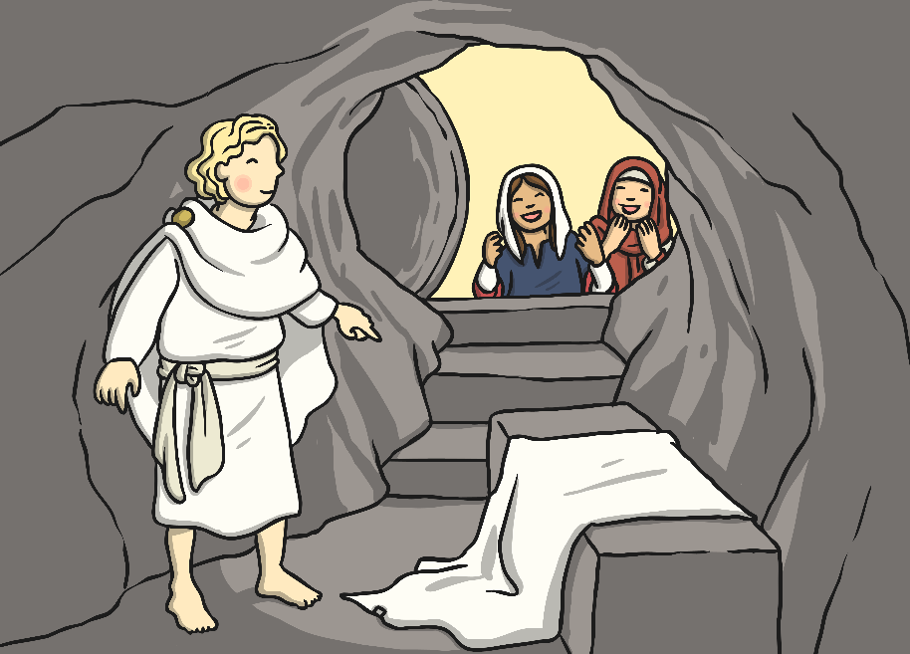
Easter Sunday
On the Sunday morning, Mary Magdalene and another lady also called Mary went to the tomb. When they arrived, they saw that the stone had been rolled away and an angel was there.
The women were overjoyed and ran to tell the disciples what had happened.

