Slide 1
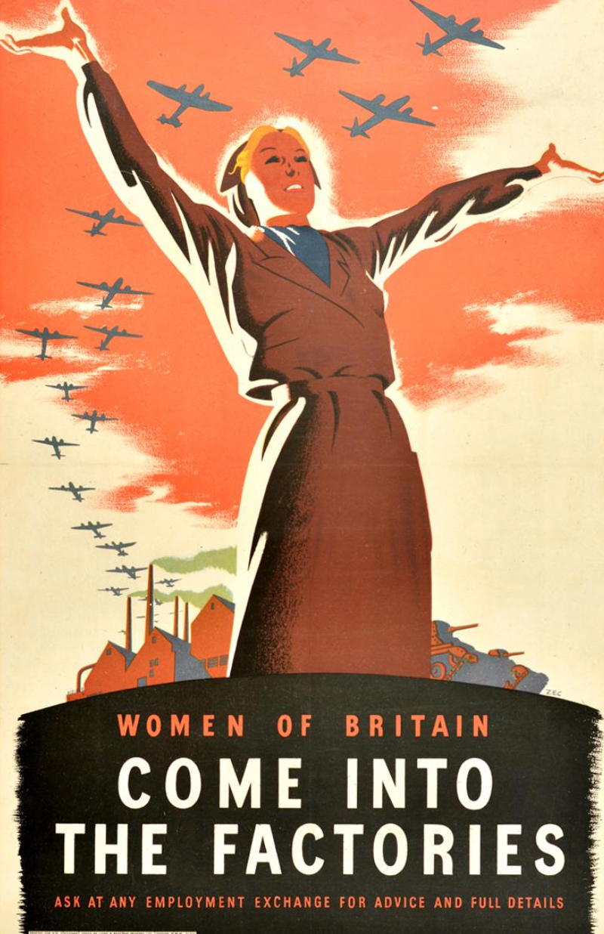
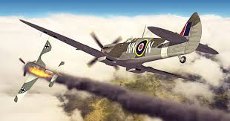
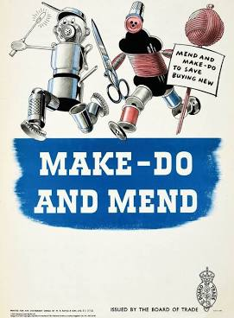
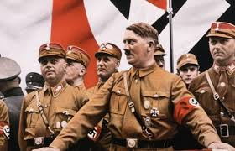
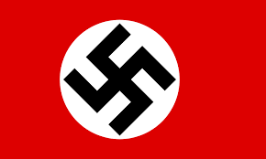
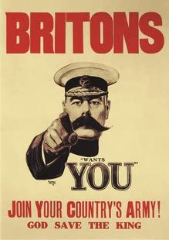
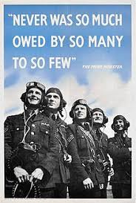
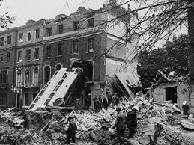
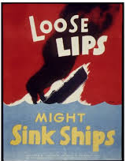
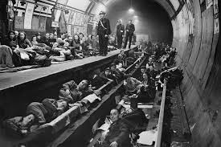
World War II
What do you think each of these pictures shows?

Slide 2
Now you need to fill in the table below (attached as a separate sheet to print out) or draw your own and send me at least five ideas in first two columns. We can revisit this sheet at the end of the topic.

Slide 3
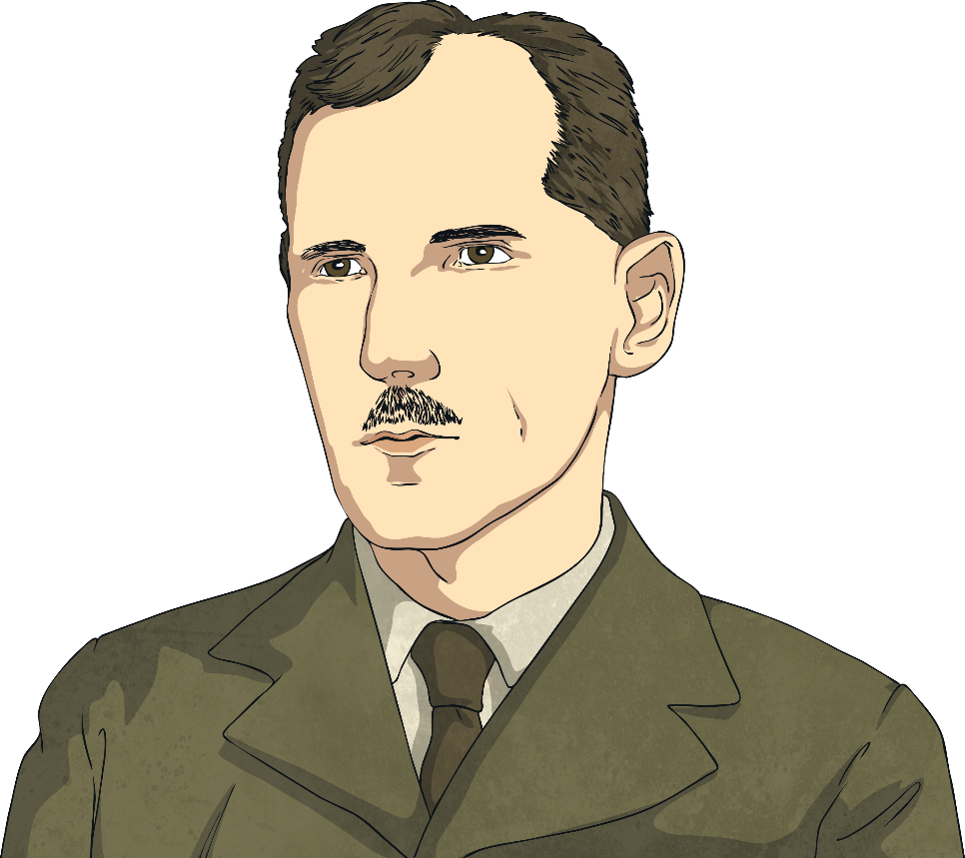
How Did the Second World War Start?
The origins of the Second World War were in the First World War. The First World War ended with an agreement called the Treaty of Versailles which was signed in 1919. The terms of the treaty stated that Germany had to totally disarm and pay reparations to some of the countries they had fought against. These reparations came to billions of pounds. Germany had to give away its colonies to France and the United Kingdom.
Talk About It
Do you think the terms of the Treaty of Versailles were fair? How do you think German people felt about it?

Slide 4
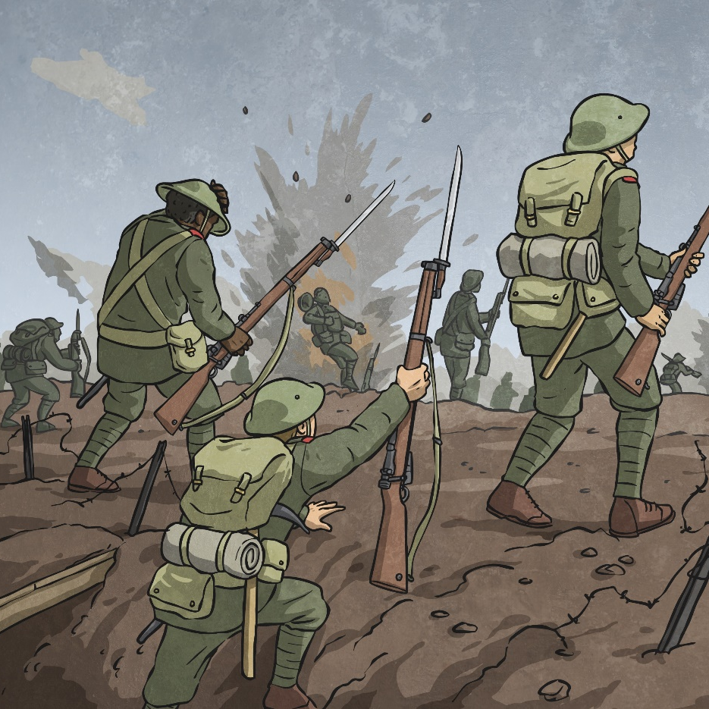
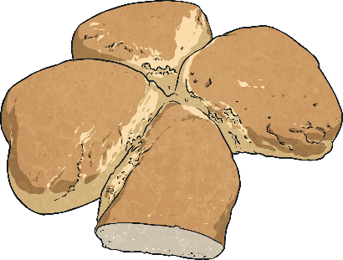
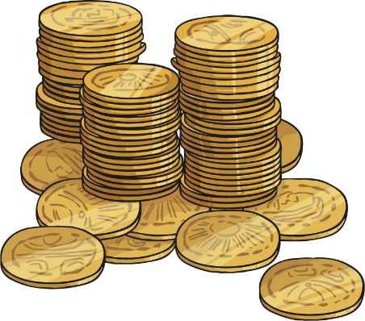
How Did the Second World War Start?
Paying reparations caused lots of financial problems in Germany. At one point, a loaf of bread cost so much money, you had to carry the money in a suitcase!

Slide 5
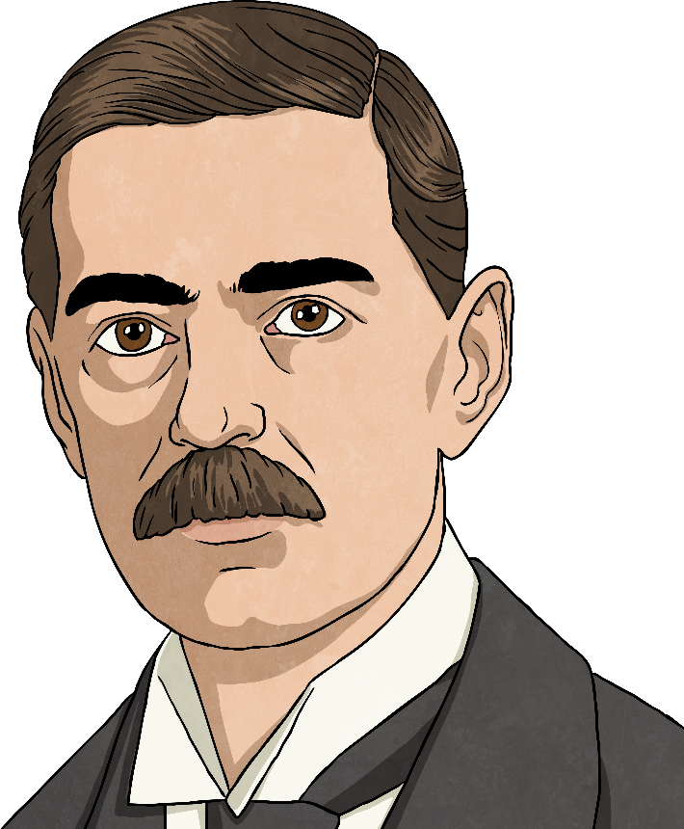
Neville Chamberlain
Listen to the audio footage of the then British prime minister, Neville Chamberlain, announcing to Britain that they were at war with Germany on 3rd September, 1939.
How do you think you would have felt to hear the announcement?
What questions would you have wanted to ask Mr. Chamberlain?

Slide 6
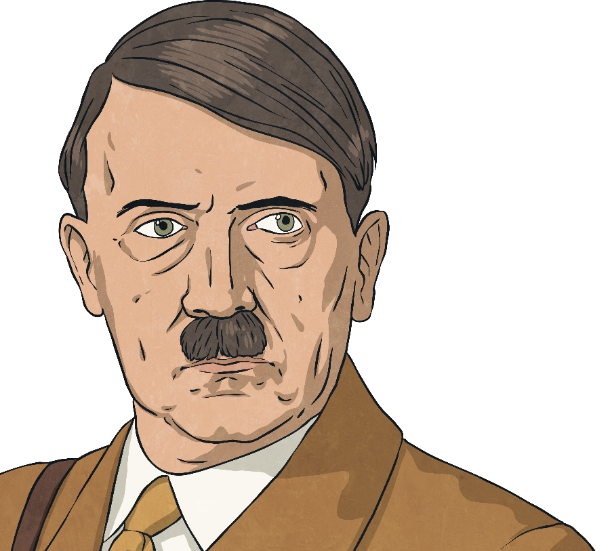
Adolf Hitler
living space
claimed as German land
Leader
Adolf Hitler was the Führer ( ) of Nazi Germany.
He had plans to invade and occupy as many countries as he could to gain Lebensraum ( ) for German people.
In 1938-1939 Hitler’s troops had already invaded and annexed ( ) Austria and Czechoslovakia.
Britain and France had promised to protect Poland if it was also invaded, so when Hitler refused to withdraw the troops that had marched into the country on 1st September 1939, Britain and France reacted.
Britain and France declared war on Germany on 3rd September, 1939.

Slide 7
Allies and Axis Powers
At the start of World War II, the Allies were the United Kingdom, France and Poland. These nations had made a pact to stand together against Hitler and the Axis Powers.
The Allies were soon joined by the British Commonwealth (South Africa, Canada, Australia and New Zealand) and then the Soviet Union, the United States of America and China.
Other Allies included British India, the Netherlands and Yugoslavia. In 1942, the Allies were officially named as the United Nations.
The Axis Powers were Germany, Japan and Italy, who made a pact to stand together in opposition to the Allies.
Colour in your World War II Colouring Map Activity Sheet to show the Allies, Axis Powers, and the Axis-controlled and neutral countries.

Slide 8
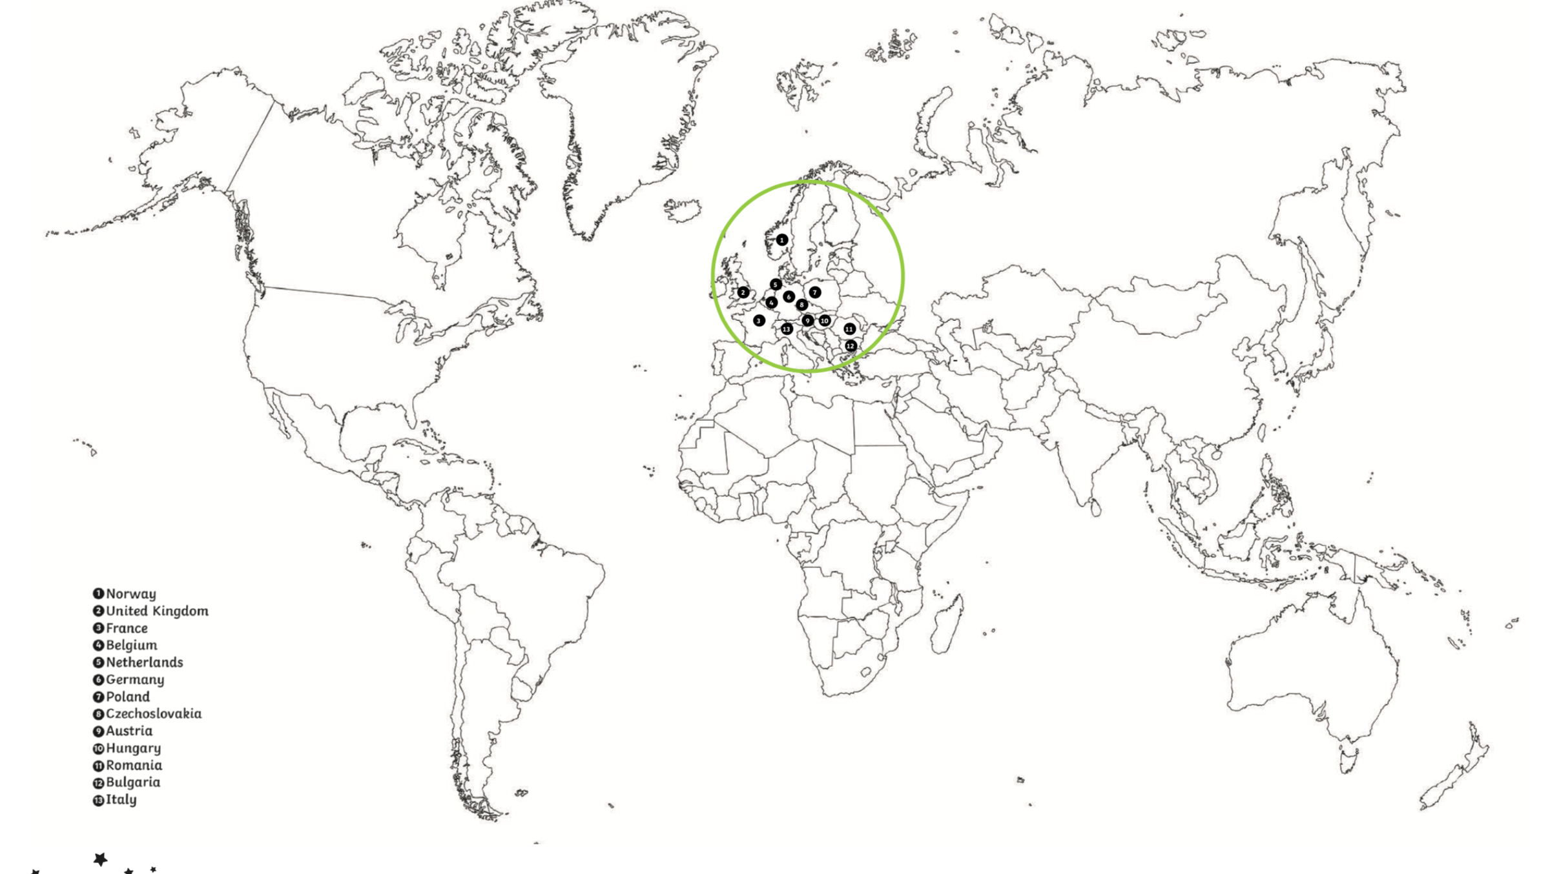
World Map Showing Allied, Axis and Axis Controlled Countries.

Slide 9
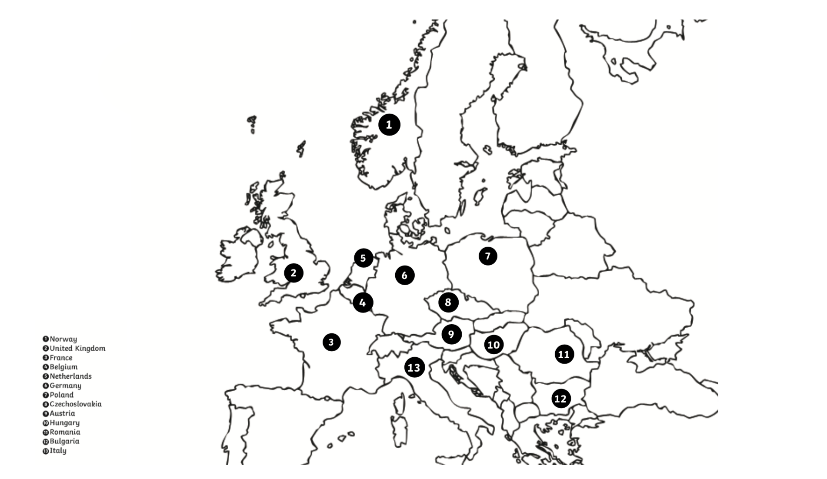
Map of Europe
Make a key, then colour in the Axis countries, Axis controlled countries and the Allied countries. If you do not have a printer then write a list in a table, under the headings, Allies, Axis and Axis Controlled.

