Slide 1
BINGO

Slide 2
Maths Mastery
Calculate, Estimate and Compare Volume of Cubes and Cuboids

Slide 3
Tuesday 2nd February 2021 LO: Can I compare Volume of shapes?
I understand volume
I know the formula
I can apply it to find the answer

Slide 4
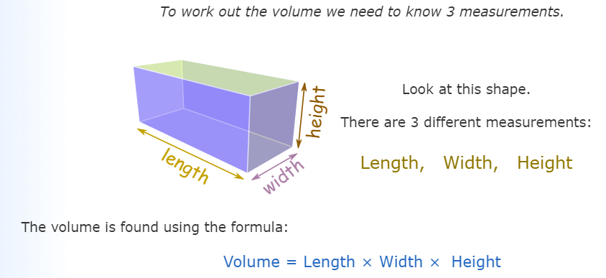
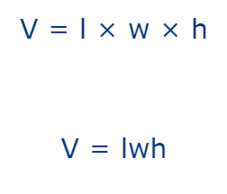

Slide 5
Calculate the Volume of Cuboids
Complete this table:
Length (cm) | Width (cm) | Height (cm) | Volume (cm³)
5 | 20 | 3
11 | 6 | 6
4 |  | 9 | 432
9 | 9 | 3
 | 11 | 1 | 154
15 | 4 |  | 420
Length (cm) | Width (cm) | Height (cm) | Volume (cm³)
5 | 20 | 3 | 300
11 | 6 | 6 | 396
4 | 12 | 9 | 432
9 | 9 | 3 | 243
14 | 11 | 1 | 154
15 | 4 | 7 | 420
Show
Answers
Hide
Answers

Slide 6
Compare
Here are three 3D shapes. Order them from smallest volume to largest volume.
C
A
B
5m × 5m × 5m 3m × 4m × 10m 9m × 2m × 7m
125m³ 120m³ 126m³
Smallest B, A, C Largest
Show
Answers
Hide
Answers

Slide 7
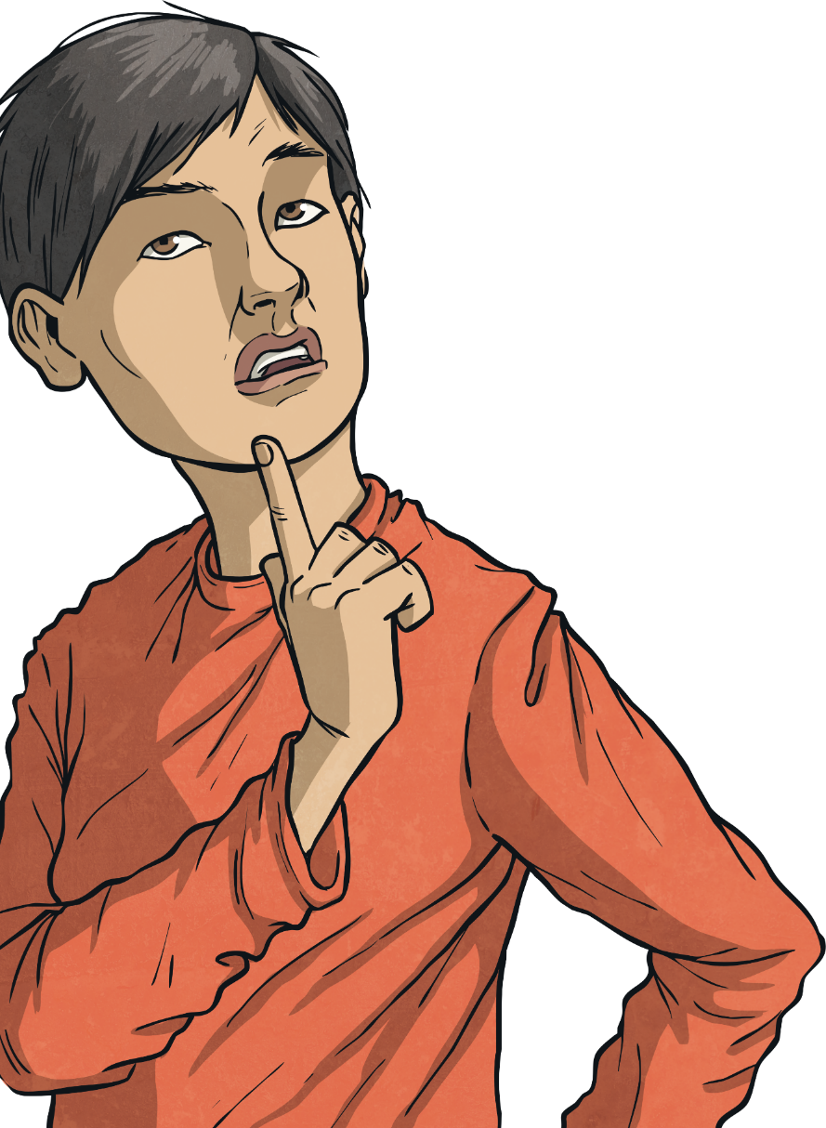
Compare Volume
Diving
Which of these shapes has the greatest volume?

Slide 8
Compare Volume
Diving
Use < and > symbols to compare these:
<

Slide 9
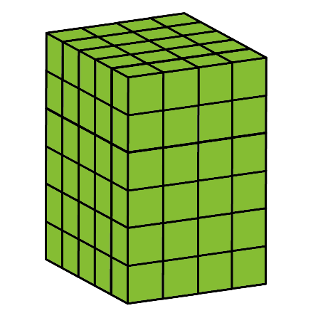
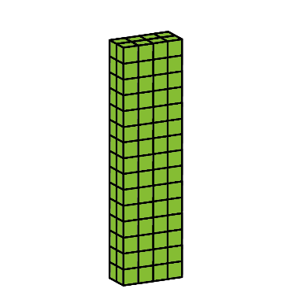
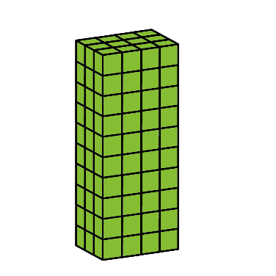
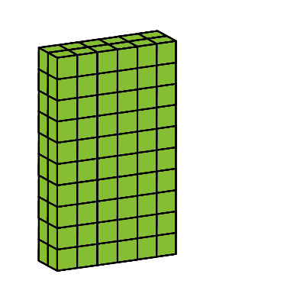
Compare Volume
Deeper
What is the volume of this cuboid?
120cm³
Could these cubes be arranged any other way?

Slide 10
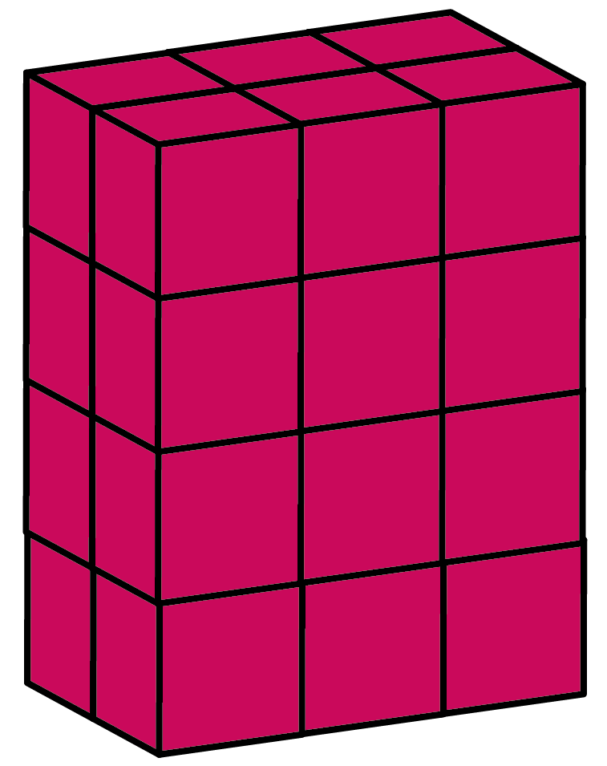
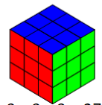
Compare Volume
Deeper
Amelie has made a shape out of 1cm cubes. Its volume is smaller than the blue model but greater than the pink model.
What could her shape look like? Make or draw it!
What could its volume be?
25cm³ to 29cm³

Slide 11
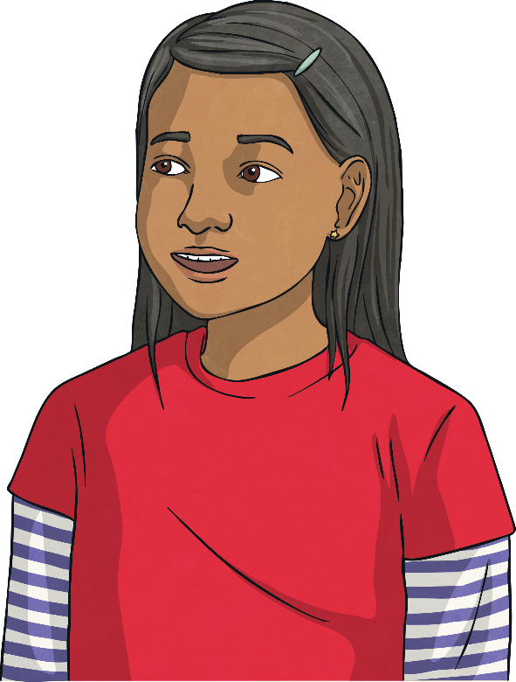
Compare Volume
Deepest
A shape made of 1cm cubes with a base that is 3cm long and 2cm wide can’t have a volume greater than this shape.
Is Sam correct?
No. We only know that the base layer of cubes is equal to 6cm³ – the shape could be any height.

Slide 12
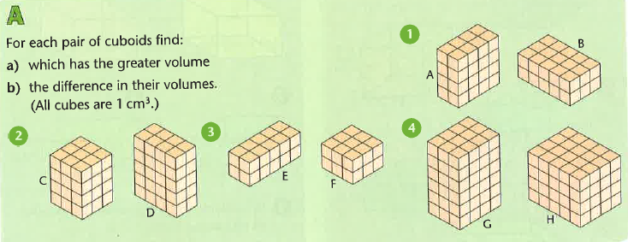
Questions

Slide 13
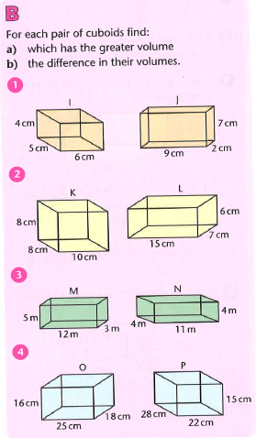
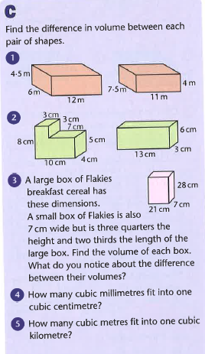
Questions

Slide 14
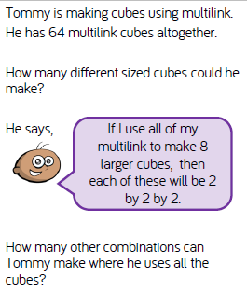
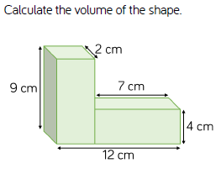
Challenges

Slide 15
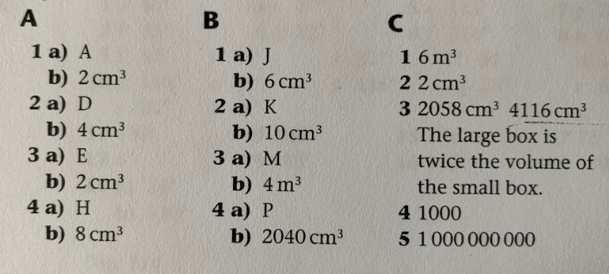
Answers

Slide 16
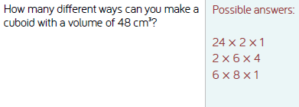
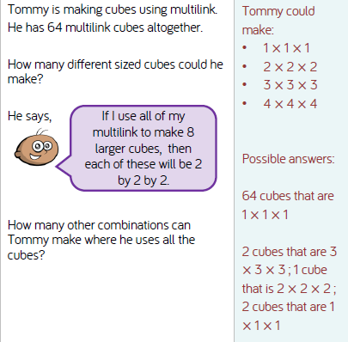
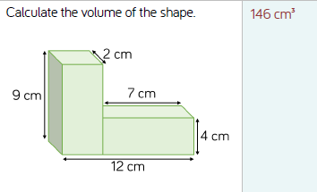
Answers – challenges

