Slide 1
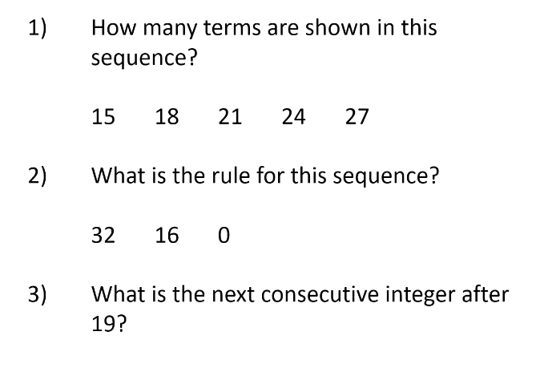
Consecutive = next or following
Integer = whole number

Slide 2
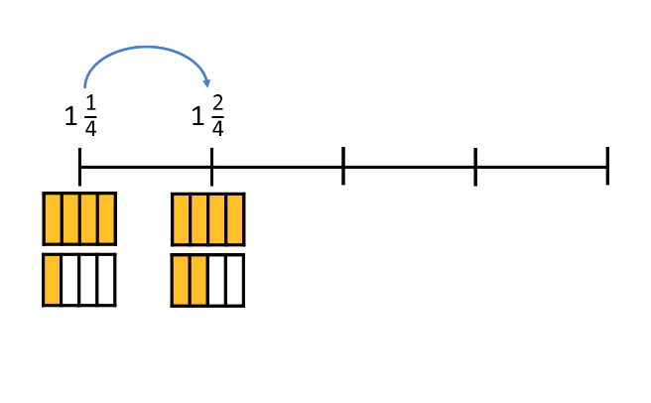

Slide 3
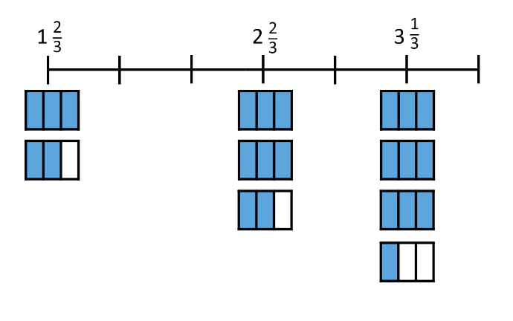
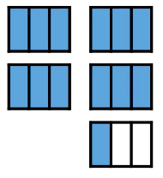

Slide 4
Improper fractions
Mixed numbers

Slide 5
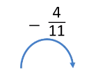
Number sequences can be descending as well as ascending.

Slide 6
