Slide 2


Inverted Commas
There are two places where inverted commas are needed when writing direct speech:
“What’s the matter, Dina?” said Sid.
Inverted Commas
Inverted Commas
You need to open your inverted commas with a “ (66) before the first word which is
being spoken.
You need to close your inverted commas with a ” (99) after the last word which is being spoken.
Imagine that inverted commas are like hands;
They hold within them only the words which are being spoken.
“What’s the matter, Dina?” said Sid.
Back

Slide 3
Punctuation
There are two places where other forms of punctuation are needed when writing direct speech:
“What’s the matter, Dina?” said Sid.
You need to end the speaking with:
a comma
a question mark, if it is a question.
an exclamation mark, if it is an exclamation.
You will need to finish your sentence with a full stop after the reporting clause.
Examples of other punctuation in direct speech are:
“How exciting it is!” exclaimed Sarah.
“I don’t know what to do,” said Sayeed.
Back

Slide 4
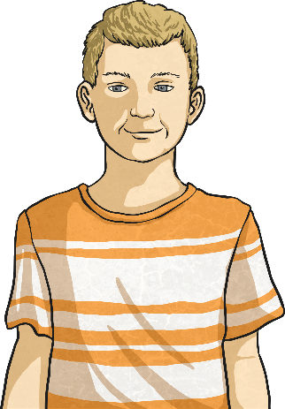
Reporting Clauses
After the speech itself, a reporting clause gives a little bit of information about who is speaking and how it was said.
“What’s the matter, Dina?” said Sid.
Reporting Clauses
In this case, Sid is speaking.
If Sid said it in a different way, you could change ‘said’ to...
“What’s the matter,
Dina?” asked Sid.
“What’s the matter,
Dina?” whispered Sid.
“What’s the matter,
Dina?” uttered Sid.
“What’s the matter,
Dina?” shouted Sid.
Back

Slide 5

It’s Your Turn…
Here is a conversation between Aminah and her son, Sunil. Write the
direct speech on a whiteboard using inverted commas and the
correct punctuation.
Sunil, can you come and help me send an email?
Aminah

Slide 6
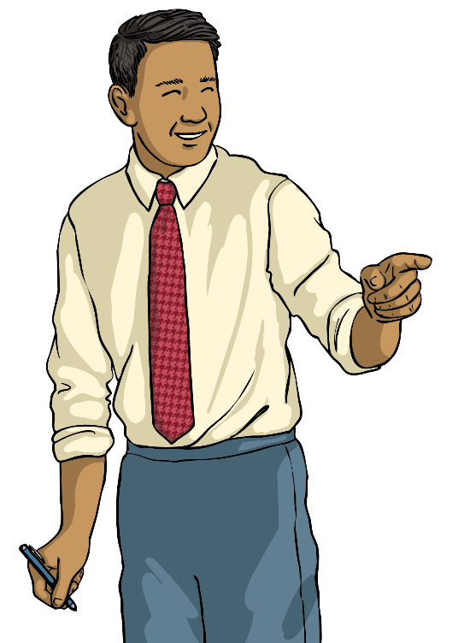

It’s Your Turn…
Here is a conversation between Mr. Miller and Max. Write the direct speech on a whiteboard using inverted commas and the correct punctuation.
Where more than one person is talking, remember to start new line for each new speaker.
Mr Miller
Please could you take those to Jessica’s classroom?
No problem, sir.
Max

Slide 7
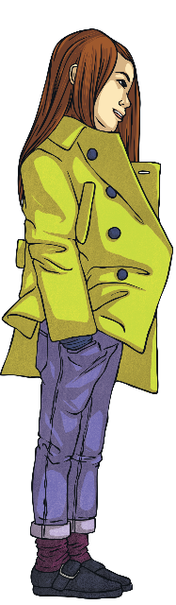
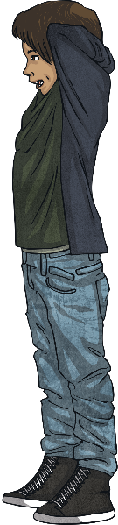
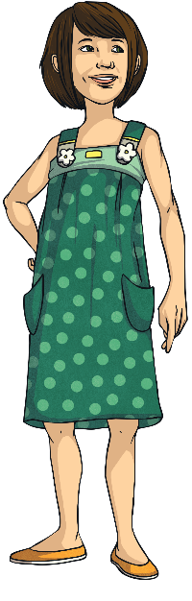
It’s Your Turn…
Here is a conversation between three friends. Write the direct speech on a whiteboard using inverted commas and the correct punctuation. Remember: new speaker, new line!
What are your plans for tonight?
I don’t really have any.
Do you fancy going out for a meal?
Lisa
Janine
Alex

Slide 8






Example Answers
How did you do? Did you remember the inverted commas, punctuation and reporting clause?
“Sunil, can you come and help me send an email?” shouted Aminah.
“What are your plans for tonight?” asked Lisa.
“I don’t really have any,”
replied Janine.
“Do you fancy going out for a meal?” said Alex.
“Please could you take those to Jessica’s classroom?” asked Mr Miller.
“No problem, sir,” replied Max.
It does not matter if you used said, asked, exclaimed or any other reporting verb – just don’t forget to mix it up a bit in your work. The same reporting verb too many times can get boring.

Slide 9
Correctly Punctuate the Speech
Below are all examples of incorrectly punctuated speech.
Tell your partner why they are incorrect and correct them on
your whiteboard.
You need to get off the bus here” said the driver.
Stop annoying me! shouted Sophie.
“Who goes there” grumbled the troll.
“What a beautiful day it is! rejoiced Sheila.”
“That’s all the money I have, explained Frank.

Slide 10
Correctly Punctuate the Speech
Did you manage to correct these sentences?
“You need to get off the bus here,” said the driver.
“Stop annoying me!” shouted Sophie.
“Who goes there?” grumbled the troll.
“What a beautiful day it is!” rejoiced Sheila.
“That’s all the money I have,” explained Frank.

Slide 11
Direct Speech Quick Quiz
Take a quiz to see if you are an expert!
Is this speech punctuated correctly?
“We’re having roast chicken on Sunday,” said James.”
”
Yes
Yes
No
No
The inverted commas are not being used correctly. Where should they be?

Slide 12
Direct Speech Quick Quiz
Take a quiz to see if you are an expert!
Is this speech punctuated correctly?
“I didn’t win at bowling but I still had fun,” said Ruksana.
Yes
Yes
No
No
How did you know that it was correct?

Slide 13
Direct Speech Quick Quiz
Take a quiz to see if you are an expert!
Is this speech punctuated correctly?
“
“Yes you can come to my party,” said Niamh.
”
Yes
Yes
No
No
There are no inverted commas! Where should they be?

Slide 14
Direct Speech Quick Quiz
Take a quiz to see if you are an expert!
Is this speech punctuated correctly?
“I’ve never been to France,” stated Cody.
,
Yes
Yes
No
No
Which sneaky piece of punctuation is missing from this direct speech?

Slide 15
Direct Speech Quick Quiz
Take a quiz to see if you are an expert!
Is this speech punctuated correctly?
“Where have I left my keys?” asked Dad crossly.
Yes
Yes
No
No
They’ve even included an adverb in the reporting clause. Way to go!

Slide 16
Direct Speech Quick Quiz
Take a quiz to see if you are an expert!
Is this speech punctuated correctly?
“I am an expert at punctuating direct speech,” bragged the teacher.
Yes
Yes
No
No
This teacher is an expert. Now you are too!

