Slide 1
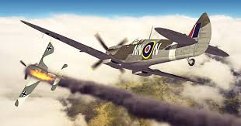
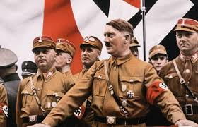
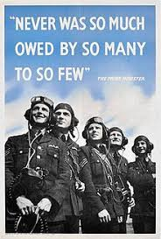
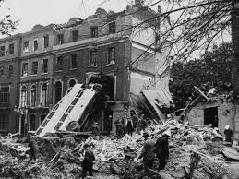
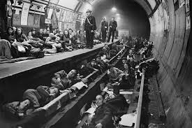
World War II

Slide 2
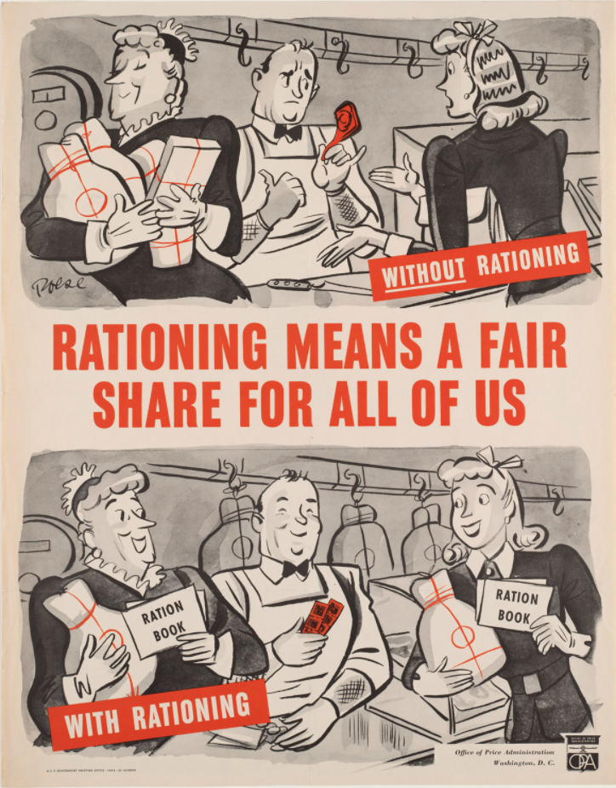

Slide 4
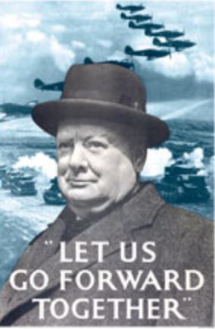

Slide 5
Propaganda Posters
Persuasive
Use bossy verbs (you must, do it now)
Exaggerate (join the army now and save the nation)
Alliterate
Rhyme
Clear message, well presented with eye catching images.
You can use the computer, or your own drawing or a mixture.
Your task:
To create your own propaganda poster for our classroom. You can choose which aspect of WWII you would like to advertise.
Use the list above to check you have all the components you need and use the images as inspiration as well as researching your own if you like.

