Slide 1
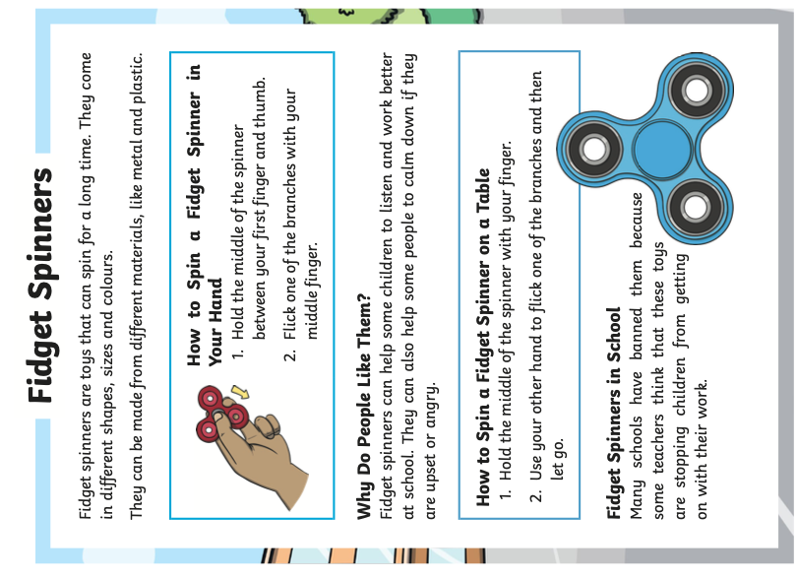
6.10.23
Otters Homework
This week we have been looking at non-chronological reports.
Can you identify the features in this non-chronological report.
Use these words to help you:
Picture, Sub-heading, Paragraph, Title, Introduction

